Slide 1


Communications Offshore
CCA Presentation and discussion for Pac Cup
Michael Moradzadeh
Bob Hinden
Stan Honey

Slide 2
Why are we doing this?
Cruising Club of America
  Association of sailors with extensive offshore voyaging experience
  Heavy overlap with most major offshore races
  Support the sport with information etc
  We co-run the Newport Bermuda race
Communications are changing fast, we have info to share

Slide 3
ToPICS
Getting data onto the boat
Installing Starlink
Installing GO!
How to meet Pac Cup Voice rule
Processing the data
Data consultation sked
Open questions

Slide 4
Make this not happen
“ … nothing like putting on all of this gear on your boat and then having it stop working a few hundred miles out. Worked fine at the dock”
        Bob Hinden

Slide 5
Ways of getting data onto the boAT
a. Starlink
b. Iridium GO!
c. Iridium Phone
d. InReach
  does not provide voice but good backup to a
e. Other
Back in the day:
Single Sideband.

Slide 6
Installing Starlink
Power
12v works, until it doesn’t USE A STEP UP converter
Antenna
Mounting
Connecting to data
DO NOT FORGET THE PASSWORD

Slide 7
Installing Iridium GO!
External Antenna
Power
  Do not use a cheap-ass USB cable. Believe me.
Suggestion:
  Have a dedicated tablet or phone to connect, and not in someone’s pocket

Slide 8
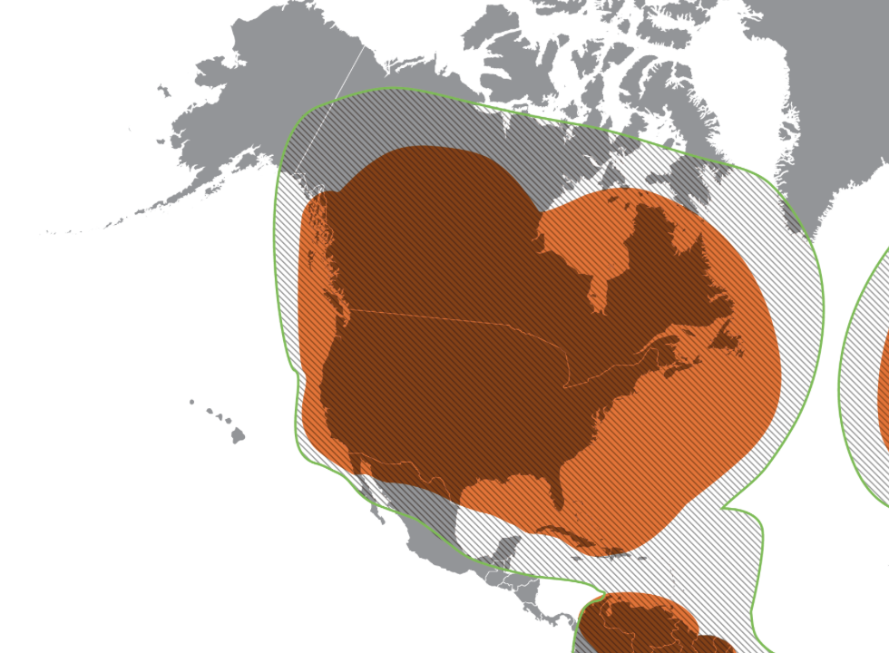
Pick the right subscription
Satellite based systems have become common on ocean racing Sailboats
Most are now Low Earth Orbit satellites (LEO)
All require Subscriptions
  Not all subscriptions work in the middle of the Ocean
Don’t find this out the hard way
Globalstar does not reach Hawaii

Slide 9
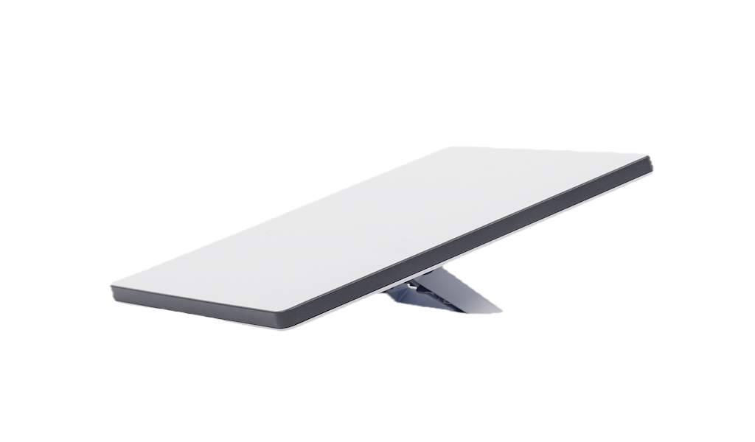
Starlink Ocean Maritime Plans
Starlink Maritime (Business): Designed for permanent, high-performance, in-motion use with coverage across all oceans and international waters.
    $250/mo (50GB), $650/mo (500GB), $1,150/mo (1TB), 2,150/mo (2TB)
Starlink Roam (with Ocean Mode): Allows "Roam Unlimited" users to toggle on "Ocean Mode" ($2/GB) to enable access beyond 12 nautical miles, ideal for occasional, deep-ocean travel.
    $175/mo + $2/GB
Coastal Coverage: Standard Roam plans work within 12 nautical miles of the coast and in inland waterways without needing special modes.
    This will not work in the ocean
Roam Unlimited with Ocean mode probably best choice for most boats in the Pac Cup
Don’t wait until the day of the race to enable plan

Slide 10
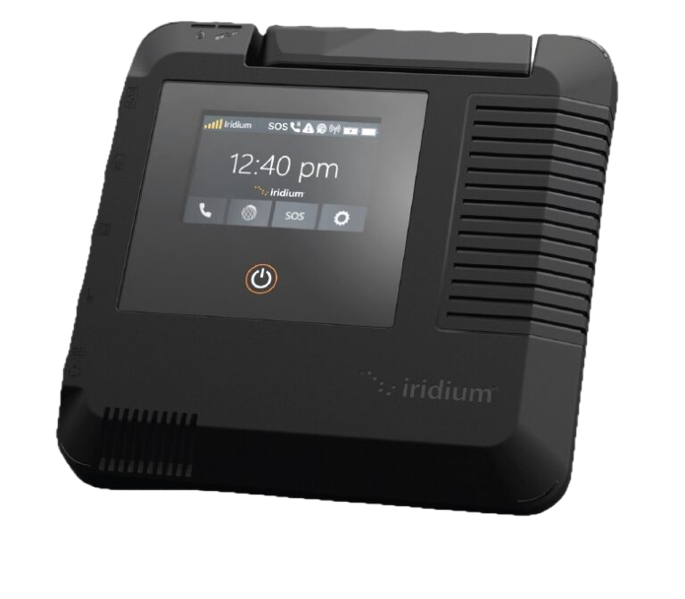
Iridium Go & Exec Plans
Iridium Go / Exec works in the ocean
Iridium Go Post Paid Plans (aka subscription)
  15 min talk + text $72/mo
  130 min talk + text $105/mo
  Unlimited Data & text $159/mo
Iridium Exec (plans may have long terms)
  Exec 50 50min+50MB $199/mo
  Exec 25 25min+25MB $109/mo
  Unlimited Data 200 min $259/mo
Requires SIM Card
Get setup well before the race

Slide 11
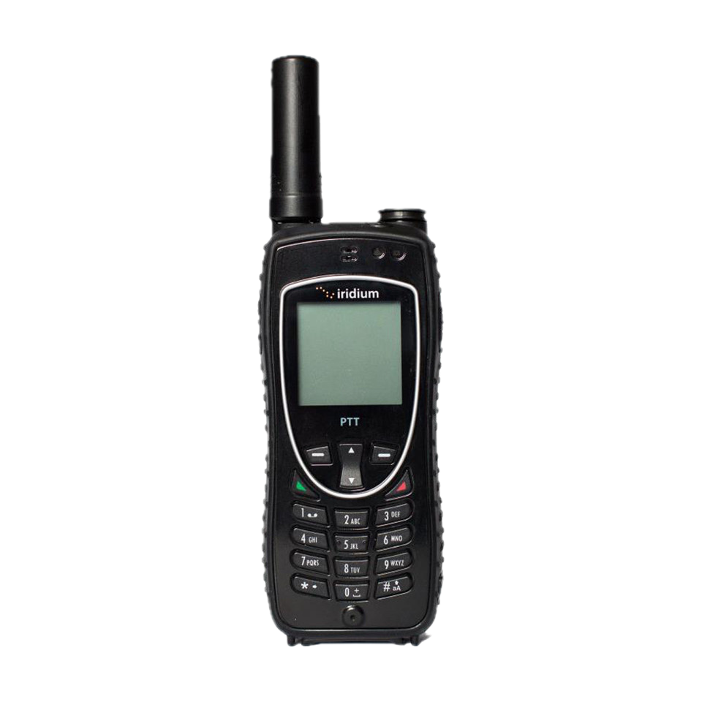
Iridium Phone Plans
Need plan with Global Coverage
  Regional plans won’t work
Prepaid Plans
  100 minutes, 30 day term, $195, to
  1200 minutes, 2 year term, $1690
Monthly Plan
  15 minutes, 1 mo term, $72/month
  130 min., 6 mo term, $105/month
  325 min., 6 mo term, $139/month
Requires SIM Card
Get setup well before the race

Slide 12
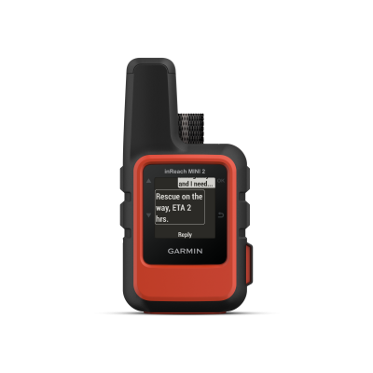
Garmin InReach
All plans work in the Ocean
Plans range from
  $7.99/mo with $.50 per message to
  $49.99/mo with unlimited messages
$39.00 activation fee
No longer term commitment (aka month to month)
Good backup to Starlink

Slide 13
Pac Cup Voice Rule
You need to have the ability to have voice comms with land
Got broadband? Your phone can probably use it natively!
Or a VOIP program and hardware
OR a communications app
You are not required by rules to have phone on all the time.

Slide 14
Processing Data
Don’t be cute. Get a PC
  Selection
    “Rugged” or maybe just pack a spare. Look at Student versions
    Look for 12v power. Pick one with low power needs
    Will it be always on?
  Config
    Add all needed software. See article.
    Turn off things that waste energy
    Turn off automatic updates

Slide 15

A Day in the life of data
Get weather
  Look for danger
  Look at trends
    Will that Pacific High snap into place? Look for the “omega” shape
  Re-run routing
  How many x per day?
Get positions
  Do they change your approach?
  Who are you covering? Who are you imitiating?
Share your story
  Post to socials
  Pac Cup wants your updates

Slide 16
Questions?
We’re here for you

