Slide 1
POWER AT SEA
POWER AT SEA
Presented by
Dustin Fox

Slide 2
D u s t i n F o x
National Marine Electronics Association Member
ABYC Certified Marine Electrical Technician
CMET Certified
FCC GROL Licensed
15+ Years Marine Industry Experience

Slide 3
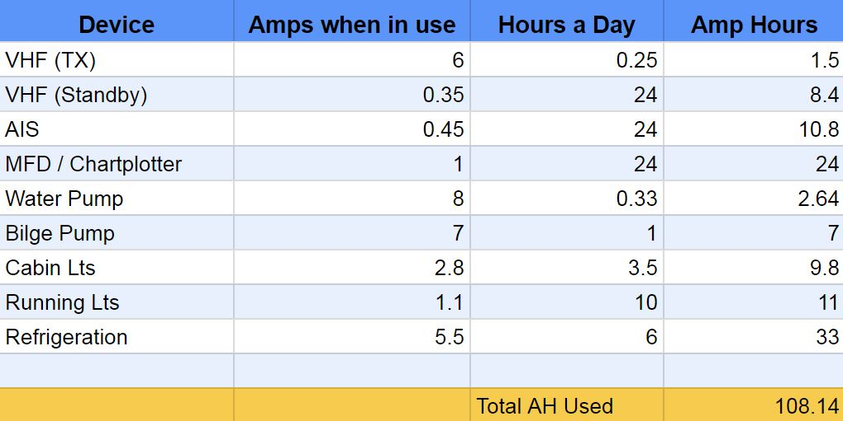
POWER MANAGEMENT

Slide 4
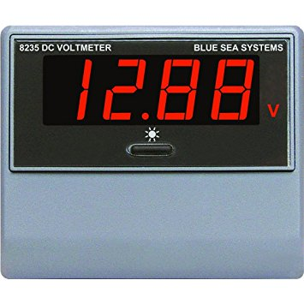
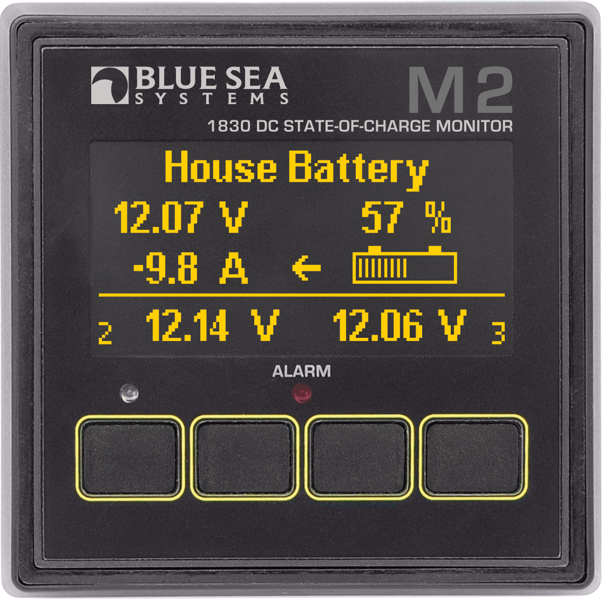
STATE OF CHARGE
vs.
VOLTAGE

Slide 5
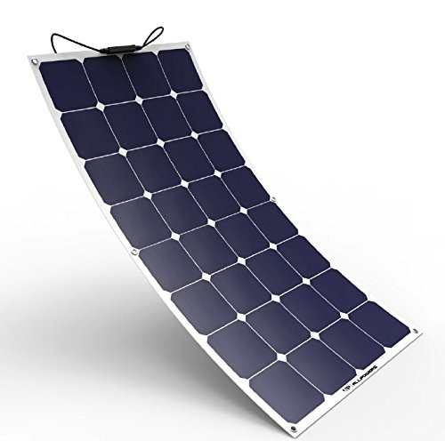
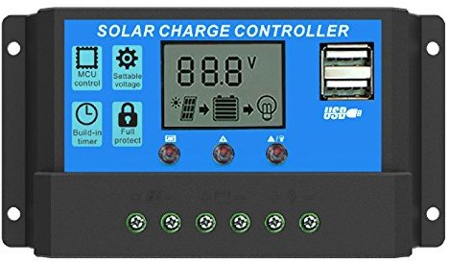
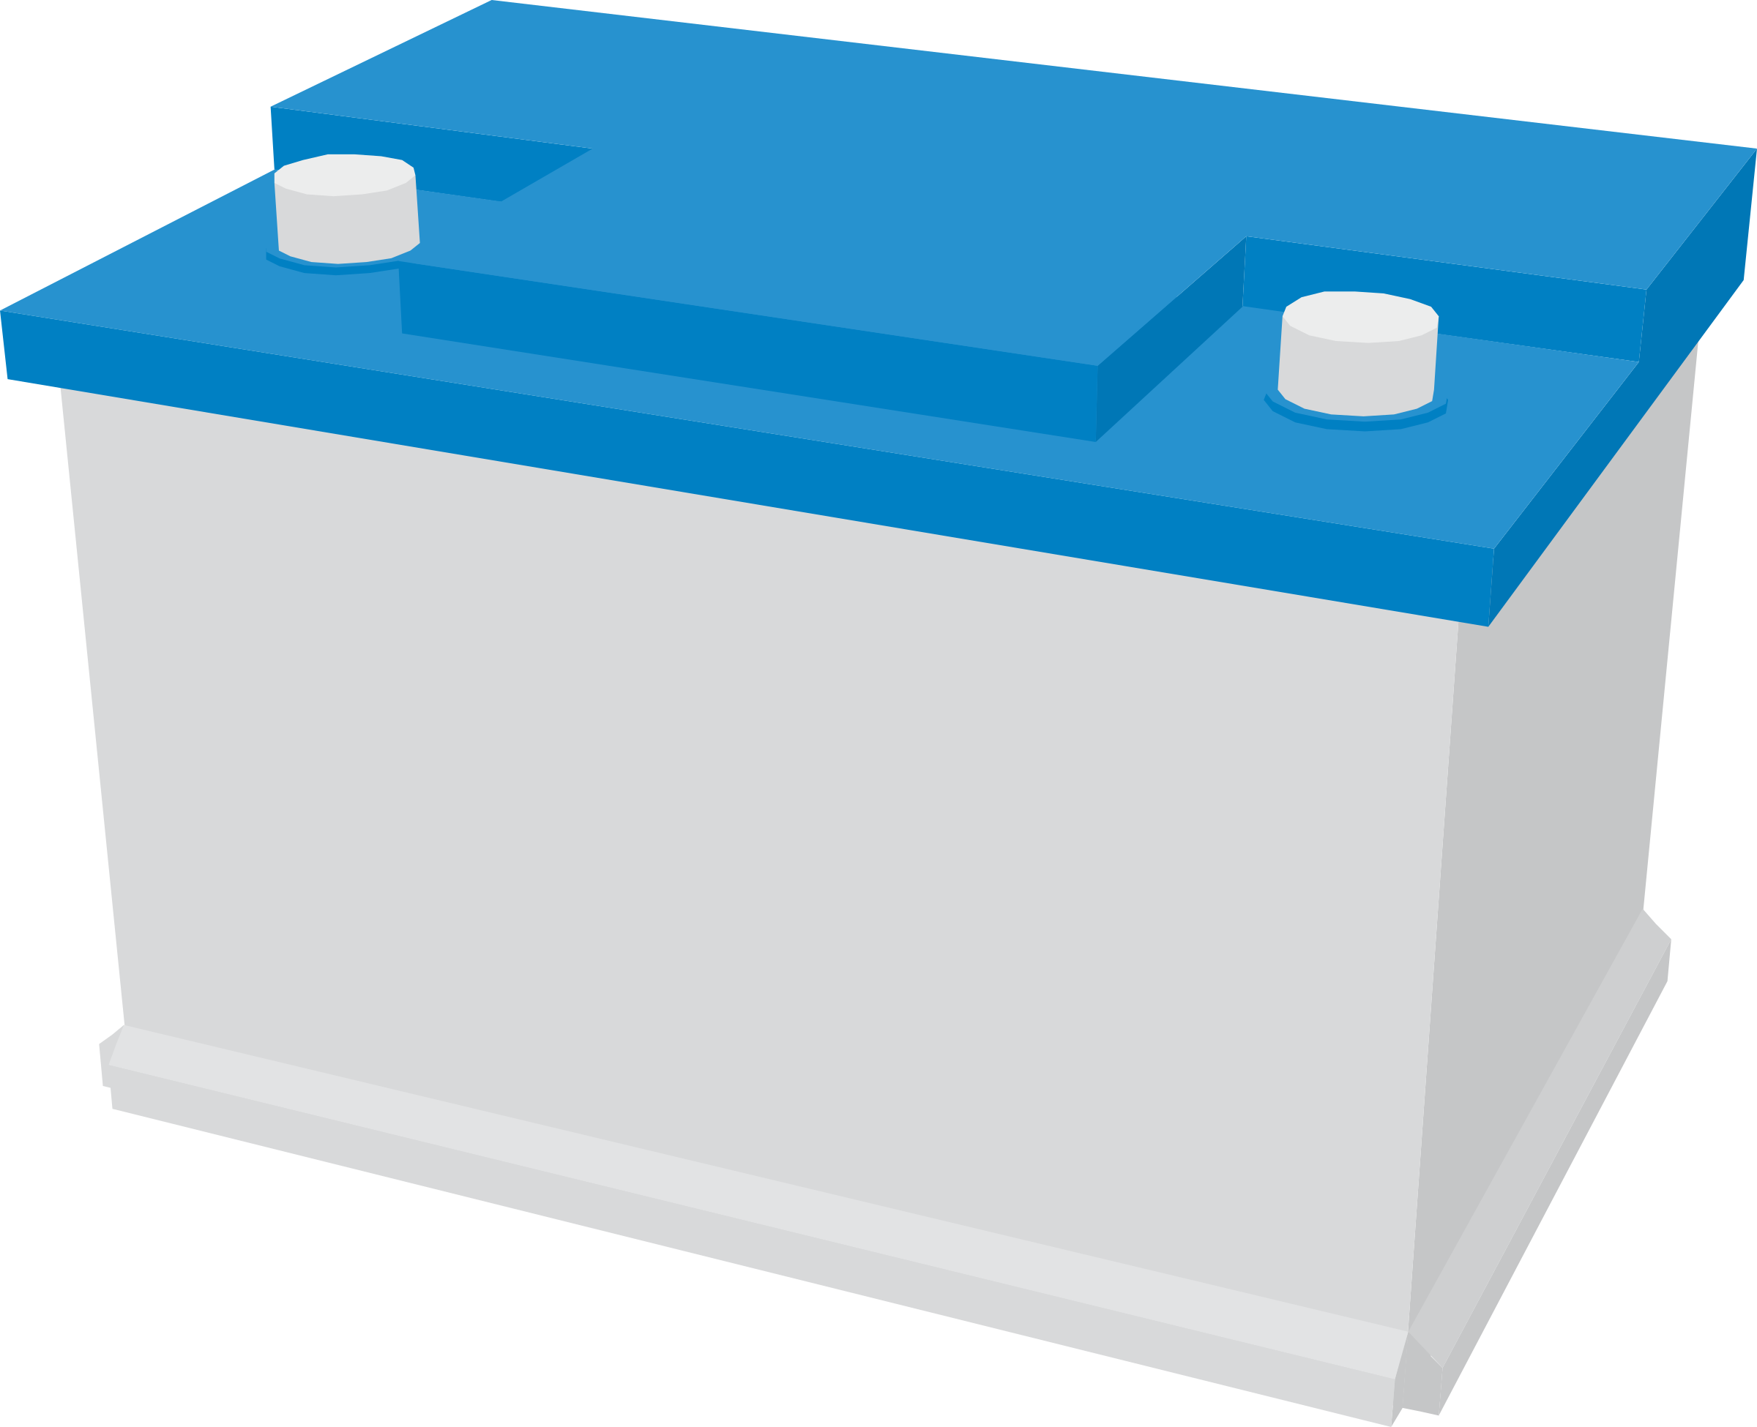
A: How much can you fit?
Q: How much solar do you need?

Slide 6
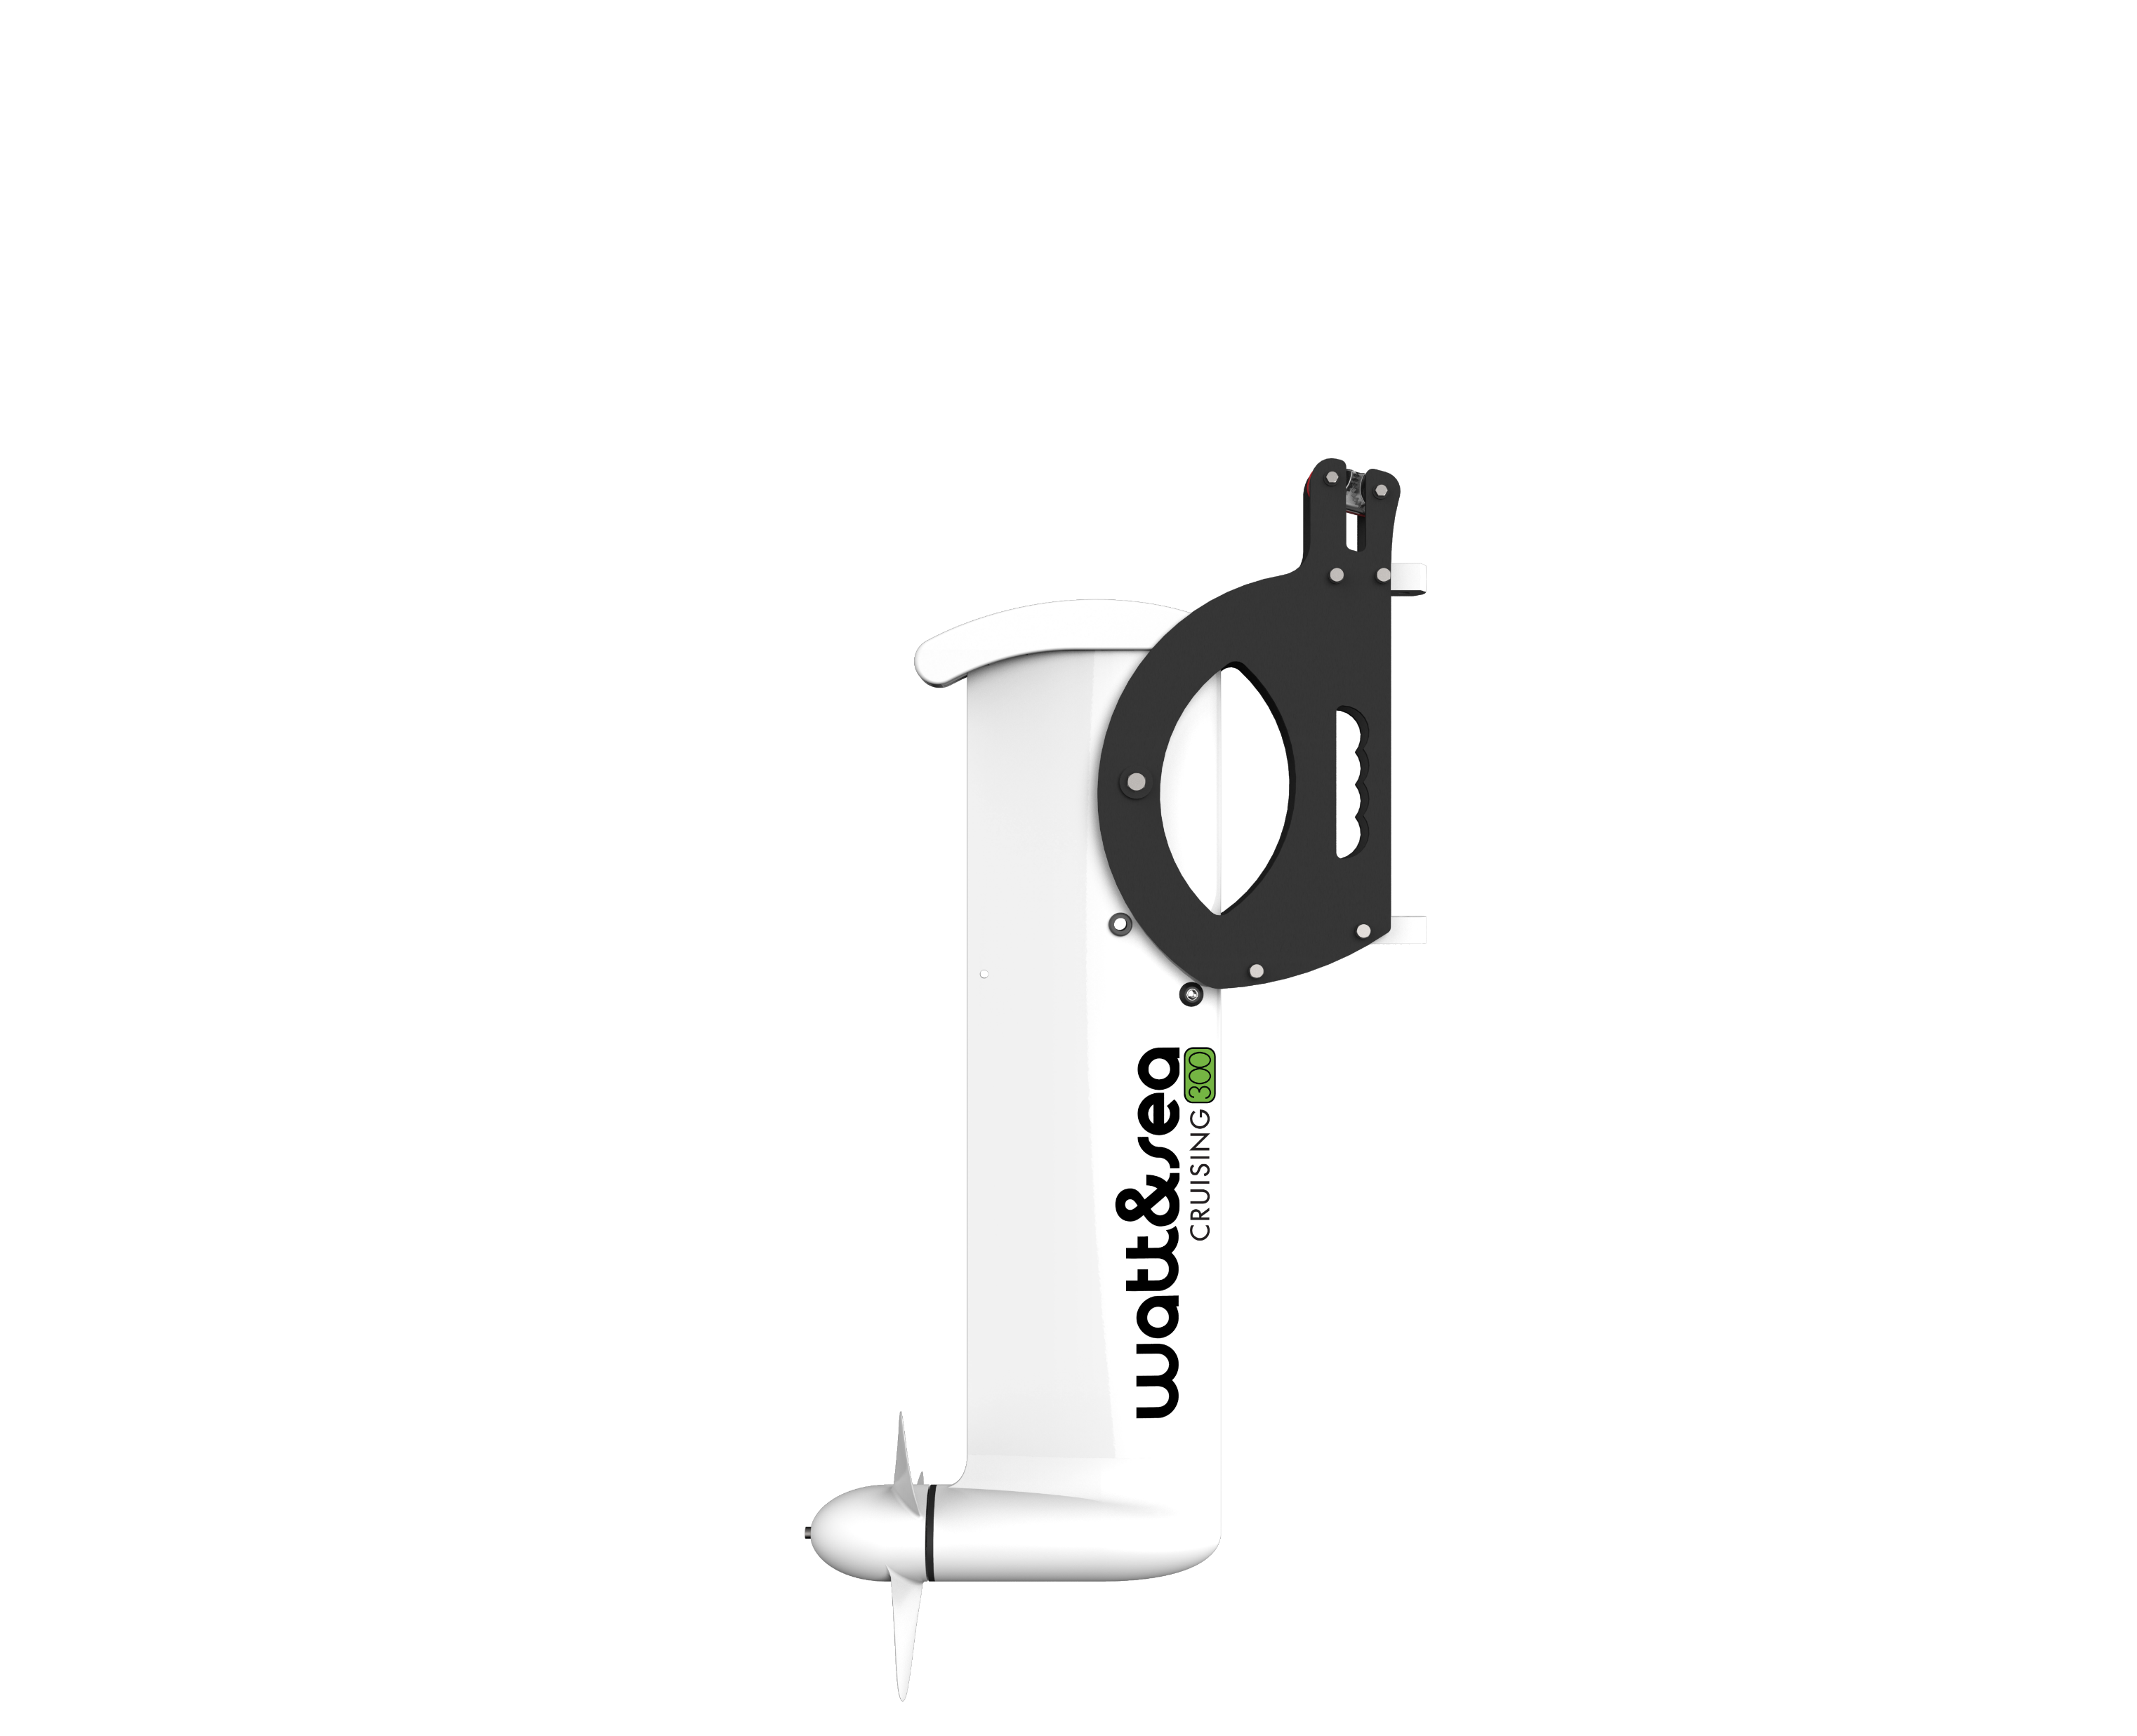
Hydrogenerator
REGULATOR

Slide 7
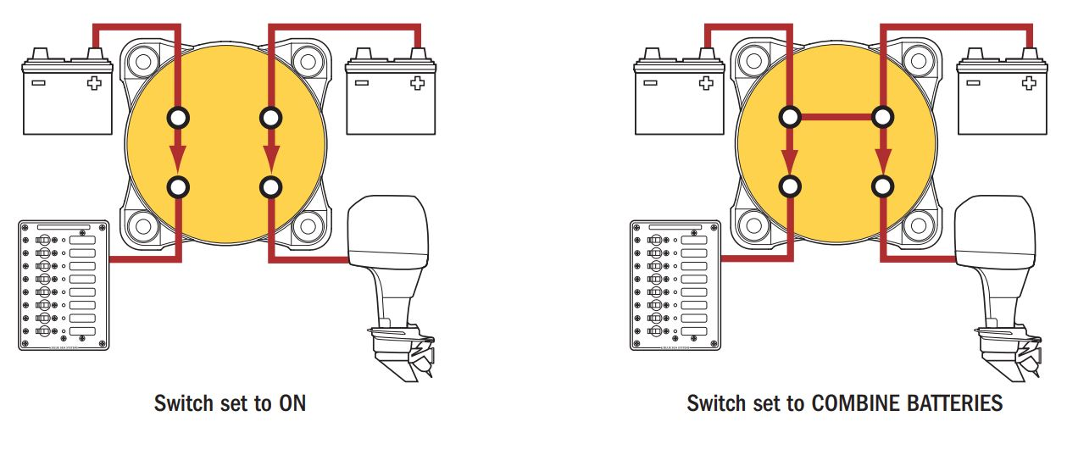

Slide 8
M
A
K
E
P
L
A
N
A
AND THEN
MAKE A BACKUP PLAN

Slide 9
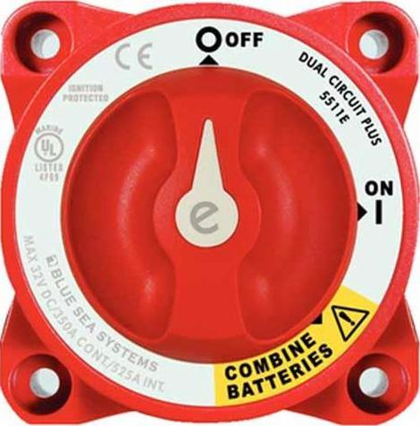
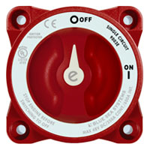
Electrical Panel
Engine
ON
ON
Engine Battery
Engine Battery
House Battery
DC
Negative

Slide 10
Electrical Panel
Engine
COMBINE
ON
Engine Battery
Engine Battery
House Battery
DC
Negative

Slide 11
Electrical Panel
Engine
COMBINE
OFF
Engine Battery
Engine Battery
House Battery
DC
Negative

Slide 12
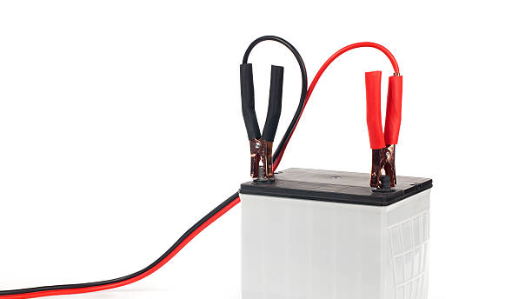
Or you could...
just wing it ☹

Slide 13
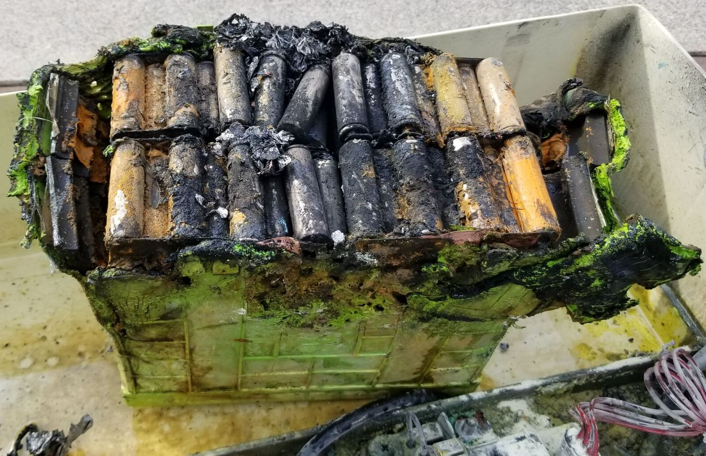
Lithium & Safety

Slide 14
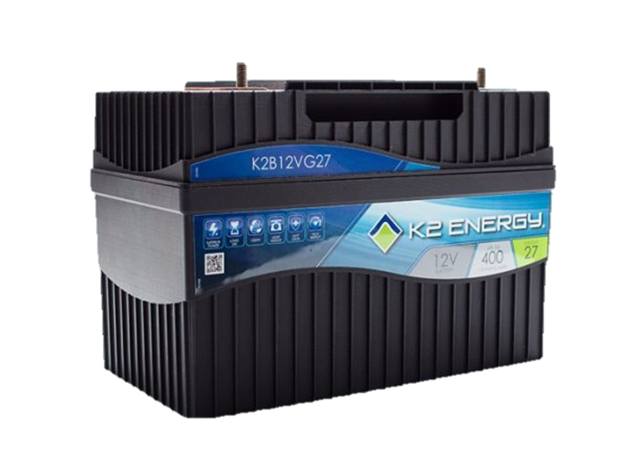
Setting New Standards for Marine Lithium Batteries
More than twice the life span of quality lead acid batteries
Light weight – 30lbs (111Ah)
Consistent power over a wide range of states of charge
Waterproof – Rated IP67
Withstands extreme temperatures – Rated for -40°C to +85°C
Internal battery management with shutoffs for safety
Short circuit protected

Slide 15
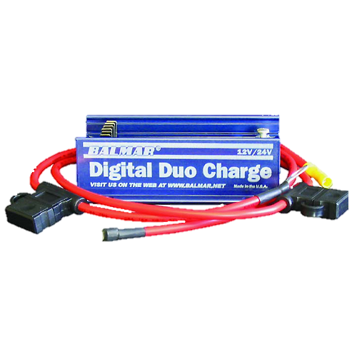
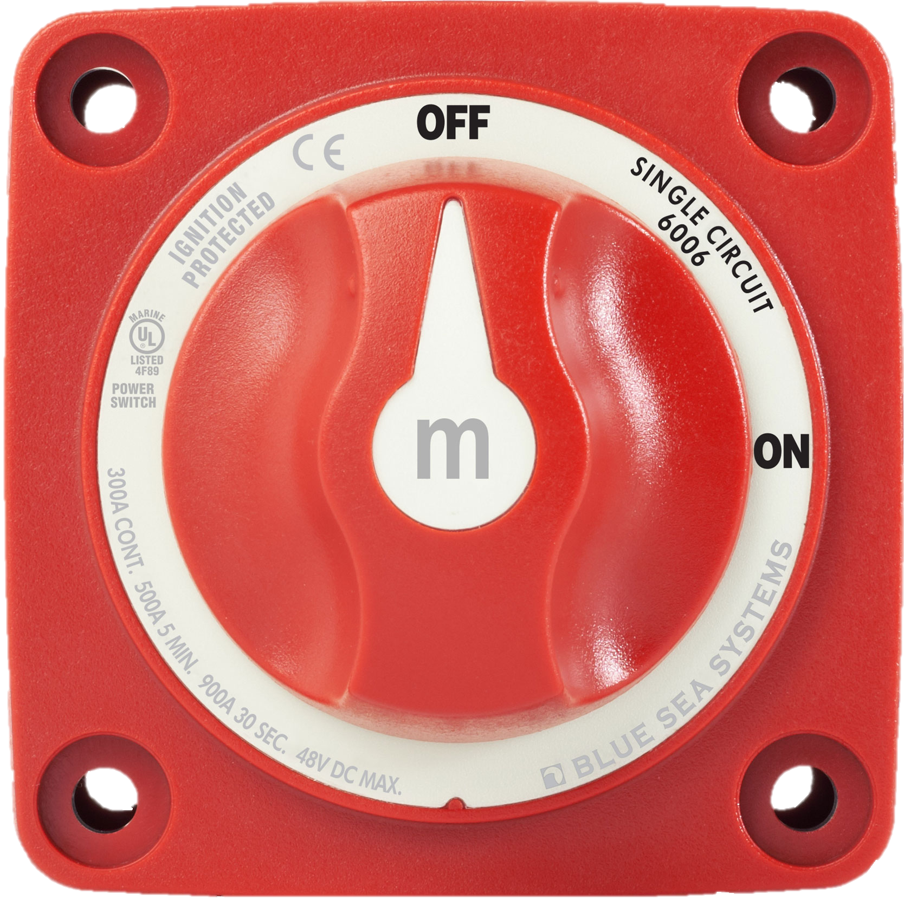
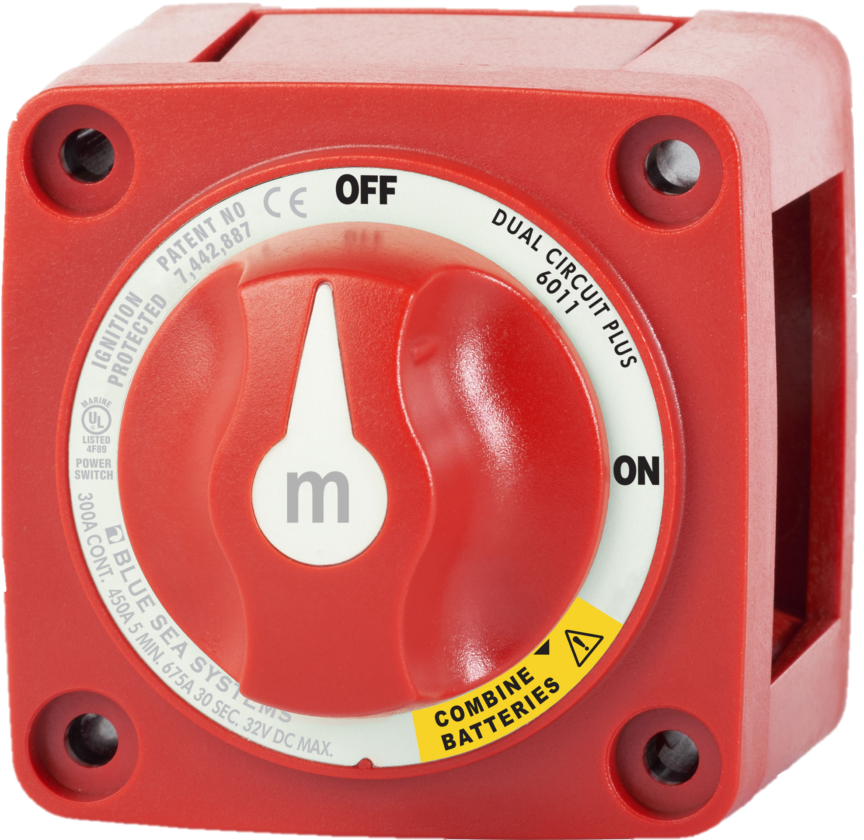
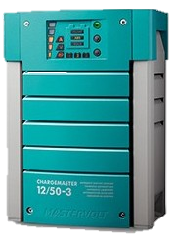
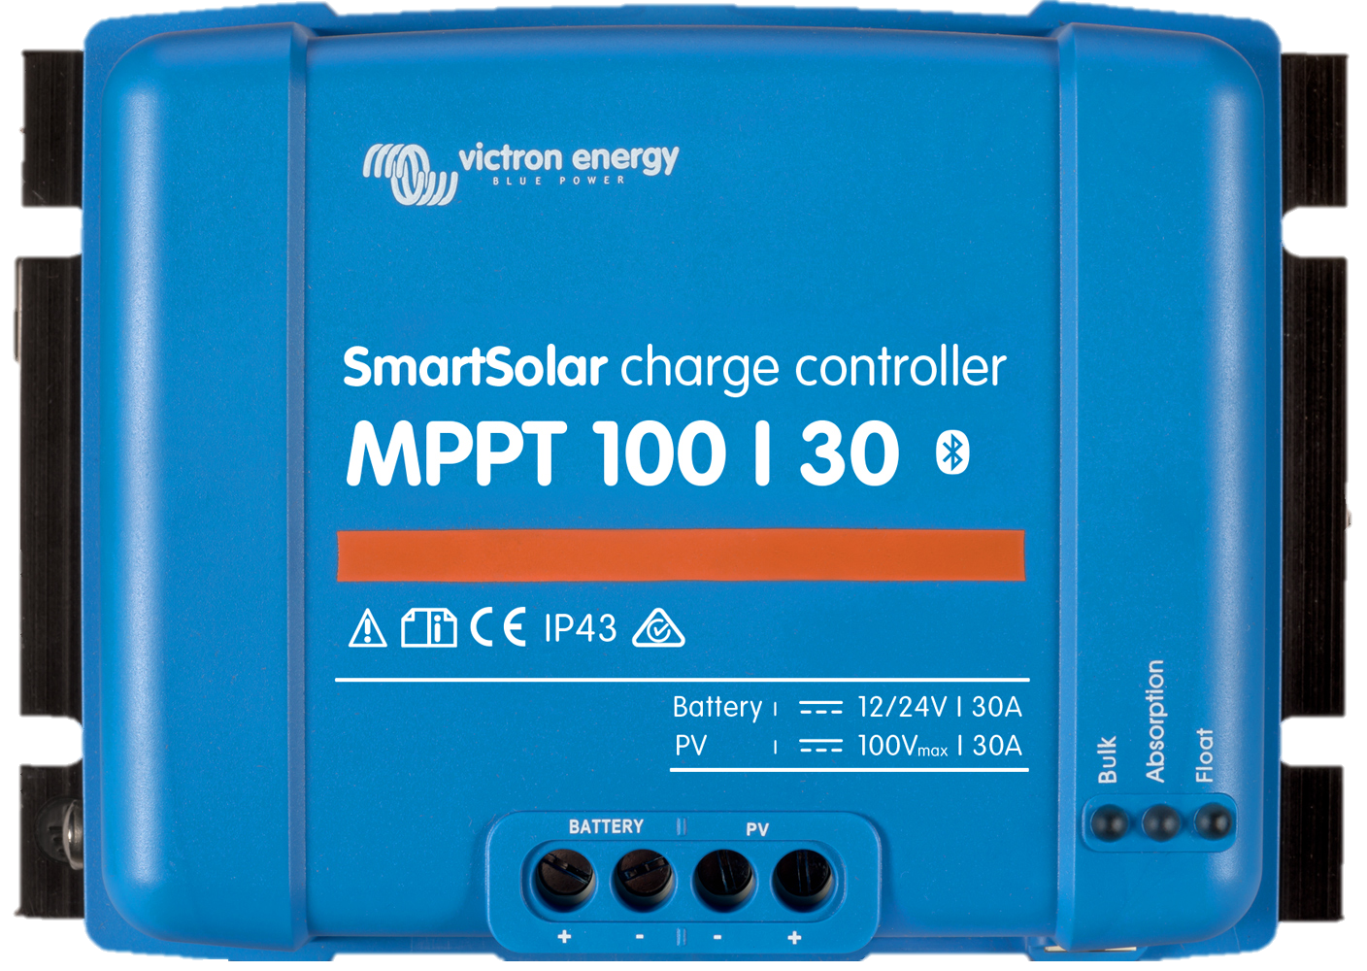
Accessorize
Balmar Digital Duo Charge
Blue Seas m-Series Mini On-Off Battery Switch
Blue Seas m-Series Mini Dual Circuit Plus Battery Switch
Programable Charger
Programable Solar Charge Controller

Slide 16
Located at KKMI
550 W. Cutting Blvd.
Point Richmond
(510) 868-5041 www.FoxMarine.US
Dustin@FoxMarine.US

