Slide 1
Common Medical Emergencies at Sea
Pacific Cup 2018

Slide 2
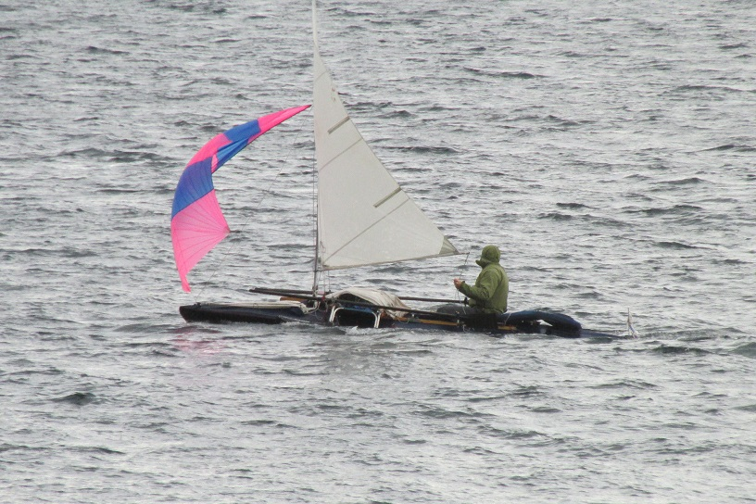
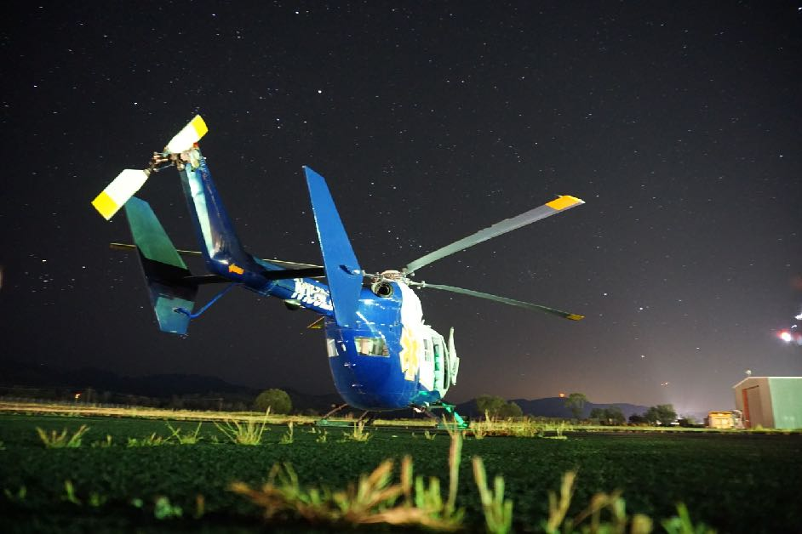
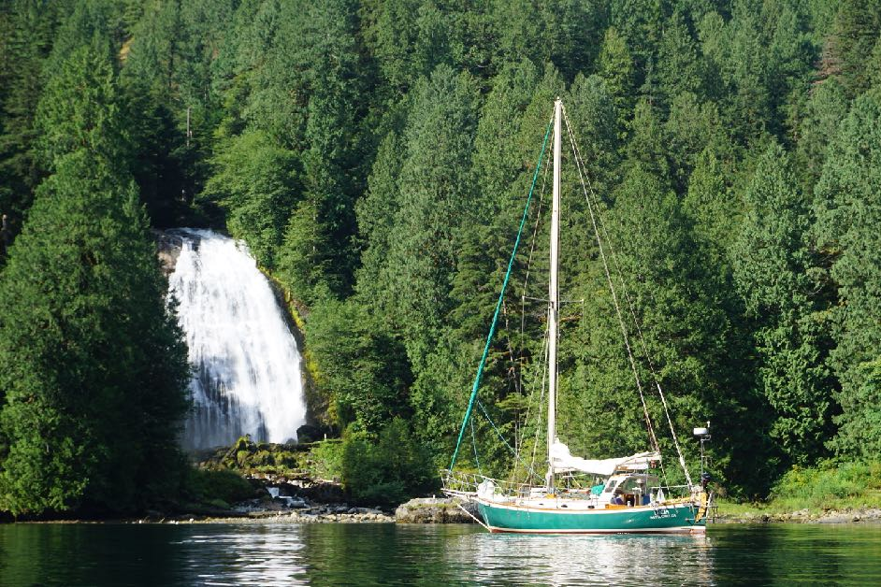
John Taussig, FP-C
Flight Paramedic
Executive Director-Backcountry Medical Guides
50 Ton USCG Captain
10,000 Miles by Kayak and Sailboat in 2017

Slide 3
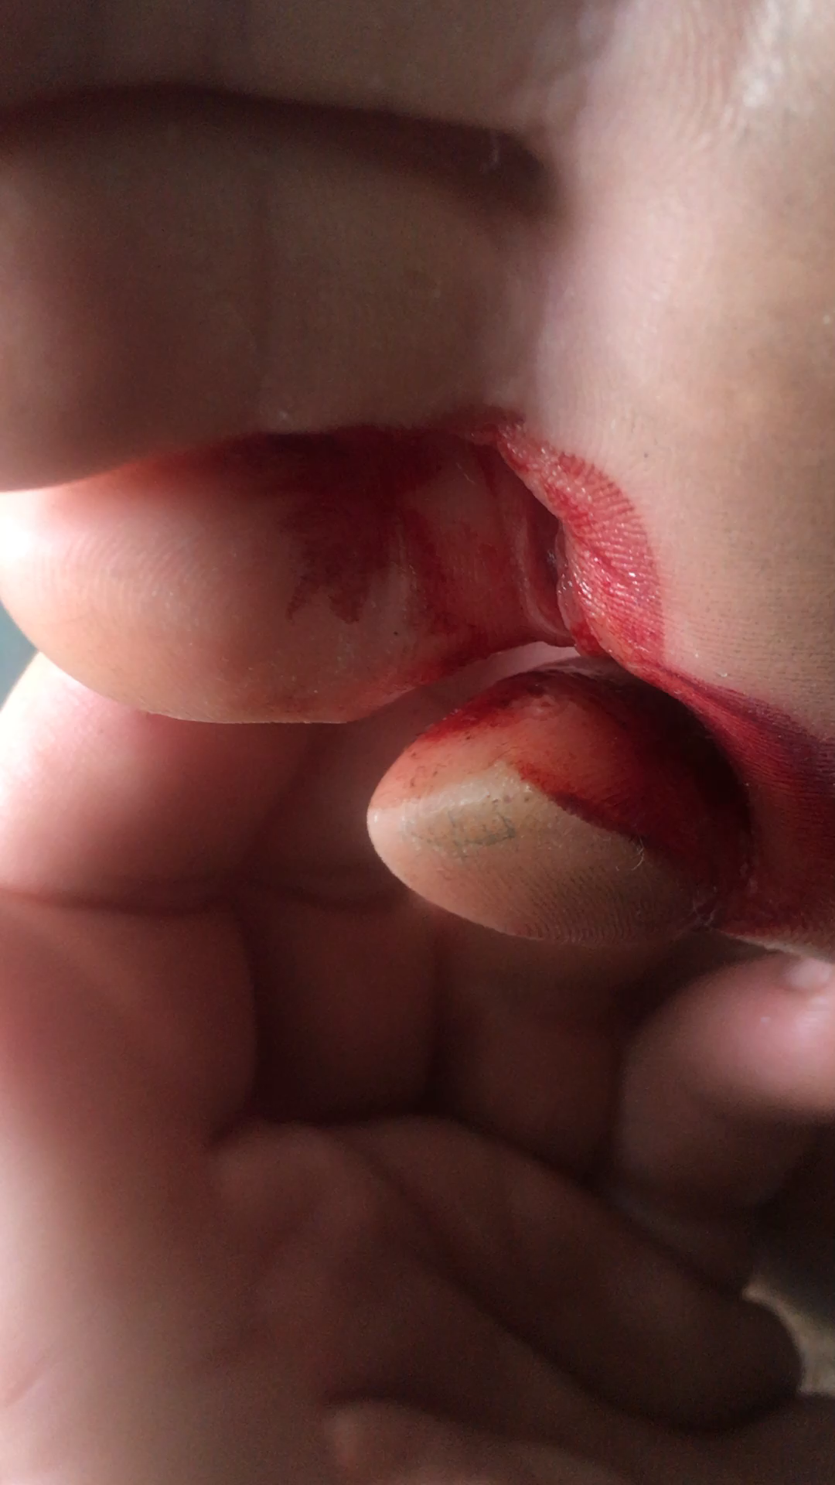
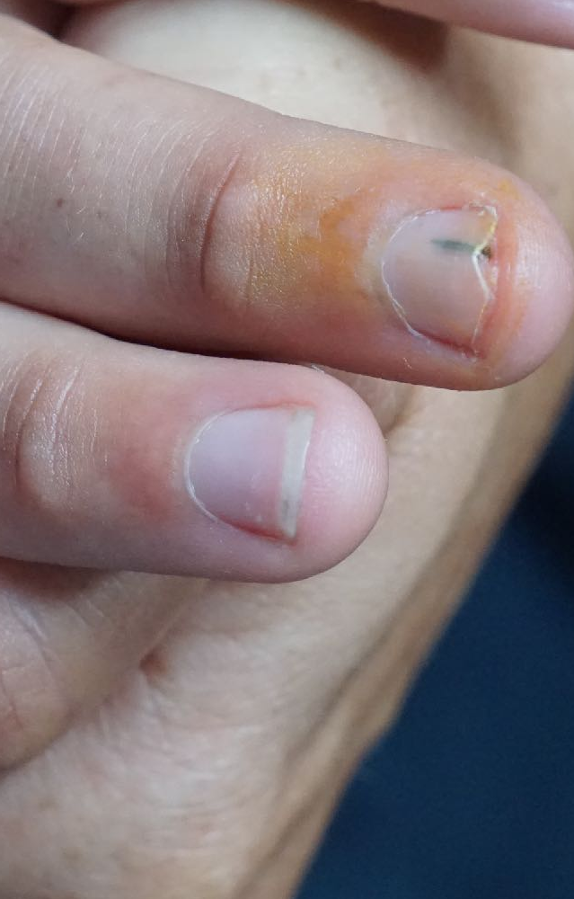
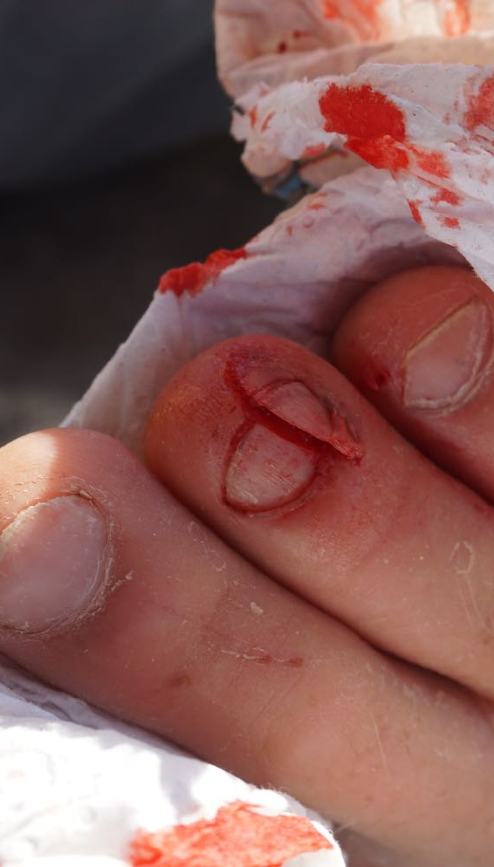
INJURIES on Board 1 YEAR AT SEA (2017)

Slide 4
ADDITIONAL AILMENTS from crew
m.p.l tear, UTI, cold sore, nora virus, epididimitis, hemorrhoid, back spasm, back rash, stomach virus,
shoulder pain, ear infection, sunburn, elbow pain, jaw pain, skin rash , possible dislocated shoulder

Slide 5
Prevention is the Key
clothing
shoes
nutrition
Sleep
Diet
Health
equipment
planning
Preparation
Checklists
Training

Slide 6
Common Medical Emergencies at Sea
Musculoskeletal Emergencies
Hypothermia
Skin Breakdown
Gastrointestinal

Slide 7
musculoskeletal injuries

Slide 8
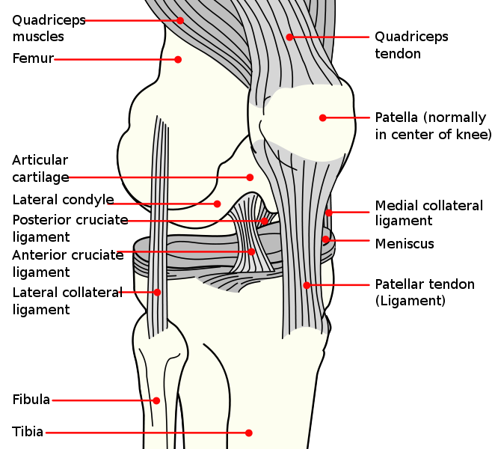
Musculoskeletal Injuries
STRAINS-
MUSCLE/ TENDON OVERUSE
SPRAINS-
LIGAMENTS
FRACTURES-
BONE MATRIX

Slide 9
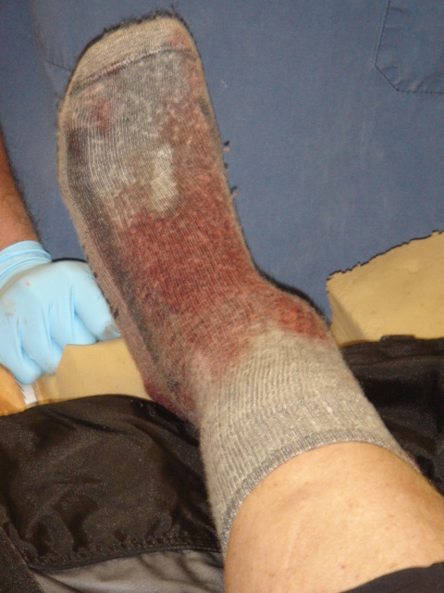
Strains, Sprains, AND SIMPLE FRACTURES
SIGNS AND SYMPTOMS:
- PAIN, DEFORMITY, SWELLING
- DECREASED RANGE OF MOTION
- SOUNDS (CRUNCH, CRACK, POP) ASSOCIATED WITH INJURY
TREATMENT FOR SPRAINS, STRAINS AND SIMPLE FRACTURE:
- REST
- ICE
- COMPRESSION
- ELEVATION
- PAIN MEDICATION
- Splinting and TAPING strategies

Slide 10
Splinting Principles
1. MANUALLY STABILIZATION OF INJURY
2. ASSESS DISTAL Circulation, Sensory, Motor
3. INJURY TO BONES- STABILIZE PAST JOINTS PROXIMAL AND DISTAL TO THE SITE OF INJURY
4. INJURY TO JOINT- STABILIZE BONES PROXIMAL AND DISTAL TO AFFECTED JOINT
5. PAD WELL, FILL VOIDS
6. USE RIGID OR SEMI-RIGID BACKBONE FOR SPLINT, DEPENDING ON MATERIALS AVAILABLE
7. WRAP SPLINT, TAKING CARE OVER SITE OF INJURY AND TO ALLOW NEUROVASCULAR CHECKS
8. REASSESSMENT OF DISTAL Circulation, Sensory, Motor

Slide 11
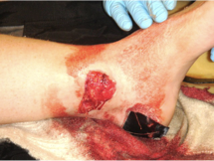
Fractures
OPEN FRACTURES
- ALL OPEN FRACTURES: CLEANSE BONE ENDS WITH STERILE WATER, TAKING CARE TO RINSE. DO NOT FORCEFULLY IRRIGATE. REMOVE LARGE DEBRIS FROM WOUNDS.
- COVER WITH STERILE DRESSING AND SPLINT IN PLACE IF CSM’S ARE INTACT DISTALLY AND DEFINITIVE CARE IS LESS THAN 6 HOURS AWAY.
- PULL GENTLE, IN-LINE TRACTION IF CSM’S ARE COMPROMISED OR UNABLE TO STABILIZE OTHERWISE OR EVACUATION WILL BE PROLONGED (GREATER THAN 6 HOURS)

Slide 12
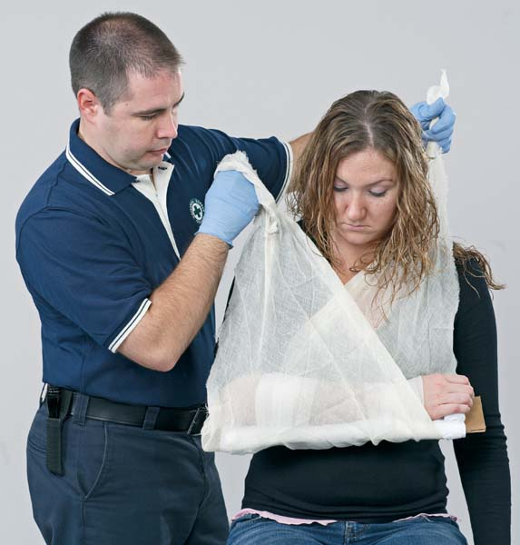
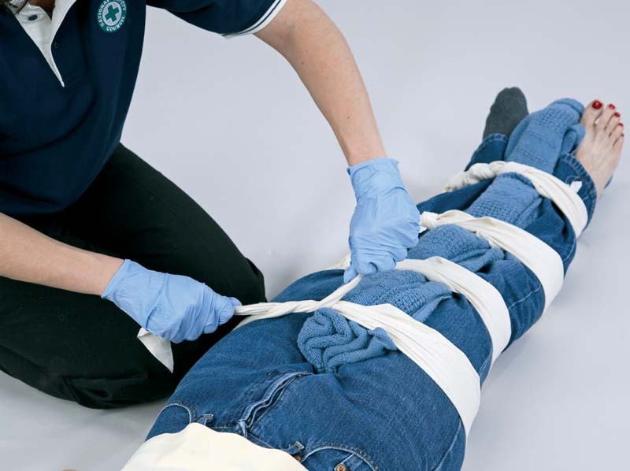
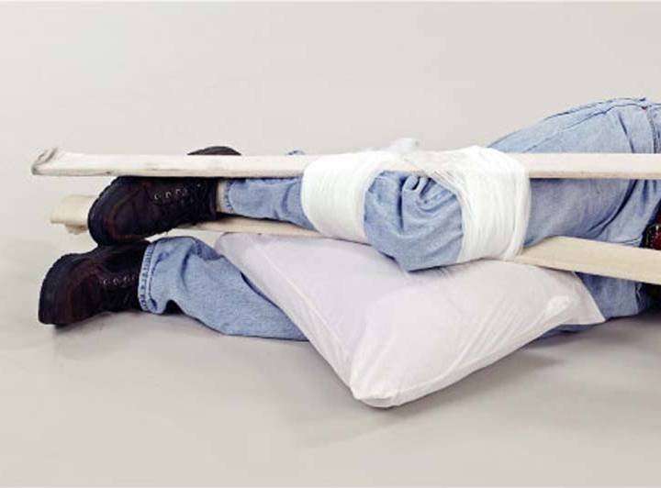

Slide 13
SPLINTING demonstration

Slide 14
Hypothermia

Slide 15
Mild to Moderate Hypothermia
SIGNS AND SYMPTOMS
Shivering
The “umbles”
(fumbles, mumbles, grumbles, stumbles)
Worsening “umbles”
Uncontrolled or violent shivering
Confusion, poor judgment
TREATMENT
Remove wet clothes
Prevent heat loss
Warm fluids, nourishment
Exercise for patients able to safely participate
Insulate, Bundle, Snuggle, Warm water bottles

Slide 16
Severe Hypothermia
SIGNS AND SYMPTOMS
Altered Level of Consciousness
Coma, Profound confusion
Shivering may stop
Paradoxical Undressing, Warm Feeling
TREATMENT
Handle with extreme care
Maintain body temperature
Hypothermia wrap, Insulate
CPR/ Rescue Breathing

Slide 17
Skin Breakdown

Slide 18
Boat Butt/ STAPH INFECTION/ MRSA
PREVENTION STRATEGIES
  Clean common areas
  Don’t share towels, clothing, cushions
  Cover wounds, use antibiotic ointment
  Shower at least ever 2 days with antibacterial soap or (at a minimum) wipe with antibacterial towels

Slide 19
Boat Butt/ STAPH INFECTION/ MRSA
  TREATMENT
  Keep area clean and dry
  Cover with gauze and antibiotic ointment
  Oral Antibiotics
  Cleaning with antibacterial soaps

Slide 20
Gastrointestinal Emergencies

Slide 21
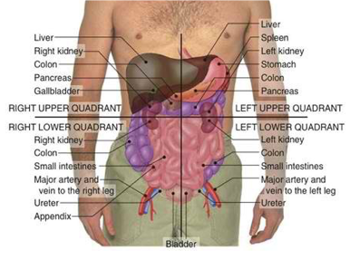
Diagnosing Abdominal Pain Can Be Very Challenging In the Field

Slide 22
Diagnosing Abdominal Pain Can Be Very Challenging In the Field
 | SIGNS AND SYMPTOMS | TREATMENT
GASTROENTERISTIS Stomach ‘flu’ Viral types may have accompanied upper respiratory infection | Cramping Upper/Lower Loose BM Nausea/Vomiting | Fluids Anti emetics for excessive wrenching
KIDNEY STONES | Sudden Onset Pain related to location 7 days to 3 weeks to resolve Agitated despite motionlessness hematuria Urge to urinate | Pain medication
PANCREATITIS Secretes enzymes that digest food Secrets Insulin Inflammation/viral infection/blockage | Severe epi-gastric pain Treatment POC sitting/leaning forward | Clear liquids and antacids ONLY Eliminate Oral Intake (Hospital)
BOWEL OBSTRUCTION | Nausea/vomiting Vomit has bile or feces Distention | Stool Softeners, maintain hydration Evacuate to definitive medical care
HERNIA Intestine slips through lining of abdominal wall | Signs and Symptoms Visible bulge next to pain (Abdomen/inguinal) Abdominal Pain | Treatment Lie on back, legs to chest, cold pack over bulge Avoid straining especially when holding breath
APPENDICITIS Vestigial Organ 9 cm Obstructed/infected or inflamed Ruptured | Pain starts central and radiates to RLQ Loss of Appetite Constipation Nausea/vomiting/diarrhea Urinary problems Resist movement of body/legs Rebound tenderness | Liquid Diet Antibiotics Surgery
ULCERS Gastric (Stomach) Peptic (Duodenum) Erosion of lining Stomach is empty During times of emotional stress Greatest acid secreted after meals and between 0000 and 0300 | Burning pain Worsening by pressing on it Nausea/vomiting Associated bleeding Infection | Ingestion of foods or antacids Drugs Avoidance **No baking soda!
Gall Stones Stores bile Released into duodenum to aid with digestion Blockage of ducts | Sudden onset following meal URQ Nausea/vomiting/fever Palpable swollen mass | Pain meds Surgery avoid fatty foods

Slide 23
EVACUATION CRITERIA FOR ABDOMINAL PAIN
-WORSENING OR SEVERE PAIN after 24-48 hours
-BLOOD IN STOOL, VOMIT, OR URINE
-FEVER WITH ABDOMINAL PAIN
-UNABLE TO MAINTAIN HYDRATION/ NOURISHMENT
Diagnosing Abdominal Pain Can Be Very Challenging In the Field
BUT REMEMBER:

Slide 24
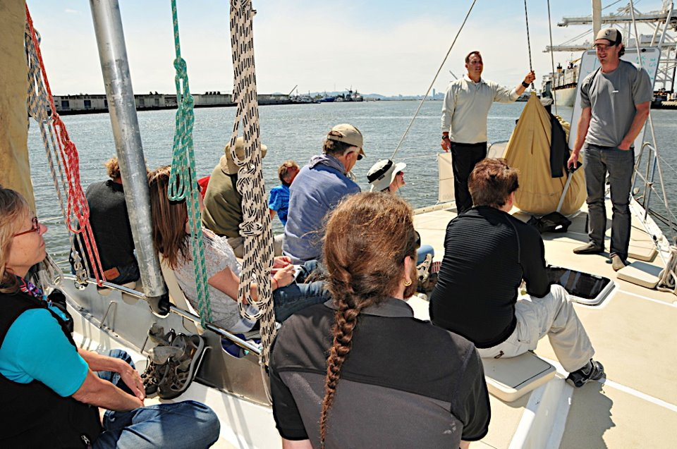
Wilderness and Maritime Medicine
Additional Training Opportunities
BACKCOUNTRY MEDICAL GUIDES:
Custom Maritime Medical courses, Wilderness First Aid, Wilderness First Responder
  backcountrymedicalguides.org
  831-295-8336

Slide 25
Wilderness medicine
Additional training opportunities
National Outdoor Leadership School
  nods.edu
FosterCalm
  fostercalm.com
Ready SF
  readysf.com

Slide 26
QUESTIONS, COMMENTS, CONCERNS
JOHN TAUSSIG- 206-412-1613

