Slide 1
Pacific Offshore Academy 2018 Medical Richmond Yacht Club February 24, 2018 Neal Sikka, MD Director, Maritime Medical Access

Slide 2
Who Am I?
Board Certified Emergency Physician
George Washington University Hospital and the VA Medical Center, Washington, DC
Telemedicine - maritime and remote medicine for over 14 years
Medical Director, Maritime Medical Access
uscg.mil

Slide 3
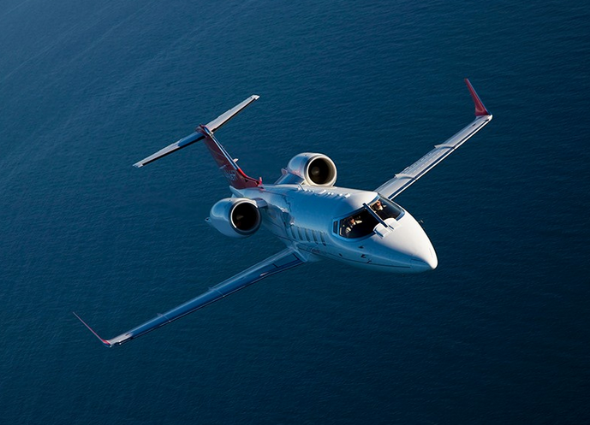
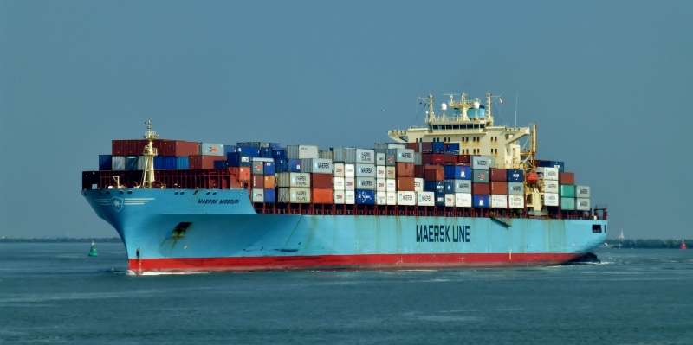
Who are we?
GW Maritime Medical Access
Founded in 1989
Provides 24/7/365 Medical Advice to Vessels, Aircraft, & Remote Locations around the World.
Board Certified, Practicing, Academic Emergency Medicine Physicians
Clients include maritime shipping, fishing boats, research vessels, business aviation, cruise lines, recreational boats, government teams & remote locations
Medical, logistical & operational support

Slide 4
Who are we connected to?
George Washington University - Department of Emergency Medicine
7th Academic Emergency Medicine Department in the USA
Operations in Kuwait, Qatar, & India
Global Educational & Medical Experience
Innovative Practice Section with Telemedicine and mHealth Operations & Experience
Maritime Medical Access
smhs.gwu.edu

Slide 5
The Pacific Cup
Race from SF to Hawaii
8 – 15 days at sea
Crews of at least 2 people
sf.funcheap.com
www.prx.org

Slide 6
So Why Am I Here?
Map of Pacific Ocean with line and then red dot…
maps.google.com

Slide 7
Brief Outline
Additional Preparation Tidbits
Medical
Equipment
Training
Medical Tidbits (Medicine at Sea Potpourri)
Medicine factoids
Medical support factoids
Things that might want to consider
Telemedicine at Sea
The Who, What, Where, When, Why and How

Slide 8
In preparation for your voyage
See your doctor
thewallpapers.org

Slide 9
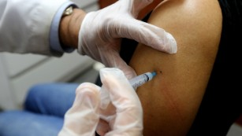
In preparation for your voyage
What are some things you would do when you visit the doctor?
Discuss the nature of your voyage
Physical
Lab work
EKG
Ensure all Vaccinations are up to date!
Other testing if high risk
Medication reconciliation and REFILLS
Get that rash, lump or other nagging issue checked out
https://www.cnn.com/2017/02/16/health/flu-shot-effective-cdc-study/index.html
Notes:
Nature – the environmental, physicial exertion, limited access to care aspects
High Risk – If you have htn, dm, high chol. You have increased risk for CAD. It may be appropriate to have a stress test.
Vaccines – FLU, Tetanus, if not checked before – Titers for MMR, Varicella

Slide 10
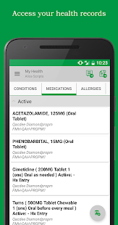
In preparation for your voyage
Gather a Medical Summary for Each of the Crew
Confidential
Laminated
Single sheet
Sealed Envelopes
Includes the following:
Name
Date of birth
Medical problems
Prior surgeries or procedures
Medication List
Allergies
Copy of EKG
Doctors Contact info
dreamstime.com
https://gameapks.com/followmyhealth-2-11-apk-game-medical/
Notes:
Check to make sure the data is saved to the phone and available offline

Slide 11
In preparation for your voyage
For medications or medical equipment:
Expiration dates
Waterproof
Quantity
Recent inspection
Batteries
safemedicinedisposal.org

Slide 12
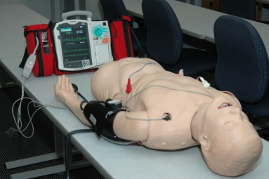
In preparation for your voyage
Do you have a satellite phone?
Do you know how to use it
Subscription up to date
Back-up
Connection to medical kit?
Course – Consider It
Safety, Survival, Firefighting, First Aid (AHA)
How many people beside yourself took a course
AED
Controversial
Notes:
Course and Training also guide Equipement and supplies – you only carry what you are trained to use

Slide 13
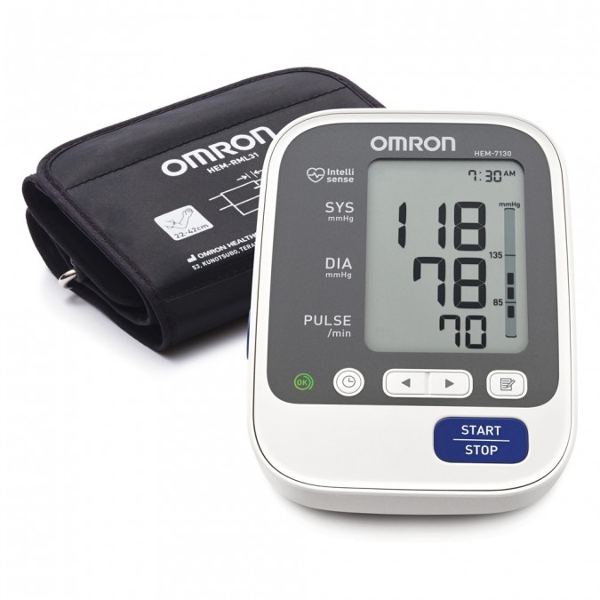
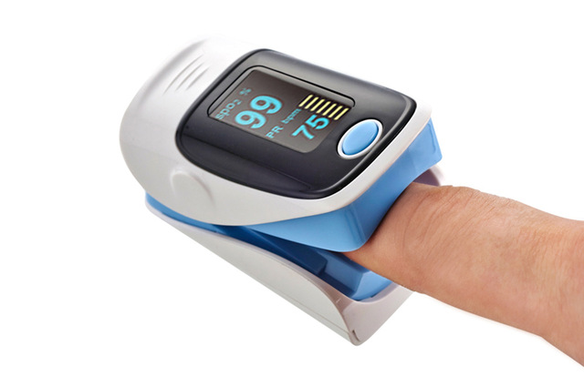
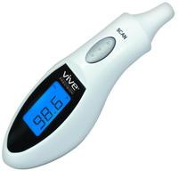
In preparation for your voyage
Equipment Recommendations:
Blood Pressure - Automatic
Thermometer
LED Bright Light/Flashlight or Penlight
Pulse Oximeter
https://www.priceline.com.au/omron-deluxe-blood-pressure-monitor-1-ea
https://www.aliexpress.com/item/OLED-Digital-HR-Pulse-Blood-Oxygen-Sensor-SPO2-Finger-Oxi-Meter-Kid-Adult-Device/32513682716.html
https://www.vivehealth.com/products/ear-thermometer

Slide 14
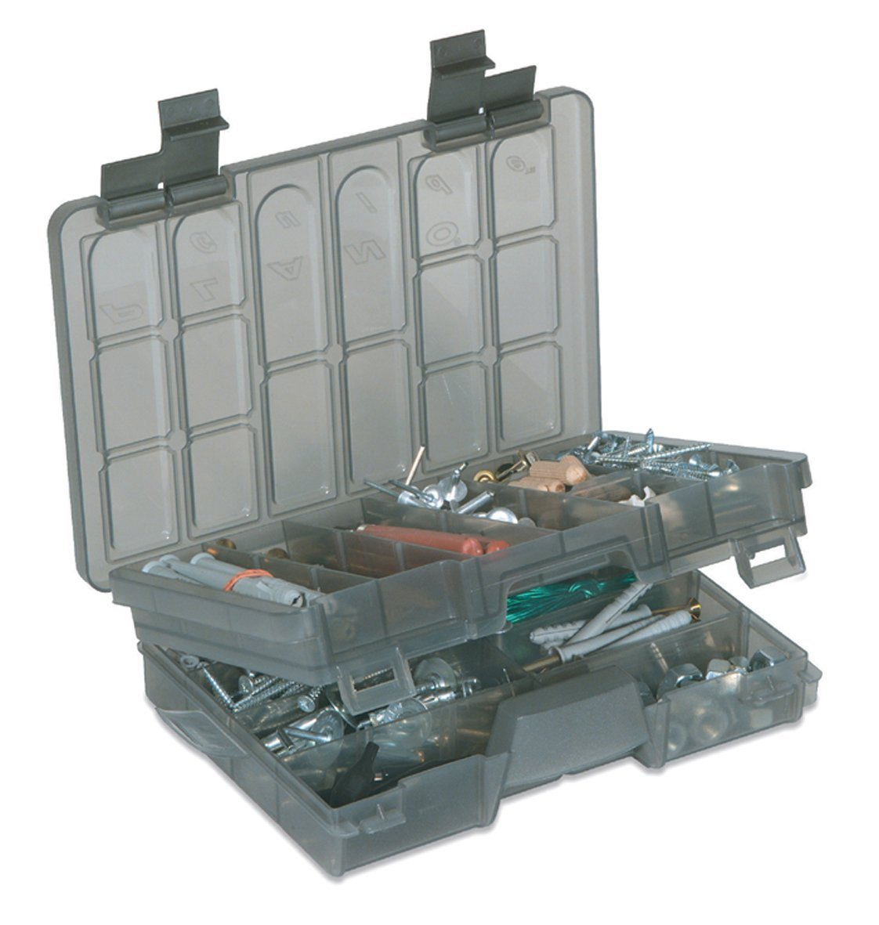
Medical Tidbits
Consider purchasing a medical kit
Marine specific
Up to date
One stop
https://www.amazon.com/Plano-Two-Tier-Tackle-Box/dp/B00469DZB2
Notes:
Can be expensive and make sure align with your training. Fishing tackle box is a good way to organize supplies

Slide 15
Medical Tidbits
Antibiotics, Pain Management and GI
For all Meds:
Side effects
Allergy profile
Interactions with other medications
How many?
How often?

Slide 16
Analgesics – Ibuprofen? Advil? Motrin?
What they’re the same thing?
Not all analgesics are created equal
Tylenol v. Ibuprofen v. Aspirin
Side effects – but they’re over-the-counter
Allergy profile
How many?
How often?
Can I take Motrin with Tylenol?
Which one is best to take?
Medication cocktails - AVOID
walmart.com
amazon.com

Slide 17
Over the Counter
Pain/Fever | Allergy/Other | GI Tract | Motion
Acetaminophen 325mg or 500mg 1000mg every 6 hours | Benadryl 25mg 25-50mg every 6 hours | Pepto Bismal tabs or liquid | Dramamine or Bonine (meclizine)
Ibuprofen 200mg 400-800mg every 8 hours | Claritin/ Allegra / Zyrtec 1 tab daily | Pepcid or Zantac 1 x or 2x daily
 | Aspirin 325 mg | Mylanta, Maalox or Gaviscon
 | Afrin Nasal Spray | Tucks pads, Anusol HC, or Preparation H

Slide 18
Other Over the Counters
Skin | Miscellaneous
Topical Antibiotics Ointment | Sterile Eye Wash
Sunscreen | Alcohol Wipes
Aloe/Burn Relief
Topical Antifungal

Slide 19
Prescriptions
Antibiotics | Nausea/Motion | Hx of Anaphylaxis | Eye
Cephalexin 500mg 1 tablet 4 x daily | Zofran ODT 4mg 1 tab on tongue every 2 hours as needed | Epi-Pen Auto Injector (2 pack) | Tetracaine 0.5% Ophthalmic Drops
Doxycycline 100mg (sunscreen) 1 tablet 2 x daily | Scopolamine Patches | Albuterol MDI Inhaler | Ciprofloxacin HCL 0.3% ophthalmic solution
Levaquin 500mg 1 tablet daily

Slide 20
How to get meds?
Local Pharmacy
Generics are OK
You don’t need mass quantities
If you remove from larger bottles make sure labeled well
Name and strength/dose, expiration date
Blister packs are preferred if available
Talk to you doctor
Get a 1 month supply of all home medications
Get a personal script for a week or 10 day supply for emergency medications
Explain the nature of the trip
Explain that the RX are for Emergencies and will only be used under the direction of GWU docs
There are no narcotics or controlled substances

Slide 21
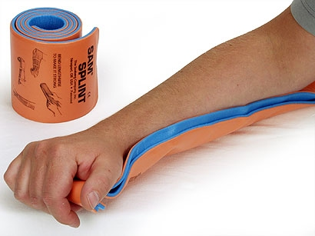
Medical Tidbits
First Aid Must Haves
Band-aids + antibiotic ointment
Gauze bandages (kerlex)
Splints (Sam Splints)
Ace bandages (2 sizes)
Iodine solution
Shears - Trauma
Tweezers
Tourniquet
Clean cravats
http://www.topsurvivalpreps.com/sam-splint

Slide 22
Medical Tidbits
Allergic Reactions and Asthma
Crew allergies
EpiPen – med kit and personal
Benadryl
Steroids
Albuterol
wholefamilyonline.org
Notes:
IF you have known asthmatics – carry 1 week of steroids (prednisone) and Inhalers /Extra ones

Slide 23
Medical Tidbits
Eyes – you only have two
Eye protection
UVA/UVB
Shatter-proof (polycarbonate)
Back-up pairs
Extra pair of prescription lenses
Save the contact lenses for shore side
mammaalcubo.org

Slide 24
Telemedicine
What’s that?
Remote medical consultation
Phone or face-to-face video
Why?
Ever been on an airplane
Where?
Wherever you are
Licensing limitations

Slide 25
Telemedicine Case Presentation
Take your time
Who? Name, Age, Past Hx
What happened and How?
When?
Condition and Vital Signs
Where are you?
Notes:
Comms manual

Slide 26
How does it work?
Consultation Initiated with Communication Center
Physician Joins (< 2 minutes later) and consults with client
Treatment Plan is Made & Reviewed with Client
Upon Resolution, Coordinator Closes Case & Generates Summary
Physicians follow-up with client as needed
Pending Diversion
Evacuation/Diversion Decisions Made by two MMA Physicians
52 Medical Specialties Available for Consultation
Integrated Case Management
Notes:
General Call/Case Flow
Intake
Vessel Operational File
MD Briefing
Conference
Scribing
Follow Up Request
PA-C Review
Case Follow Up
Case Closure
Evacuation Procedures
Dual MD Consultation
Coast Guard Coordination
Hospital Briefing

Slide 27
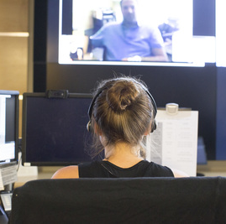
Worldwide Emergency Communication Center
Communication & Operations hub for all MMA services
Staffed by EMTs & Paramedics
Instant access to client information, medical records, & medical kit contents
Custom-built database of global medical facilities & capabilities
Secure storage & management of medical & operational records

Slide 28
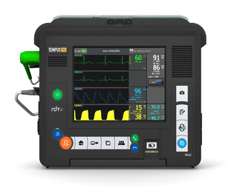
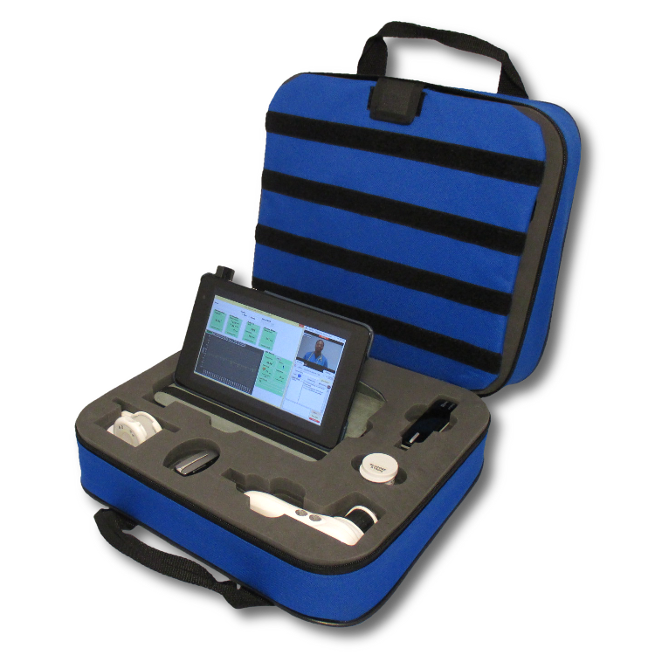
Communications and Technology
Communications
Phone, e-mail, fax
Secure telemedicine systems
Secure video conferencing
Comprehensive Operational System
Custom-built operational database system
Telemedical Systems Compatibility
System-agnostic Communication Center
DigiGone & Tempus i2i
Capable of interfacing with whatever technology you are using
Notes:
Infrastructure:
Centralized Medical & Operational Hub (WECC) supporting small team of EMED Physicians in telemedicine
Differentials of GWMMA & other programs
Direct to MD Consultations
Comprehensive services from vessel—hospital—home
In-depth physician, PA-C, WECC & Administrative Involvement
1 POC for all medical needs

Slide 29
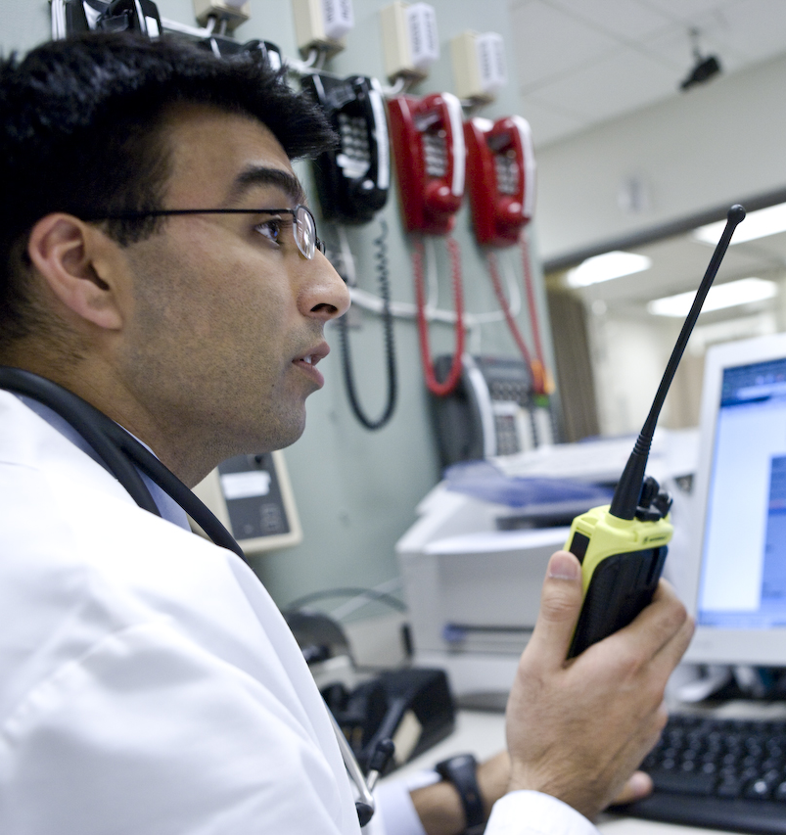
Who’s Taking My Call?
Board Certified Emergency Physicians
Dedicated to the maritime program
On-call 24 hours a day
Physicians who possess experience in maritime, aviation, and austere medicine

Slide 30
When Should I Call?
When is someone sick enough?
Simple rules
Does it make you nervous
Does it impact the mission
Call early, call often
How often should I call
Whenever you need
Communications schedules
Communication Check
Contact GW MMA before the race to confirm you have the right information
Contact us at the beginning of the race to ensure systems are working
Email us your medication and supply lists as soon as final.

Slide 31
Coverage Particulars
Dates of Coverage
July 1st, 2018 to August 31st, 2018
Length of a Call
As long as you need
Some examples of typical calls
Injuries
Medication questions
Emergencies
Fainting
Abdominal pain
Short of breath

Slide 32
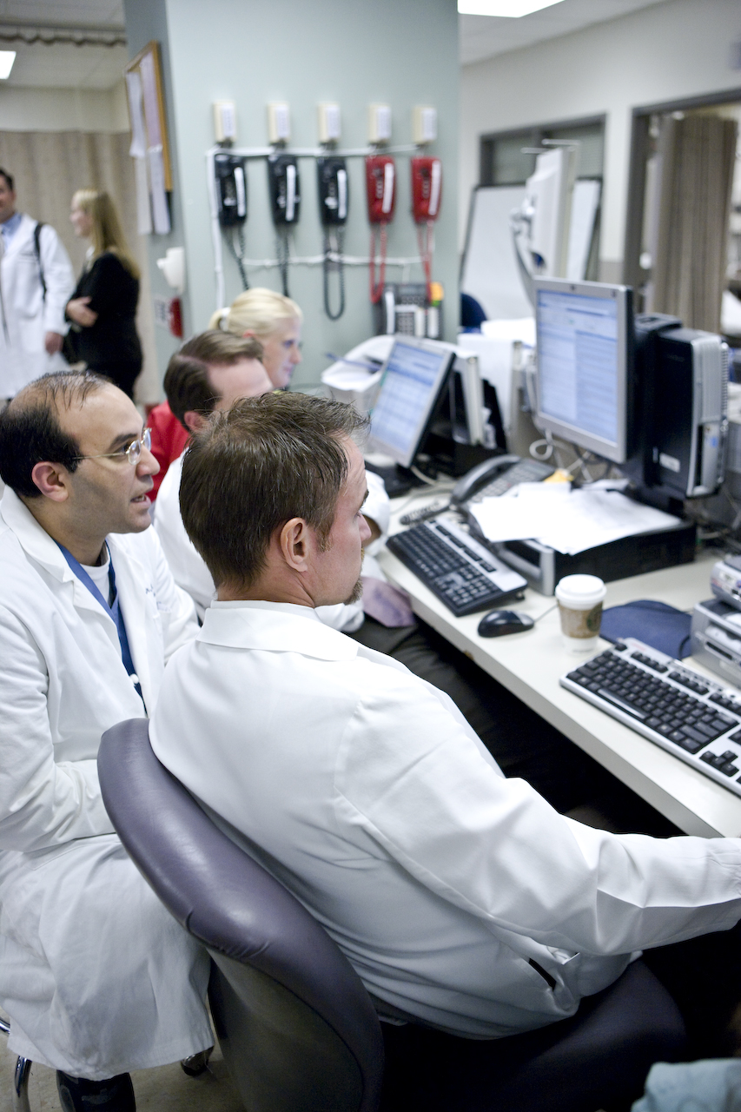
What Makes Us Unique
Over 25 years of experience supporting remote clients with robust telemedicine services
Each case receives immediate attention from a specialty-trained GW Emergency Physician
24/7 communication center supporting multiple telemedicine platforms and technologies
Access to a multi-specialty academic medical center’s clinical resources
Accessible, service-driven team, responsive to the unique, diverse, & evolving needs of those in austere & unusual environments

Slide 33
Contact Us
Maritime Medical Access
2120 L St NW Suite #530
Washington DC 20037
gwmma@gwmaritime.com
Neal Sikka, MD
Medical Director
nsikka@mfa.gwu.edu
202-741-2936
Kai Neander, NRAEMT Program Manager
kneander@mfa.gwu.edu
202-741-2918
“MMA has provided very fast responses with follow up questions and treatment that help crew members return to good health as quickly as possible.”
-Fishing Vessel Captain

Slide 34
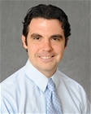
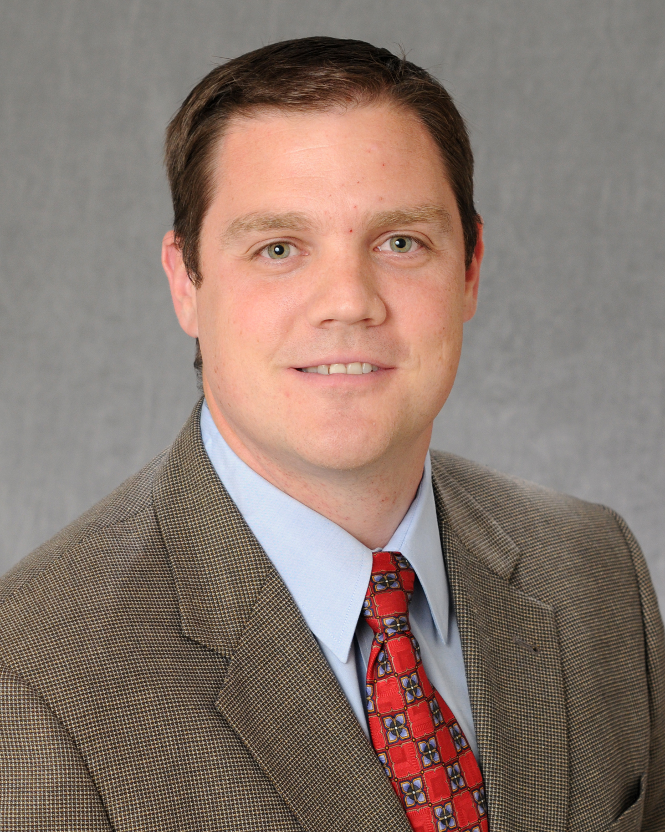
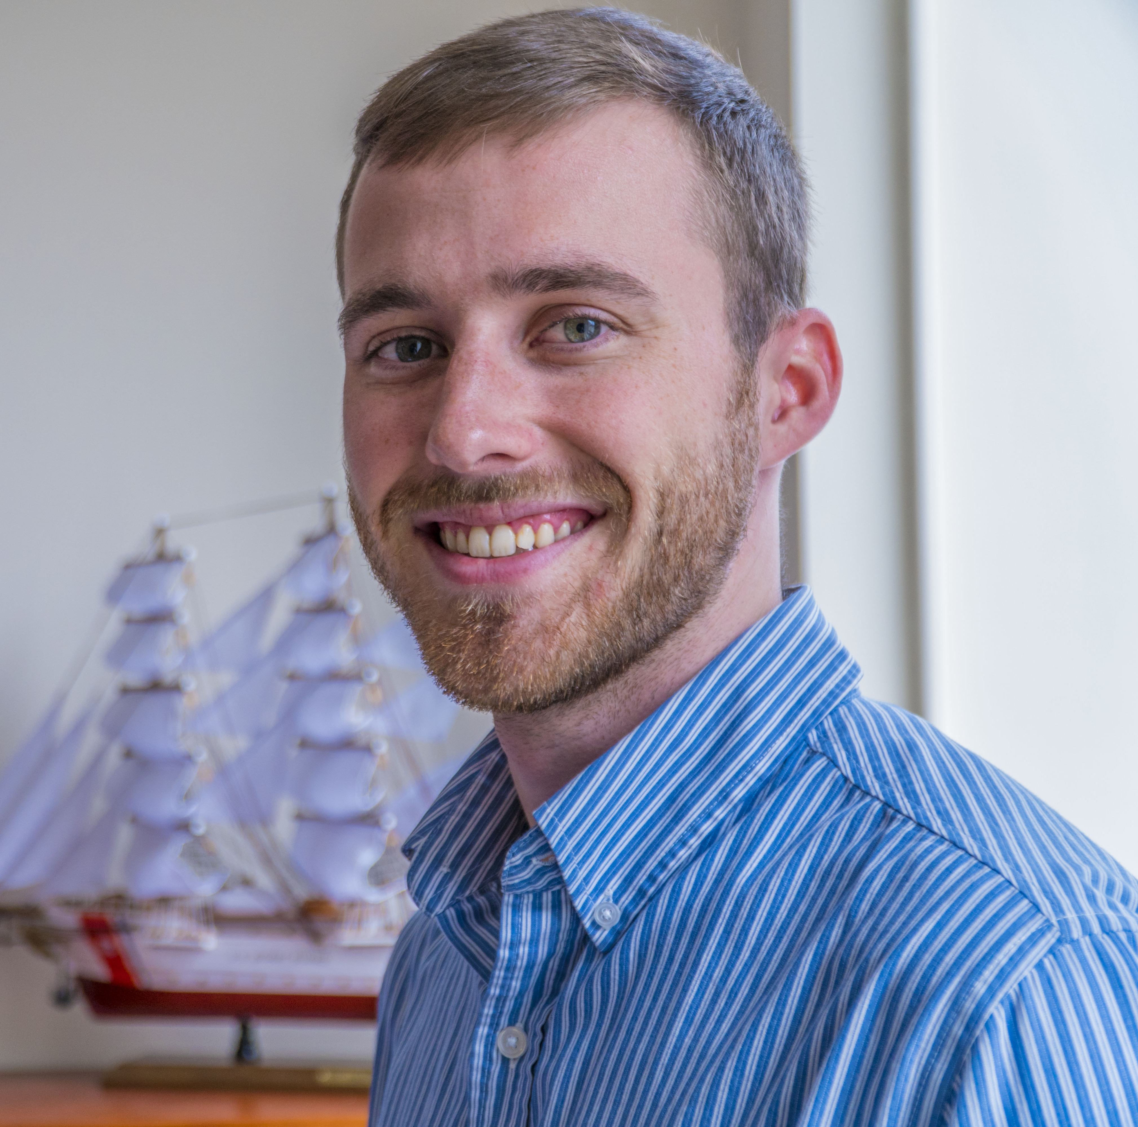
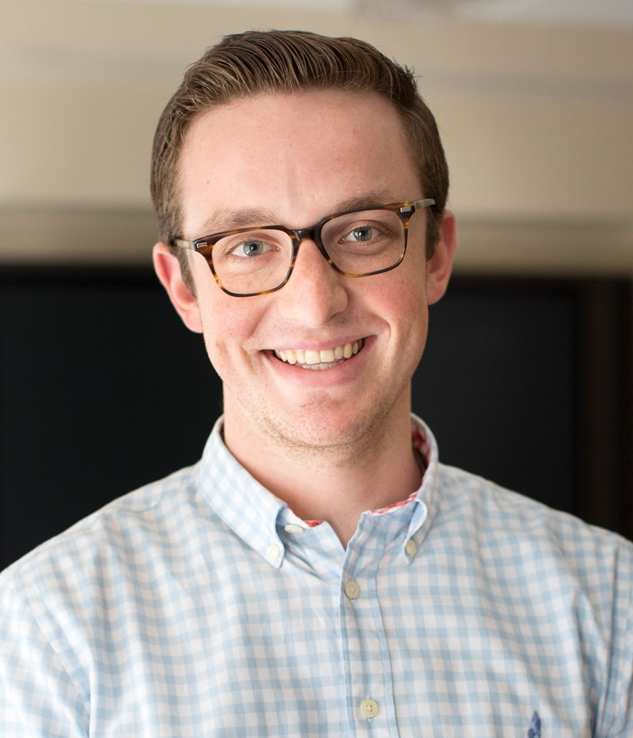
GW MMA Staff
GW MMA Clinical Coordinators
Emergency & Remote Medicine Trained PA-Cs
Case management
Clinical & Administrative functions
Alex Lee PA-C
Drew Maurano PA-C
GW MMA Program Administrators
Primary client liaisons for all Services
Direct and oversee all operations
Provide ancillary support services
Chris Faircloth, NREMT
Kai Neander NRAEMT

Slide 35
Conclusion
We’re there
We’re ready
Call early
Call often
Thank you

