Slide 1
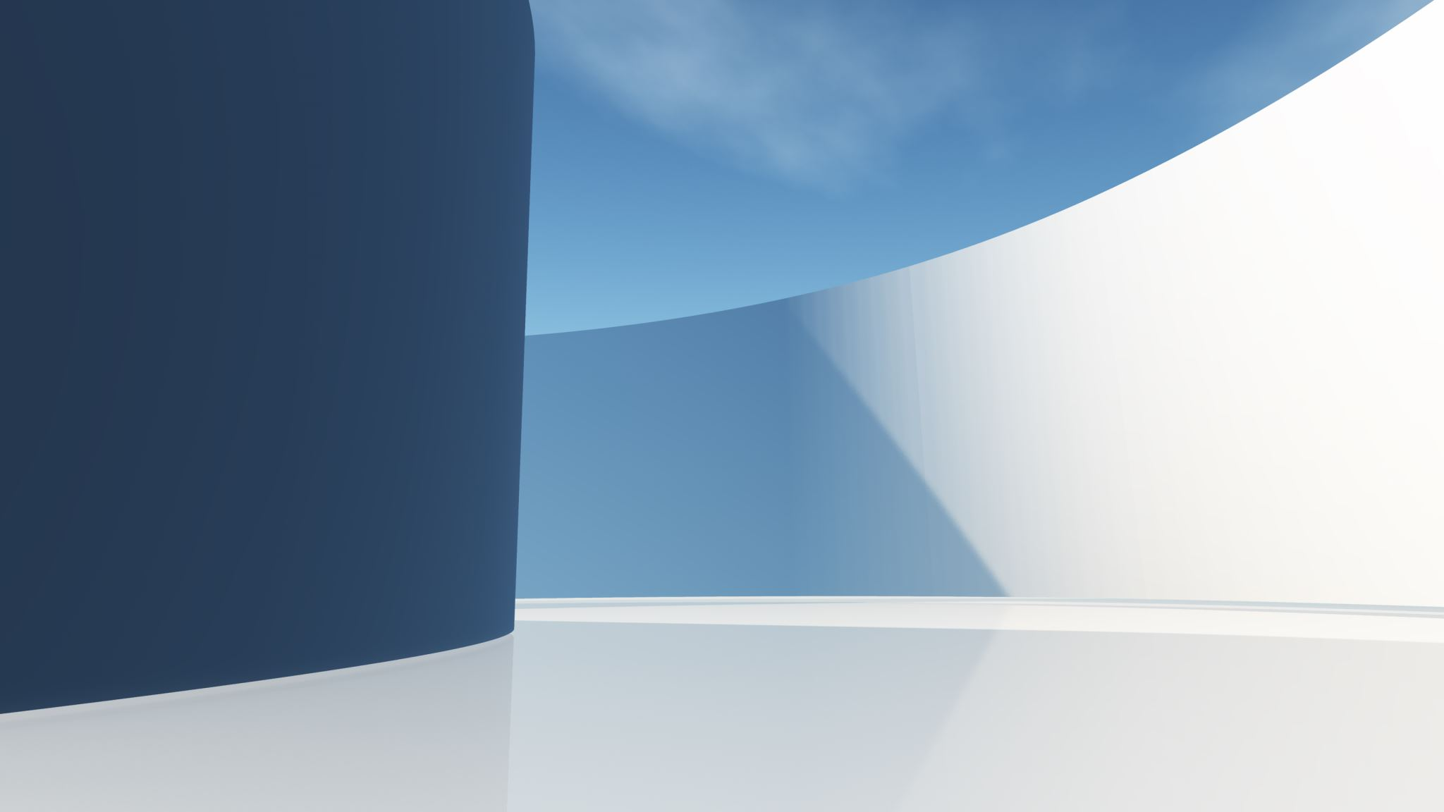
2024 Pacific Cup Skippers’ Meeting
Finishing
Big Picture Way Points and Finish Line Hazards Meeting your escort
Buzz Blackett

Slide 2
Big Picture
Note the changing orientation, from east-west to north-south
Finishing Starts Early (100 miles out)

Slide 3
WayPoints and finish line
Waypoint north of Mokumanu ~2 miles from finish line
Finish line ~0.7 miles long (note lat/lon at ends) ~[300]º measured from east to west
GET ALL 3 ON YOUR CHART PLOTTERS NOW!

Slide 4
Finish line details

Slide 5
hazards
Firing Range (beige ¼ pie)
Wave Buoys Big round cylinders Low to water Dimly lit Tethered together
Reefs Parallel to finish line < 0.5 miles Know bearing to escort location

Slide 6
Meeting your escort
Hailing and dialogue Channel __
Meet outside of the Sampan Channel Entrance Lighted Buoy 2 (FL (1) R 2.5s) at approximately 21°28.166’N x 157°46.632’W.
Sailing through Channel usually OK
Pay attention to Channel buoys and marks!
Dropping sails and mounting motors inside Bay

