Slide 1
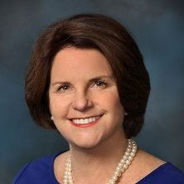
Medical Review
Mary P. Lovely, PhD RN
Medical Liaison

Slide 2
1 on 1 with EVERY crew member to review their health and meds (no surprises… Skipper with a crew member too!)
Sign of illness? Call George Washington EARLY (don’t wait)
Medical Kit
Check its there and complete (ie antibiotics)
Upload Med Kit inventory on PacCup web site
Under your boat (“Safety” section)

Slide 3
Start crew on seasickness pills the day before your start
Importance of SLEEP (b4 the start and especially first few days)
If sailing home, signup for George Washington for the return

Slide 4
Medical Review
Mary P. Lovely, PhD RN
Medical Liaison

Slide 5
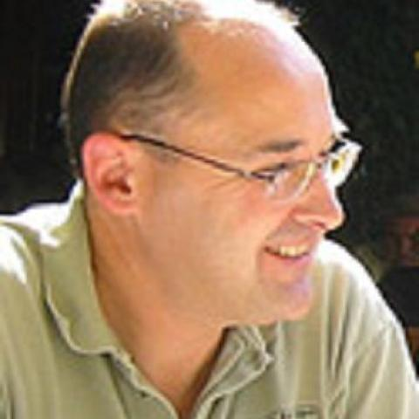
Weather & Strategy
Jim Quanci
Repeat Offender

Slide 6
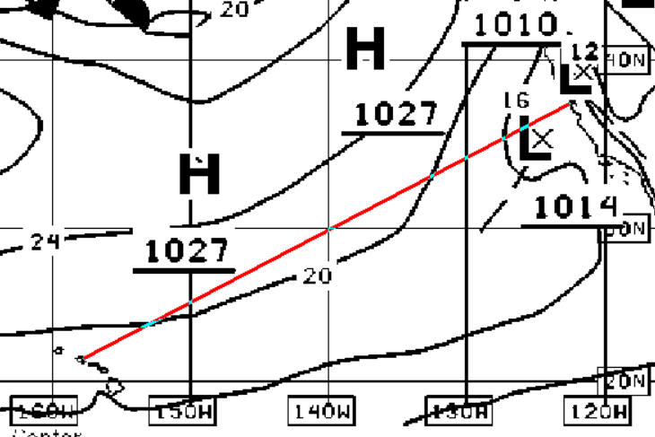
NOAA 48 hr

Slide 7
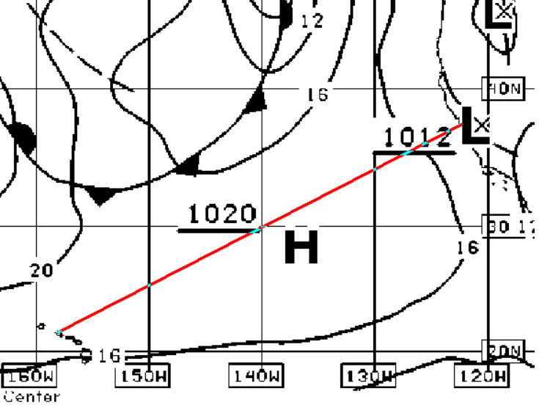
NOAA 96 hr

Slide 8
HRRR

Slide 9
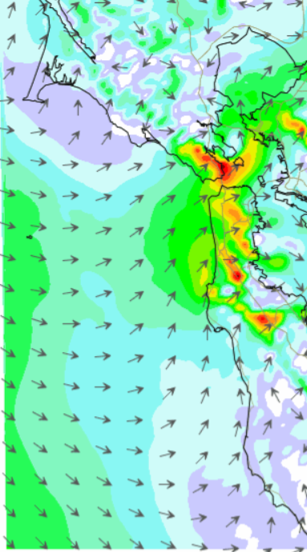
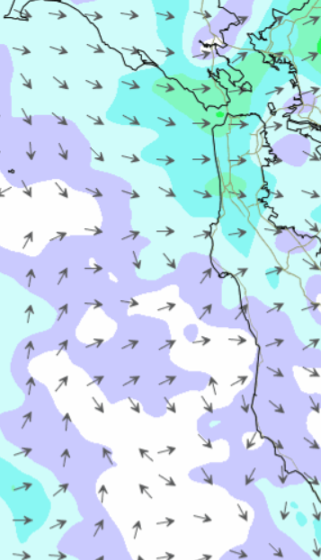
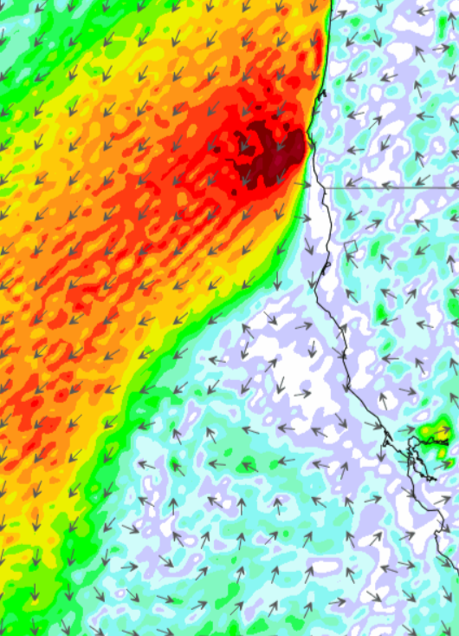
SailFlow 1 km
Sunday
SailFlow
Monday
SailFlow
Monday

Slide 10
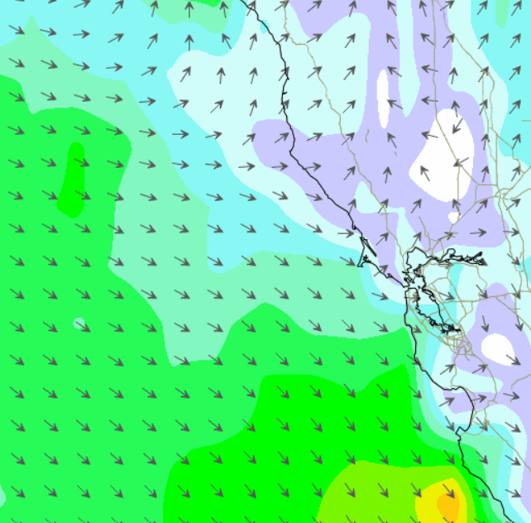
SailFlow
Wednesday

Slide 11
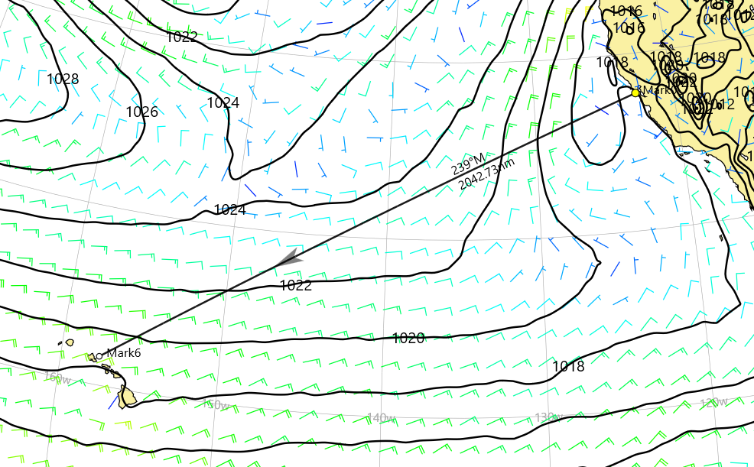
ECMWF 15th

Slide 12
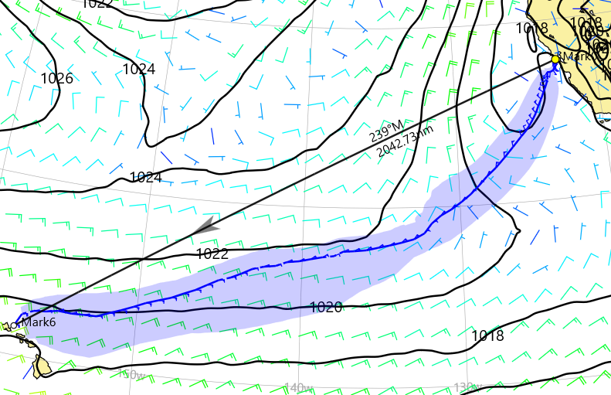
ECMWF 15th

Slide 13
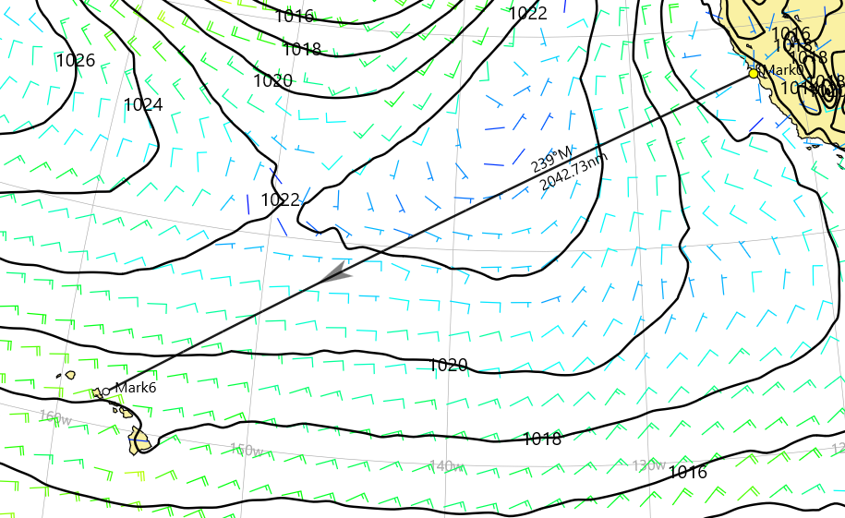
ECMWF 16th

Slide 14
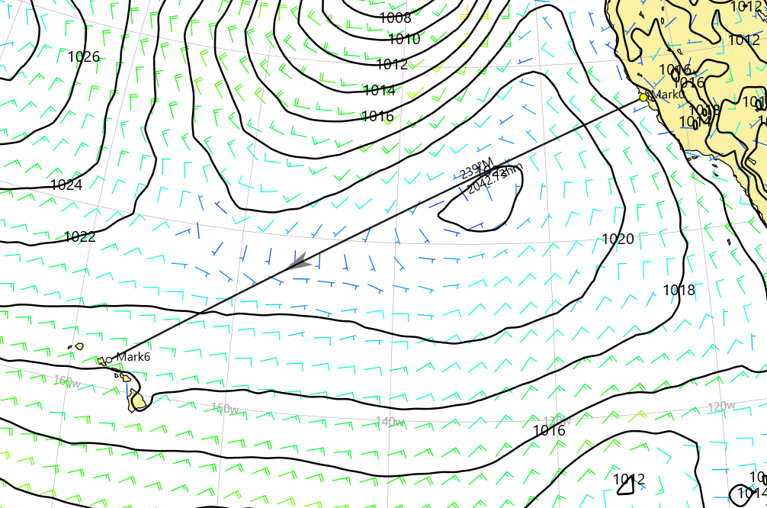
ECMWF 17th

Slide 15
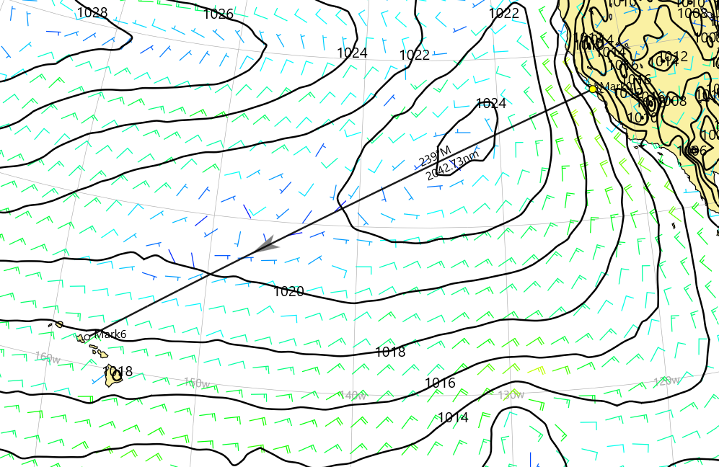
ECMWF 18th

Slide 16
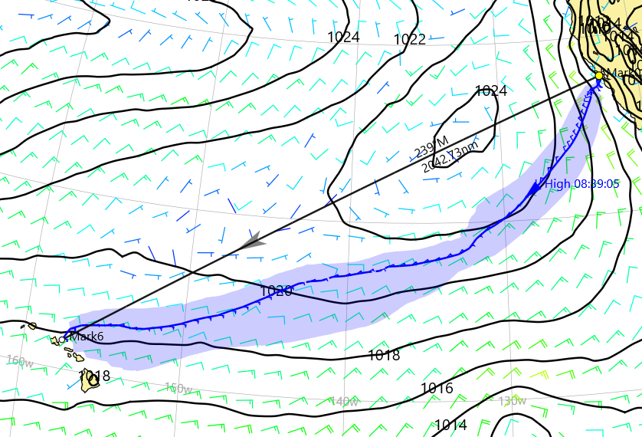
ECMWF 18th

Slide 17
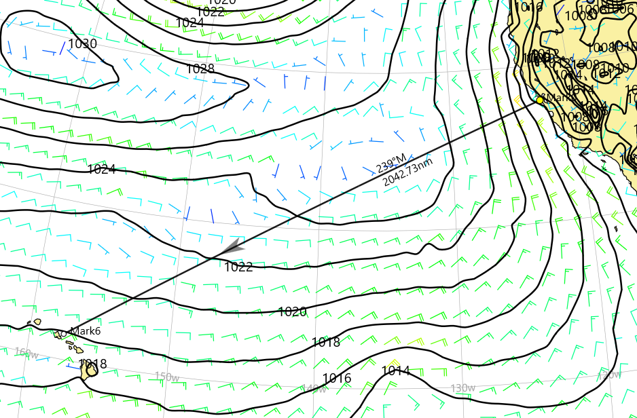
ECMWF 19th

Slide 18
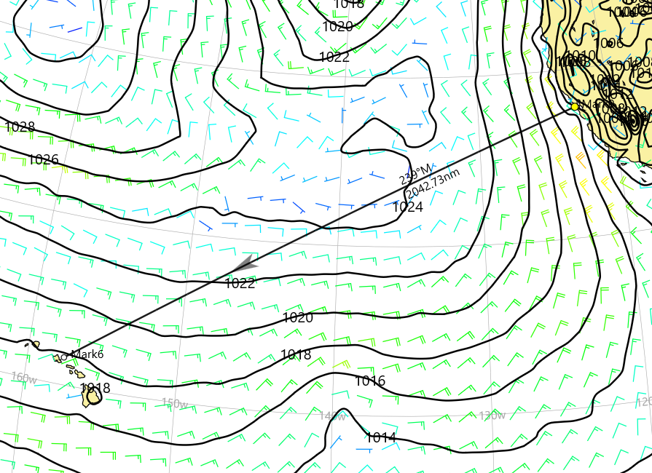
ECMWF 20th

Slide 19
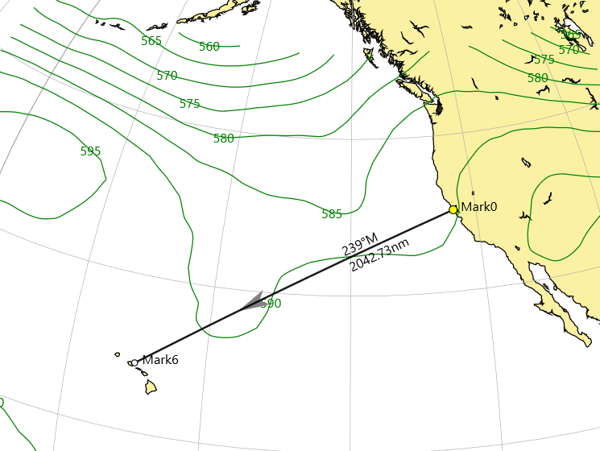
500 mb 15th

Slide 20
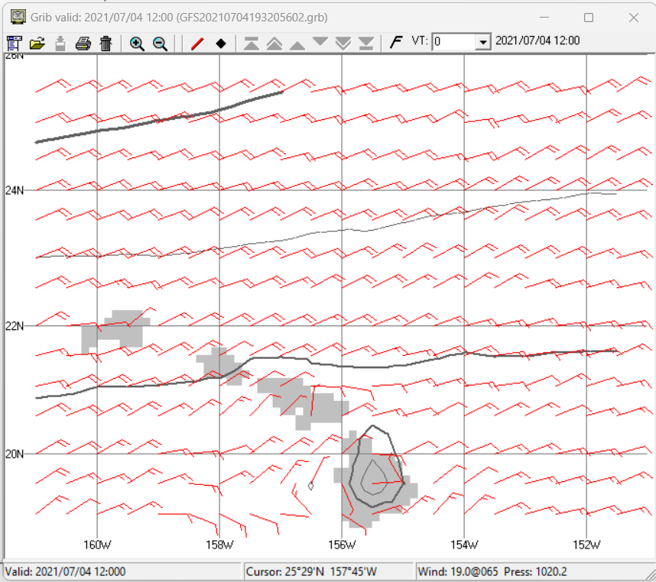
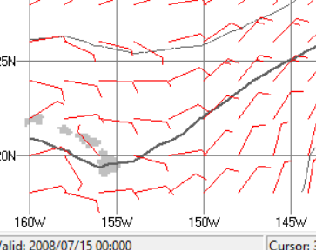

Slide 21
Weather & Strategy
Jim Quanci
Repeat Offender

