Slide 1
Stan Honey Pacific Cup Weather and Tactics Agenda:
Standard, ebb-tide, Farallon Race first leg.
Get to the Synoptic Wind before the glass-off the first night.
Pick and race to your Ridge Waypoint.
Carefully deal with Cutoff Lows
Slot-cars to the shift, ideally on hot “Ocean DW” angles
Squalls and Cloud Streets in the trades
Pick the correct corner on the Run
Approaching the Finish
Sources of weather data, before and during the race.
MOB stop and return tradeoffs

Slide 2
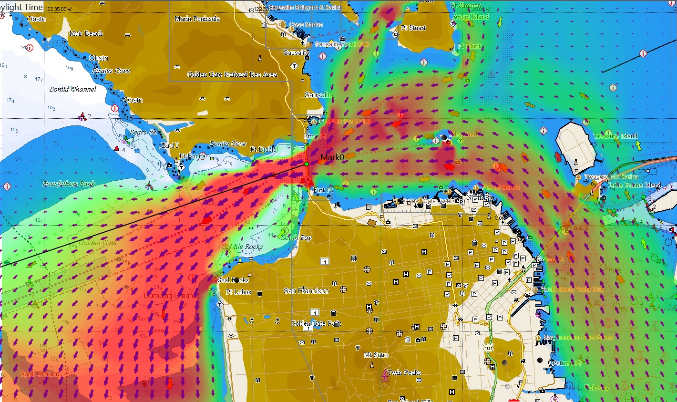

Slide 3
Reach the Synoptic Wind before the inshore glass-off.
Stay in the favorable ebb, know where it is.
Take advantage the wind shift near Pt. Bonita, if in the normal WNW wind.
Don’t sail in the left shifted wind off Seal Rocks and spend the night slatting in the Montara Hole.
Know where the Synoptic wind is, and get there before the inshore thermal wind quits. Nothing else matters until you get into the synoptic wind (which blows all night). (aka gradient or system wind)
There are good for-fee mesoscale models useful before the prep signal, (PWG, PWE, NAM, NAM Hires, HRRR, Coamps) Choose your mesoscale model by watching for previous several days.
Free mesoscale data sources: Coamps is good. HRRR is excellent with hourly updates. US Gov doesn’t charge but be sure to find a free source such as Saildocs or NOAA Ready.
You will smell the synoptic wind when you reach it. Then you’re off on the race to the ridge. Don’t use mesoscale models when in the synoptic wind, instead use GFS and free ECMWF.

Slide 4
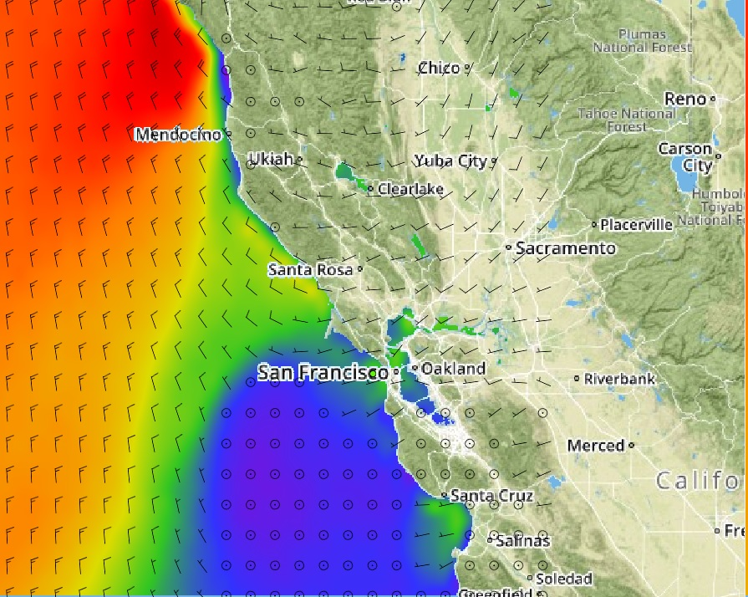

Slide 5
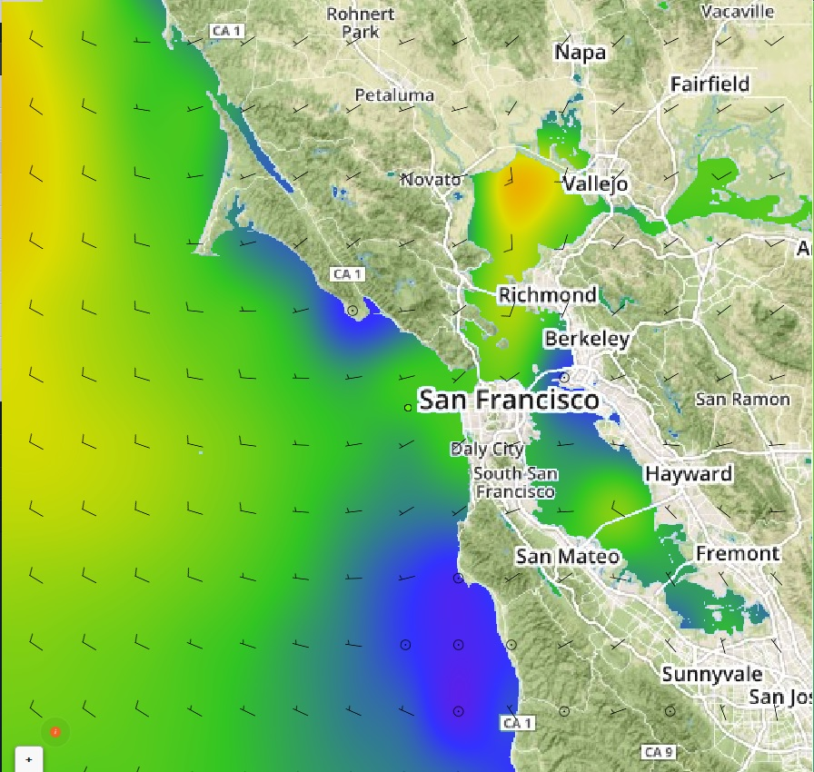

Slide 6
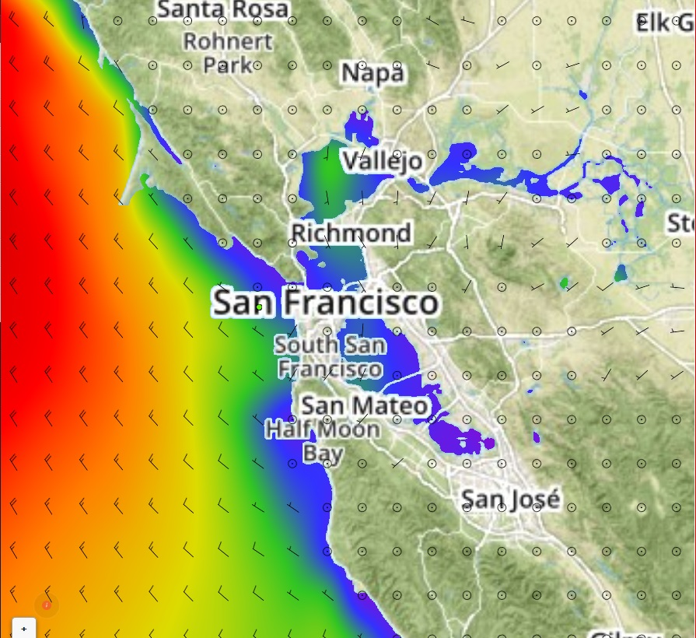

Slide 7
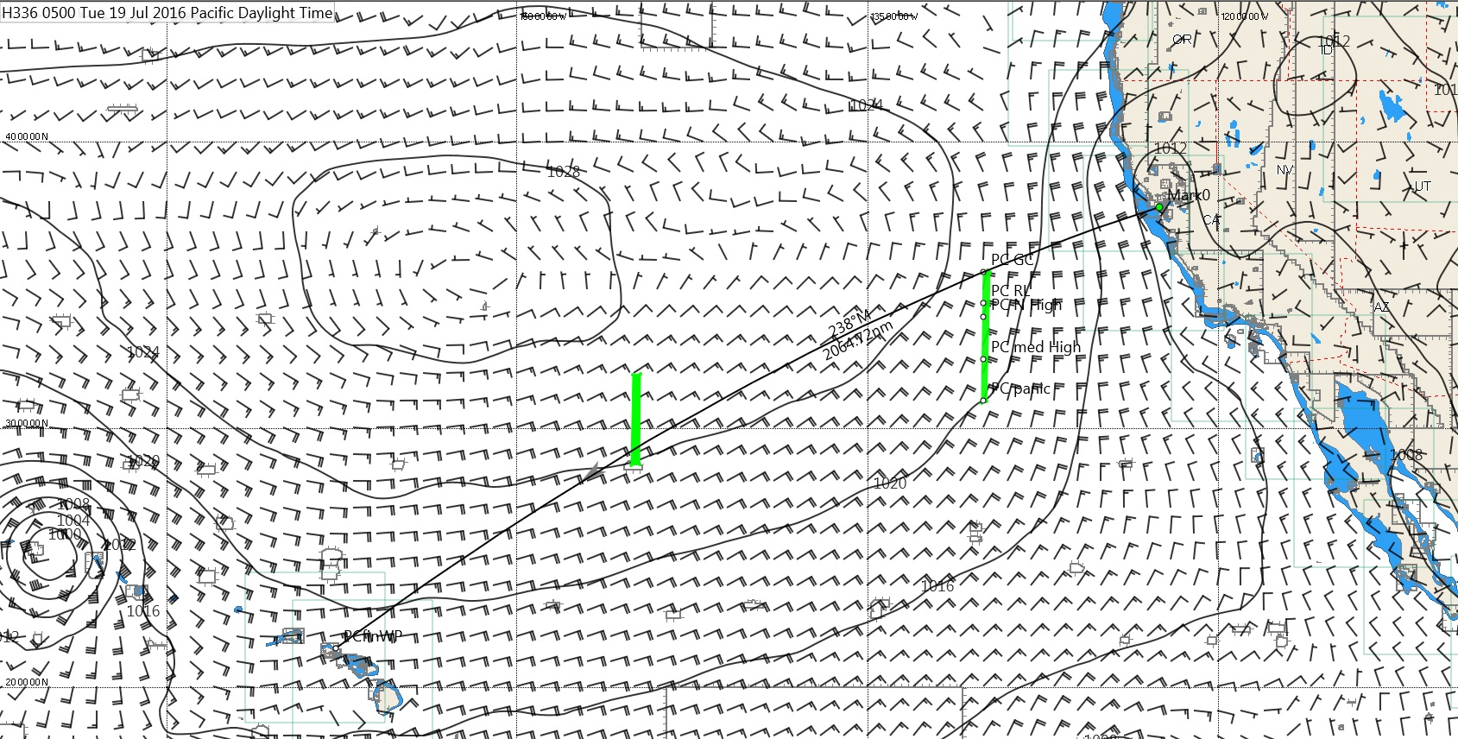

Slide 8
Pick Waypoint on the Ridge
Too far North: wind gets too light before you get to the shift so you have to gybe out on an unfavorable angles. Or you sail slowly in light air, in denial.
Slightly too far North: you have to sail inshore vmg angles. That is slower than sailing slightly hot offshore downwind angles to the lift.
Too far South: you sail extra miles needlessly. The boats to North have just as much wind, sail fewer miles, get the shift first, gybe out on port, and cross in front of you.
To win you have to get it right and cross the ridge at the right place.
Pick based on expected strength and location of High when you are 130-145 lon. Use GFS gribs, free ECMWF gribs, 96 hr fax progs, UL charts.
Router will take you too far North. Understand why. Still useful. Use router as a N wall.
Possible waypoints on ridge, 130 Lon
36N GC 0 nm 236mag note course is right past Farallon Island
34.5N RL +9nm 226mag only if extreme N High
34N +16nm 223mag normal N High
32.5N +50nm 215mag med High
31N +110nm 206mag really expensive, sometimes req

Slide 9
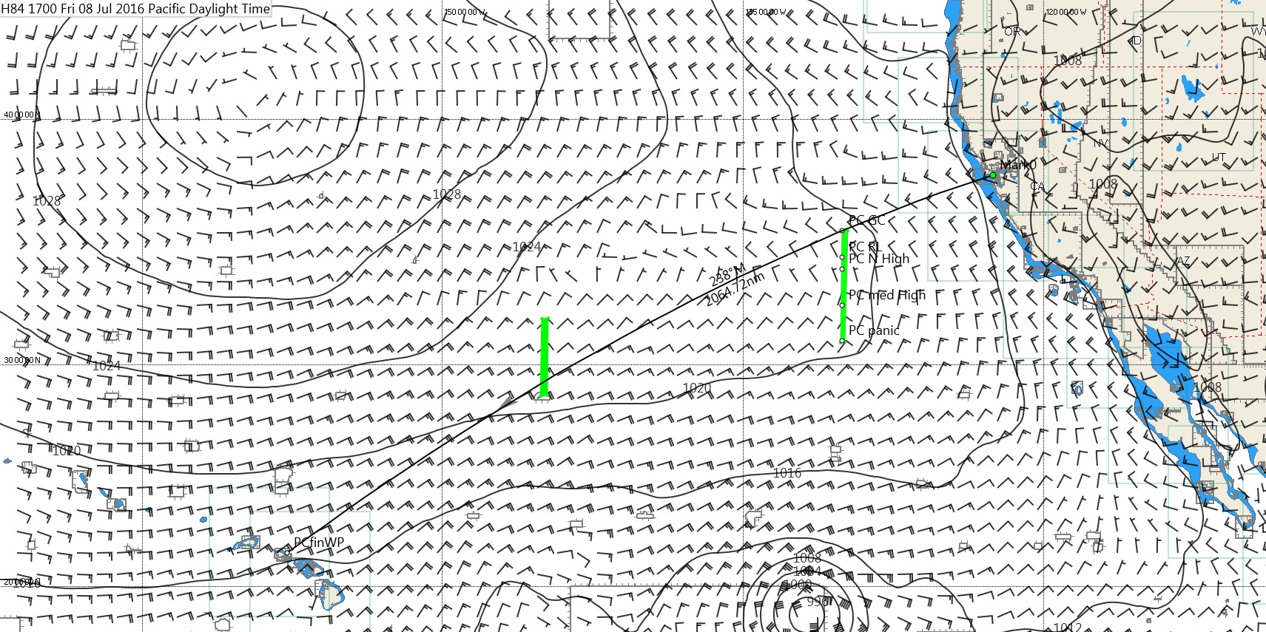

Slide 10
Sources of Weather
Only use free sources of weather after Prep Signal; see RRS41, WS Case 120, and the communications restrictions in the SI’s. Don’t cheat even accidentally. Ok to pay for satellite comms. Prohibited to pay for data or to get custom data. Be careful to not use paid subscriptions.
Free GFS data is widely available via saildocs and several other services. Don’t break the rules by paying for it. ECMWF gribs are also free at 0.5 nmi resolution.
Coamps is free and is a good mesoscale model. HRRR is terrific, updates hourly, and free. Other for-pay mesoscale models (e.g. PW) are also useful but only before your prep signal, and only update every 12 hours.
Don’t use GFS or ECMWF in terrain effects and don’t use mesoscale models when in synoptic weather.
Do look at the OPC (weatherfax) charts.

Slide 11
Routing tips
First look at the OPC charts and do an eyeball route and review.
Next just look at the gribs and do an eyeball route and review. Shade rain to make fronts visible.
Scale wind 115% in Hawaii Race.
Finally load gribs, correct for “ground truth”, run routes and lots of what-ifs.
Be sure to understand cost of alternate routes either by forcing with “restricted areas”, by review of tangent zones of forward/reverse isochrones, and by “cost” shading.
You’re not done until you can explain the route in sailing terminology to sailors.
Watches need to fully understand the route objective in sailing terms, the near-term “free advance” course, as well as have a good 12 hour forecast, every 6 hours including likelihood of squalls.
Understand why the router always takes you too close to a High.

Slide 12
Rules of Thumb
Never trust rules of thumb
Normal High, try to be 5-6mb away at the closest point.
4mb is dicey but ok if strong 500 mb Omega Block, no mid-lat lows on their way, and High moving N.
7-8 mb might be good if zonal UL flow, incoming mid-lat lows to N, H sagging S, or H far North so it is inexpensive.

Slide 13
Tradewind Run
Nighttime dipole squalls, strong and long-lasting.
Have separate “feed”, updraft different from downdraft.
Rain before wind
“If the wind before rain, let your topsail fill again. If the rain before wind, sheets and topsails mind.”
Wind toes in at the front of dipole squalls
Simple “pop-up” daytime squalls, they grow with convection then their downdraft “cool pool” kills them. Catspaw fan-out, weaker and short-lived. Wind comes before the rain.
Simple slow/heavy boat tactic, get on port early, stay on port until squall is gone. Don’t cross upwind of squalls.
Fast boat tactic, gybe back in front of dipole squalls.
Avoid the light air behind the squall. Port pole is best exit because squalls move as if on starboard pole.

Slide 15
Tradewind Run
Daytime Cloud Streets, stay on edge of clouds. Starboard gybe will often keep you there.
Late afternoon left shift and increase around 5-6pm local.
Windy, cloudy, 3-4 hour left as you enter tradewinds, in transition zone.
Take southing if you need it.
Lots of sail handling if you don’t, as you change to JT and then back.
Often mis-interpreted as a left-shifting, long-lasting, squall.

Slide 17
Final Shift
Right corner generally pays because of continuing veer.
Left corner pays if you are leading a tropical (inverted trough) to the finish.
Right pays big if you are following a tropical to the finish.
So keep your eye on the tropical “inverted-troughs”.
Don’t overstand, wind will build and veer.
Last 20 miles:
Don’t overstand
Don’t overstand
Generally right pays
Left pays for early evening finish because of late afternoon lefty.
Generally not close enough to Molokai channel wind to get acceleration on the left corner.

Slide 18
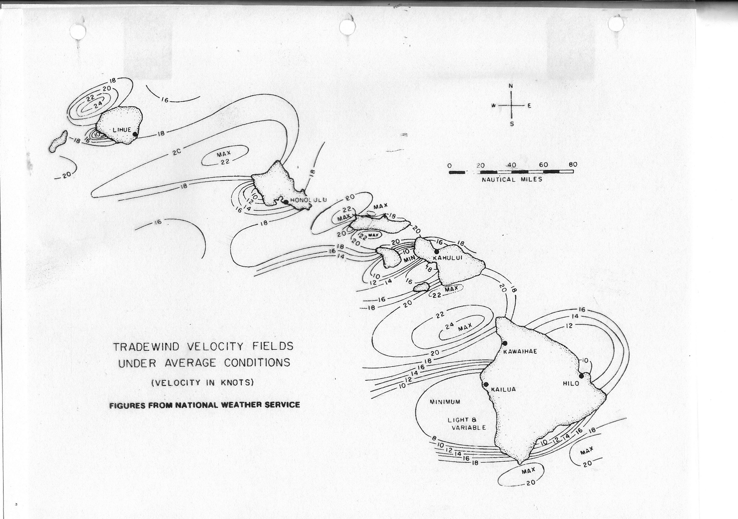

Slide 19
Finish
Navigate to the finish.
Take bearings on lights or landmarks and plot them on the chart to confirm your GPS and improve your spatial awareness.
Test your spinnaker halyard a few miles out.
If you can’t douse: promptly jibe to starboard, sheet main in, and reach along the reef.
Navigate to the dock after the finish, it’s your hide.

Slide 20
What if the High goes bad?
The high goes bad by turning into an E-W ridge and sagging to the S.
Decide whether you can get to and stay in the Trades that will live South of the ridge.
If not consider whether Trades will fill from the NW? They rarely re-fill from the S.
Sometimes it makes sense to stay above old ridge, beating in light Westerlies, to be the first to get the new trades associated with a new High filling in from the NW.
Think ahead about how the trades will fill in. Trust the GFS given no alternatives.

Slide 21
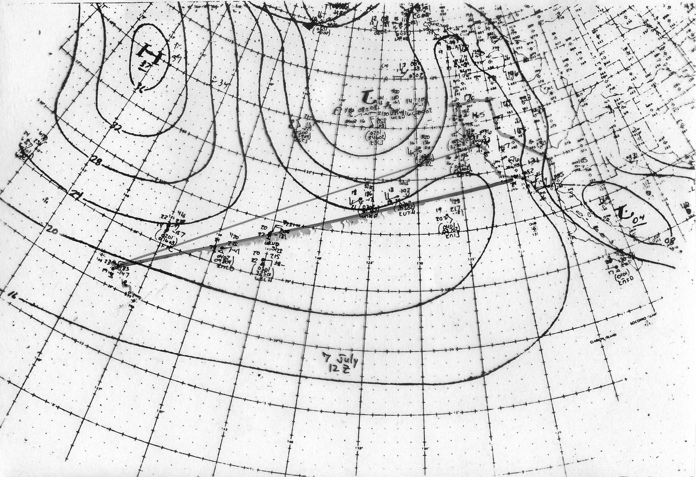

Slide 22
Some sources of Weather Data Before Prep signal (ok to pay) Legal During Racing (free)
SailFlow pro WF WRF (.02) SailFlow pro HRRR (.027), hourly update SailFlow pro Observations Anita, TI (L6), Blunt, Aquatic Park (1), Berkeley Marina, Royce Beach Toll PWE (.01), 12 hour update (0000 and 1200 PDT) PWG (.01), 12 hour update (0945 and 2145 PDT) SailFlow pro current model Tidetech current model (.001), check timing to NOAA Satellite imagery IR is best for convection Looped images from geo satellites, not APT Adrena provides terrific overlay on grib data. Sailtactics.com, wind and current, Mike Dvorak | HRRR from Saildocs (.027 resolution) Updated ~ 35 min after each hour SailFlow Observations via free account GGB, CG pier, Pier 1?, Oakland, Marina District?, TI (10th st)?. (? = sketchy data) NOAA Ready site HRRR chart (.027), 850mb/10m temps, CAPE, LFTX, Skew-T hourly updates Weather radar (lots of free sites)

Slide 23
Vertical Stability, seabreeze potential, squalls/thunderstorm potential offshore.
CAPE (convective available potential energy) (>1000 gets interesting)
LFTX (lifting index) (< -2 gets interesting)
Surface temp-850mb temp (> 7 deg C gets interesting)
Skew-T plots
Satellite imagery esp IR (terrific offshore to detect squalls, when legal)
Coastal Mesoscale models (HRRR is stunning, US only, free, legal anytime via Saildocs or NOAA Ready, hourly updates, essential)
Watch vertical stability in Lodi to predict thermal (38.25 -121.25 decimal deg)

Slide 26
Legal URL’s and Email requests for grib files:
Send an email to: “query@saildocs.com” The subject line doesn’t matter, include one of the following lines. Send one per email to keep it simple but multiple lines are accepted. Will get response within seconds. Free and legal while racing.
send gribmodels
This provides a list of models and parameters
send gribinfo
This provides background information on grib retrieval from saildocs
send HRRR:38.5N,36.5N,124W,122W|0.02,0.02|0,1..24|WIND,LFTX,CAPE,RAIN
This provides a 400kB HRRR grib file for SF Bay and offshore, available hourly at 40 minutes after every hour. H0 time will be 1h40m prior. Forecasts hourly through H18. Free and legal under RRS41 and Case 120, but large. Grib file viewable by Expedition, Adrena, DfW, Maxsea, Viewfax (free), and other programs.
send HRRR:38.5N,35.5N,126W,122W|0.2,0.2|0,1..18|WIND
This provides a 20kB HRRR grib file for SF Bay and offshore which is a reasonable size for SailMail or Iridium, and legal to update during the race (first afternoon).
NOAA Ready site: https://www.ready.noaa.gov/READYcmet.php
Source of HRRR and NAM HI forecast wind charts, Skew-T soundings, 850mb/10m temps, spot forecasts, CAPE, LFTX
User interface takes some practice. Hostile for sailors, familiar for meteorologists. Fast, free, legal, with hourly updates.

Slide 27
MOB stop and turn tradeoffs. There is no right answer, just tradeoffs.
Quick Stop, i.e. instant round-up
Ideal when beating or reaching.
Running:
Risky if the douse might turn to custard:
spinnaker blows through or wraps on rigging, on keel, on rudder, on prop
Halyard Locks won’t open (locks often are unpredictable in unusual situations)
Time consuming to get a tender boat’s rig and kite out of the water.
Long Return Alternative, i.e. race takedown.
Warm water helps
Pneumatic or quick release JonBuoy or MOM helps
AIS MOB beacon helps
Bear off and slow down right away to reduce the return distance.
My experience when running.
Quick stop: C40 or equivalent in any wind when crewed (no halyard lock, stiff)
Long return: multihulls, tender monohulls, boats with halyard locks, doublehanded.

Slide 28
Thank you.
Questions?

