Slide 1
Marine Electronics, Power
Eric Steinberg - Farallon Electronics

Slide 2
Agenda
Common Problems - usually have common sense solutions
The Power Plan

Slide 3
Common Problems and Solutions
80% of failures are installation related
If it were a car, we would call it a lemon
Keep the water out
Inspect everything
EVERYTHING
Workmanship
Dishes in your cupboard (whaaat?)
Keep complexity below your pain threshold
Know your systems, labels and drawings are helpful!

Slide 4
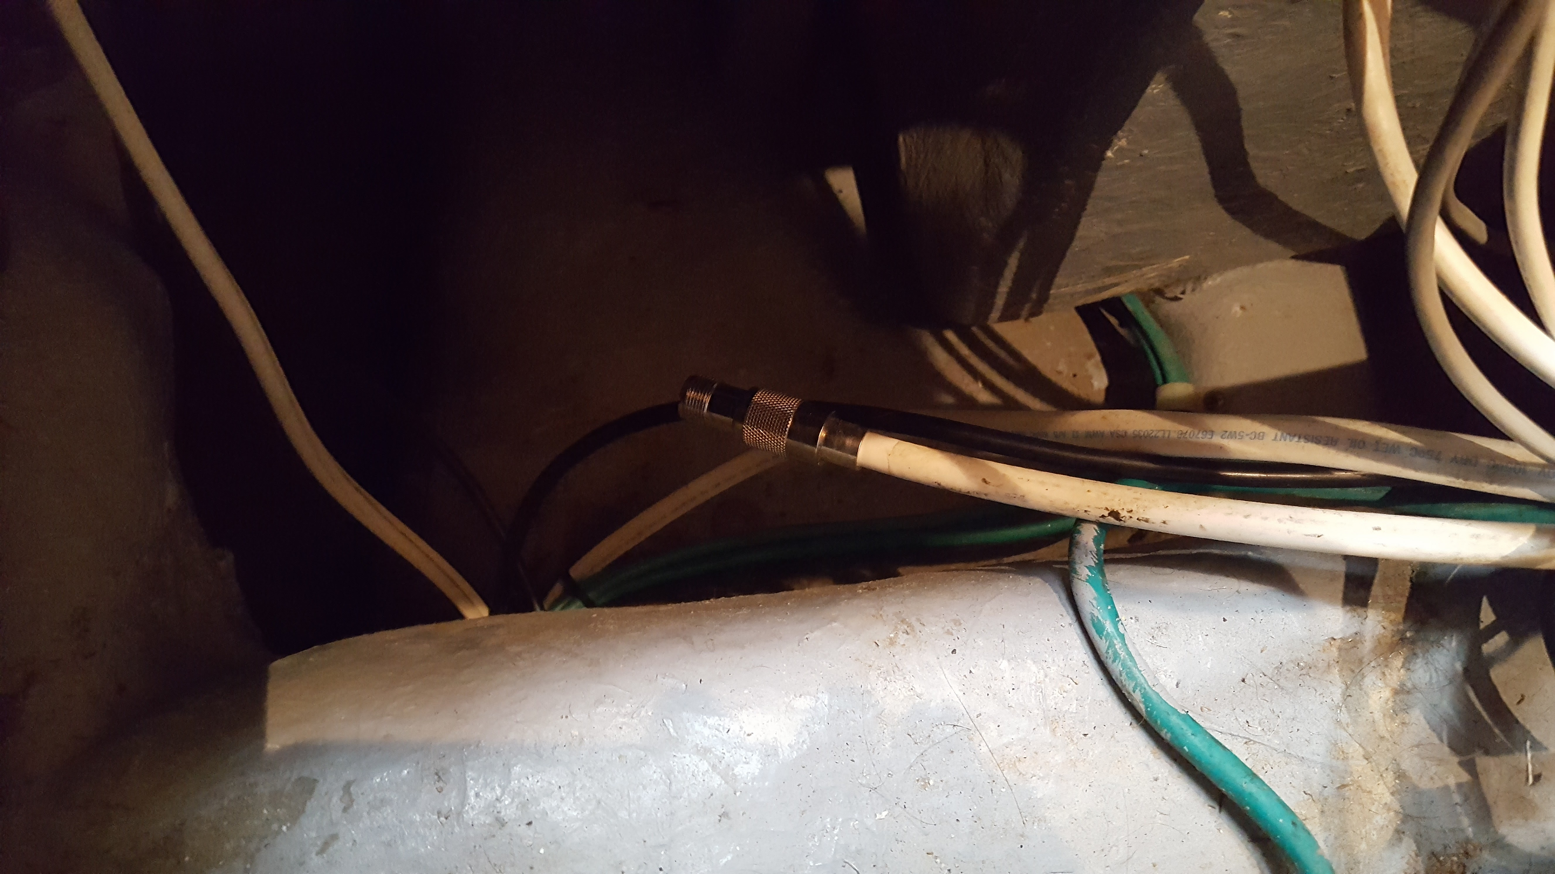
VHF antenna connector in the bilge area

Slide 5
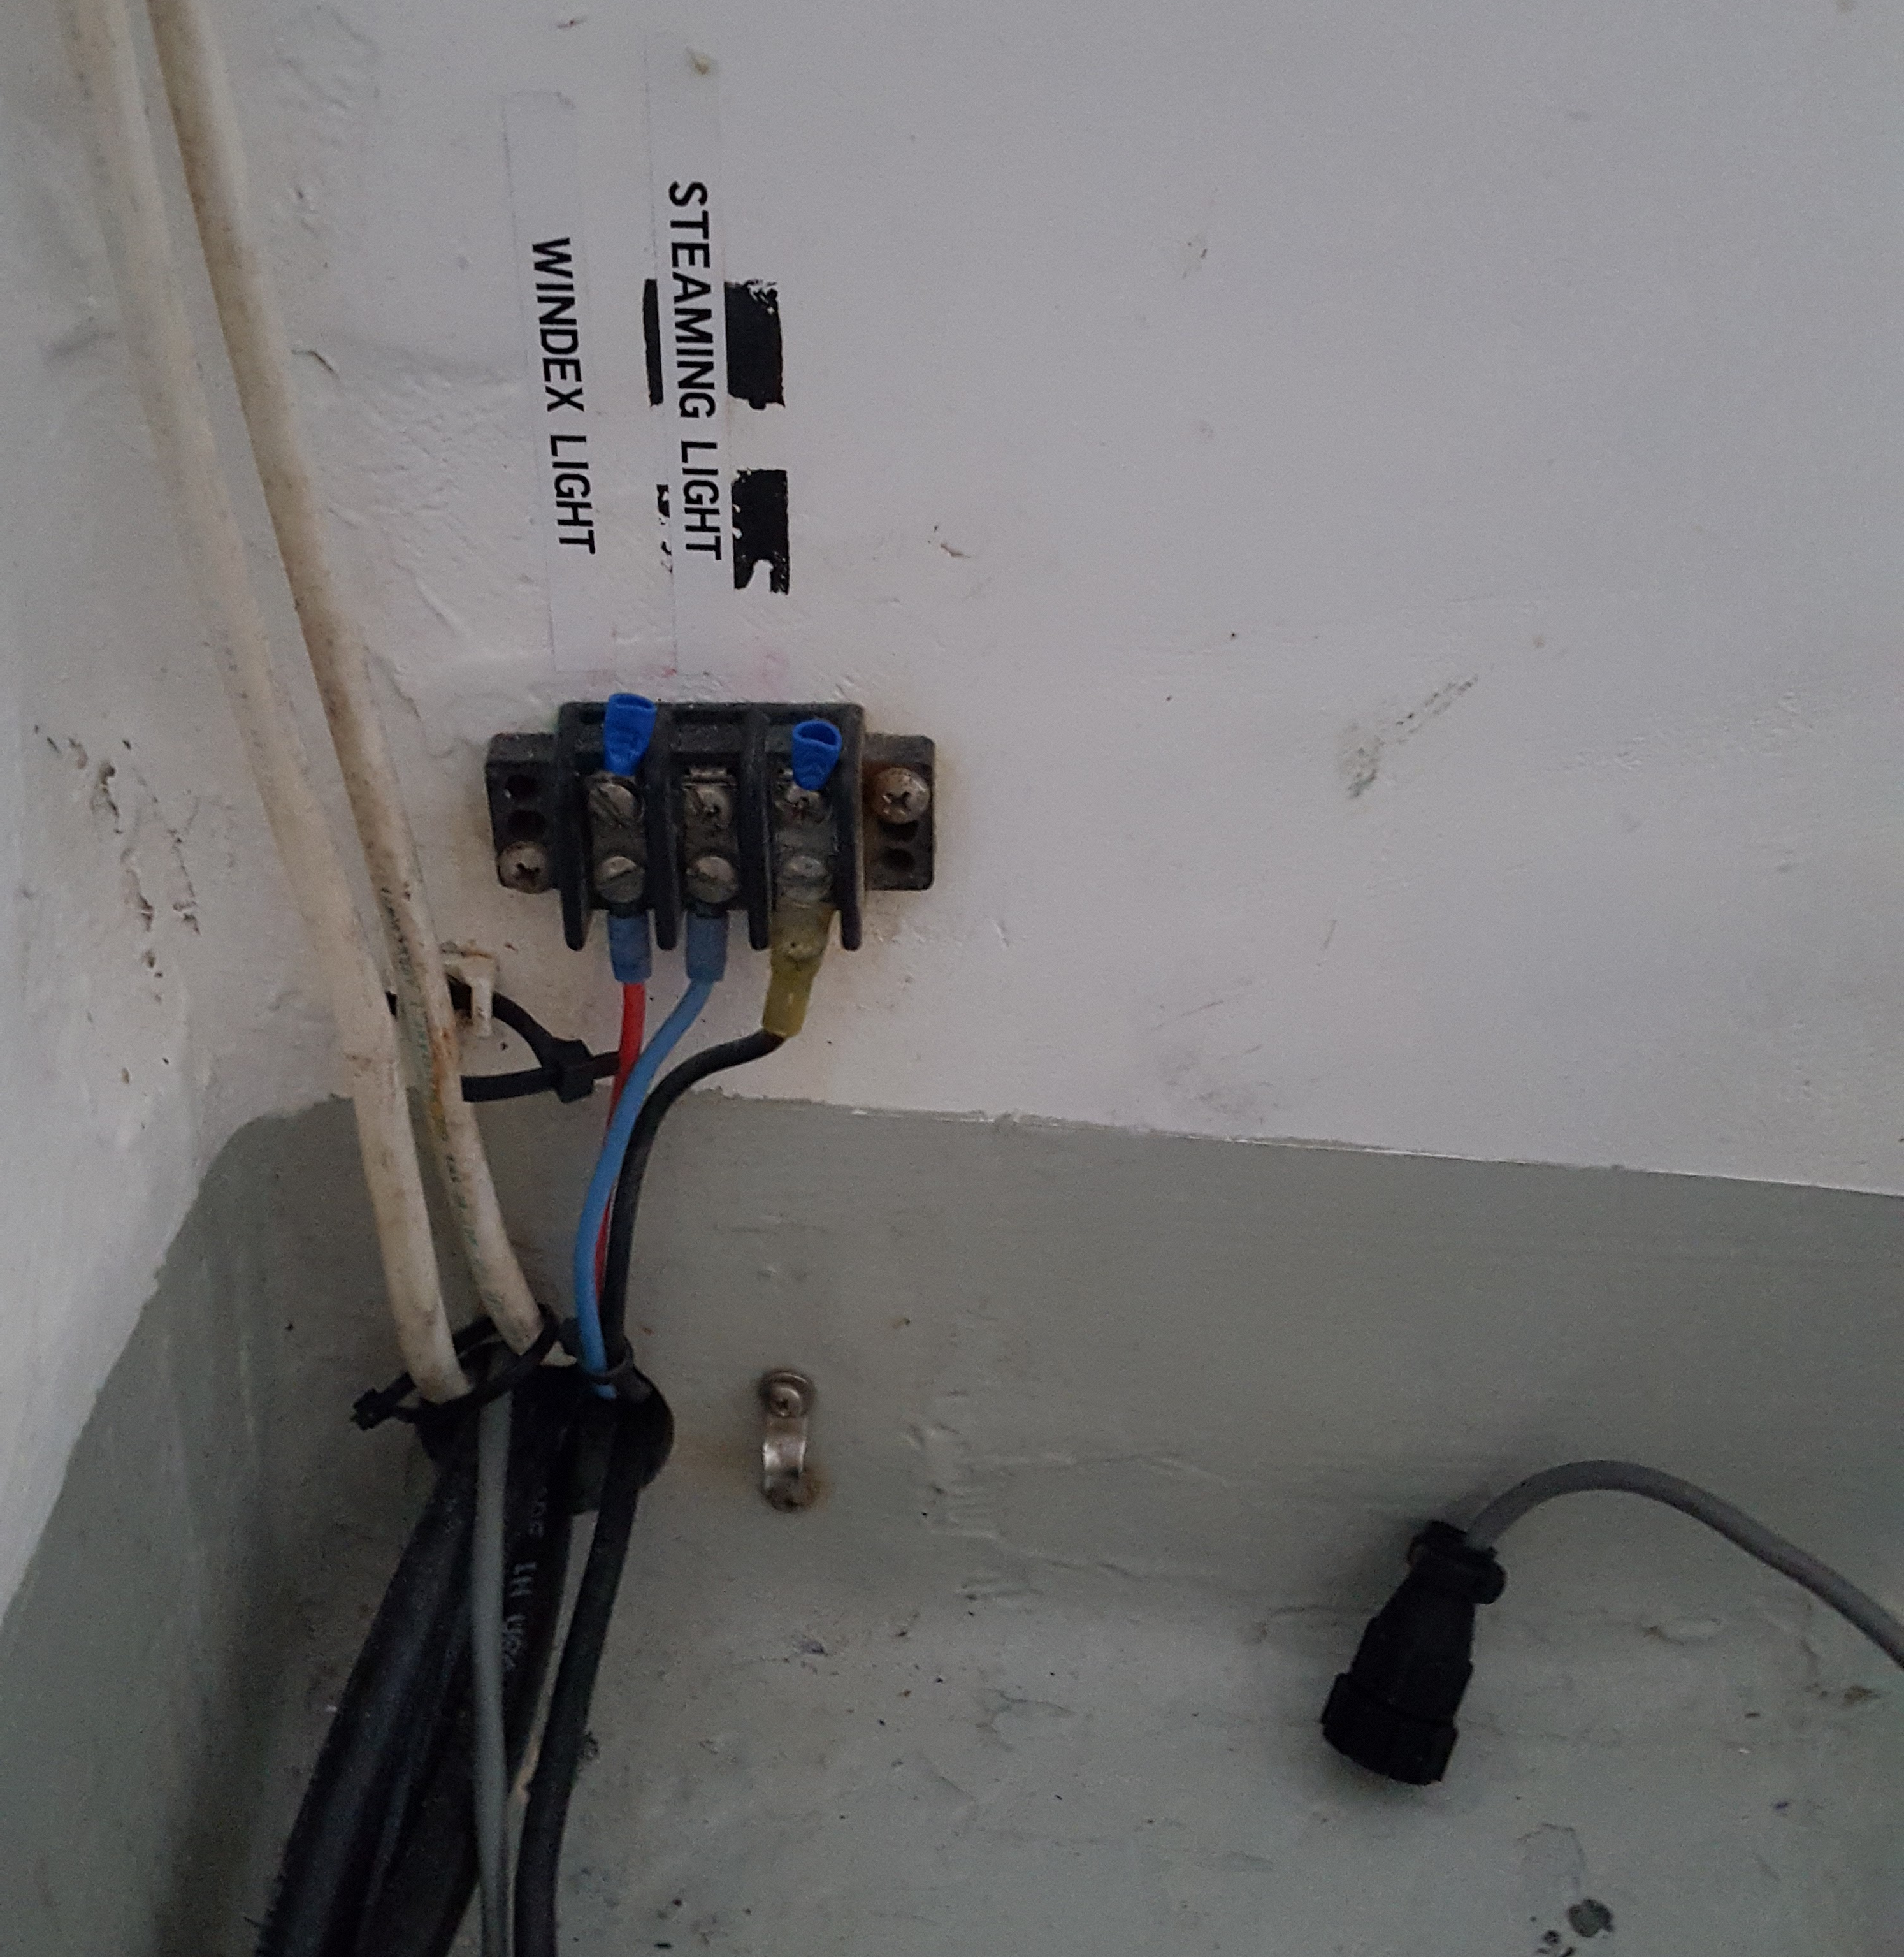
Open terminal strip
near the floor

Slide 6
Common Problems and Solutions
80% of failures are installation related
If it were a car, we would call it a lemon
Keep the water out
Inspect everything
EVERYTHING
Workmanship
Dishes in your cupboard (whaaat?)
Keep complexity below your pain threshold
Know your systems, labels and drawings are helpful!

Slide 7
Common Problems and Solutions
80% of failures are installation related
If it were a car, we would call it a lemon
Keep the water out
Inspect everything
EVERYTHING
Workmanship
Dishes in your cupboard (whaaat?)
Keep complexity below your pain threshold
Know your systems, labels and drawings are helpful!

Slide 8
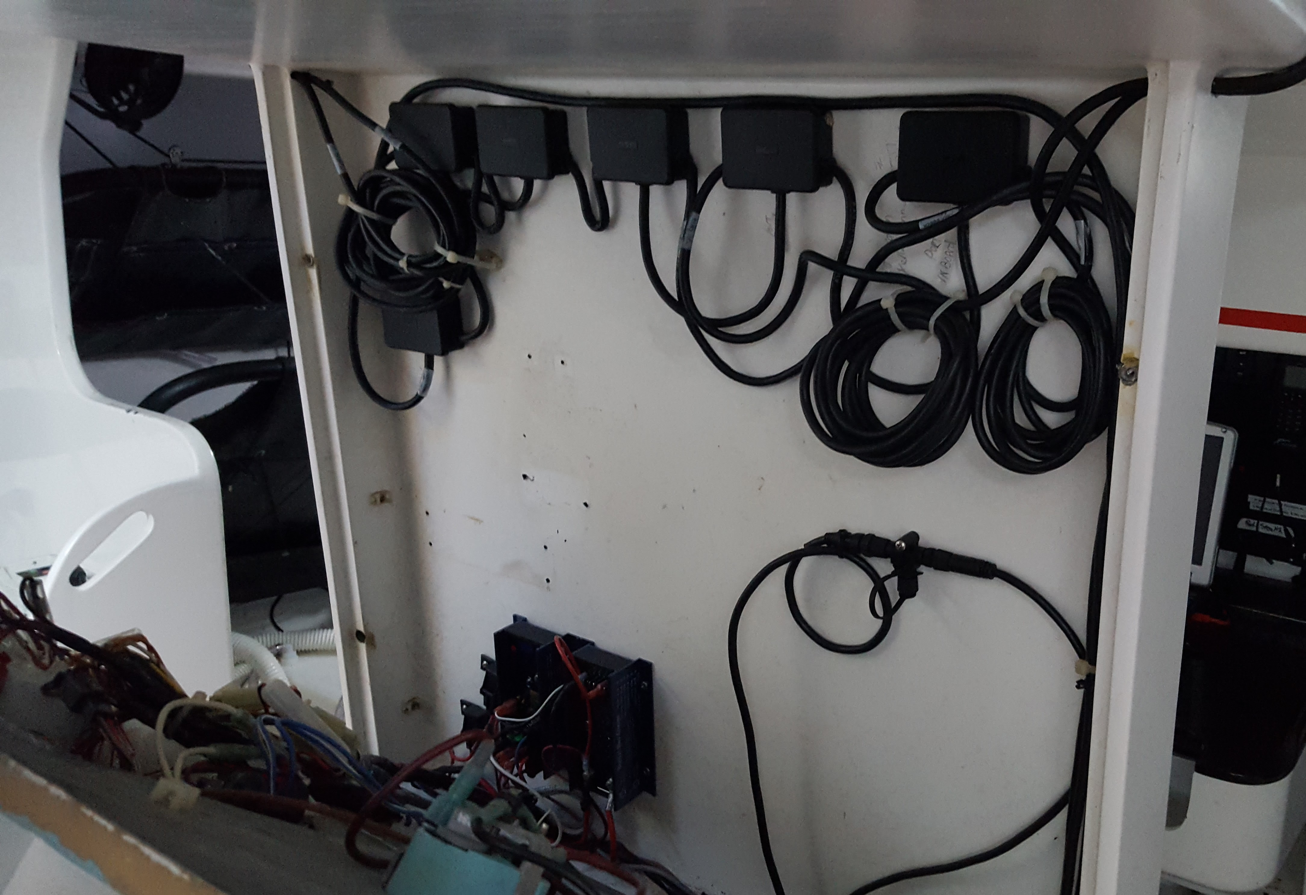
Chaos

Slide 9
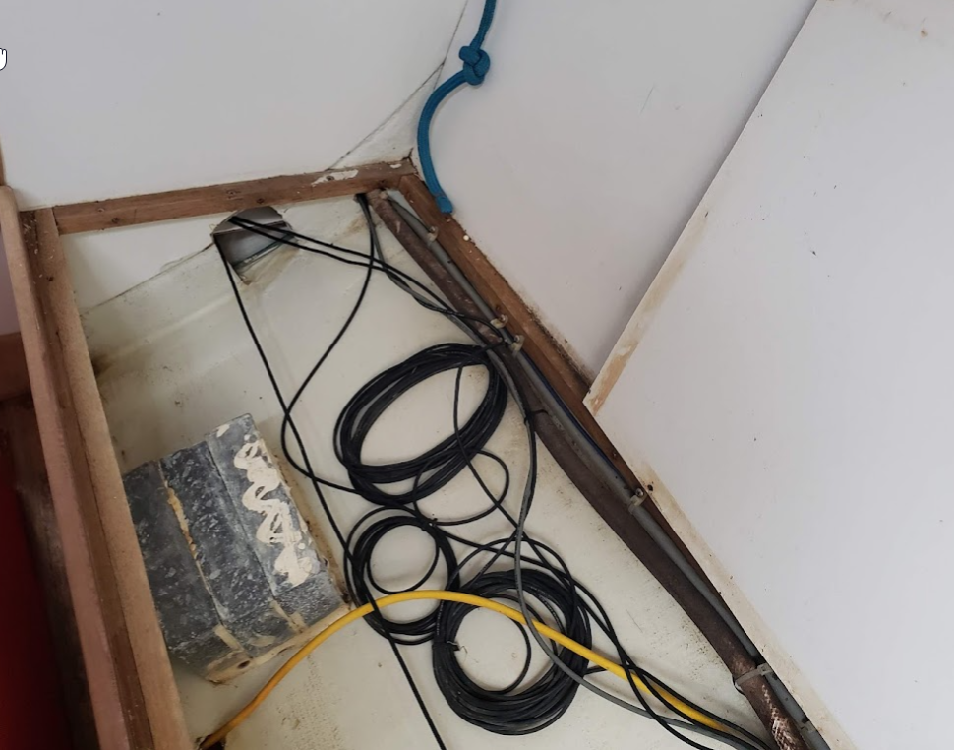

Slide 10
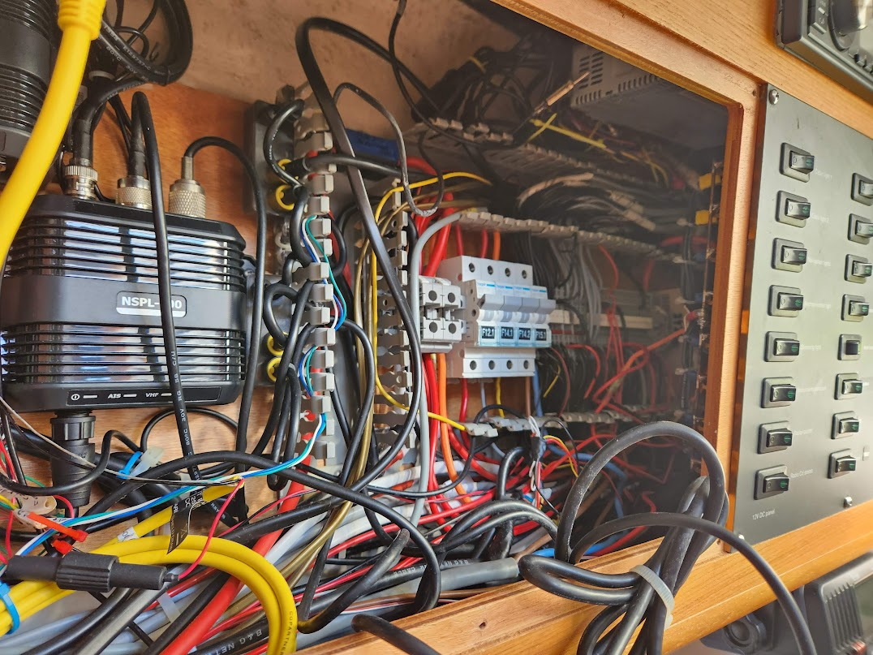

Slide 11
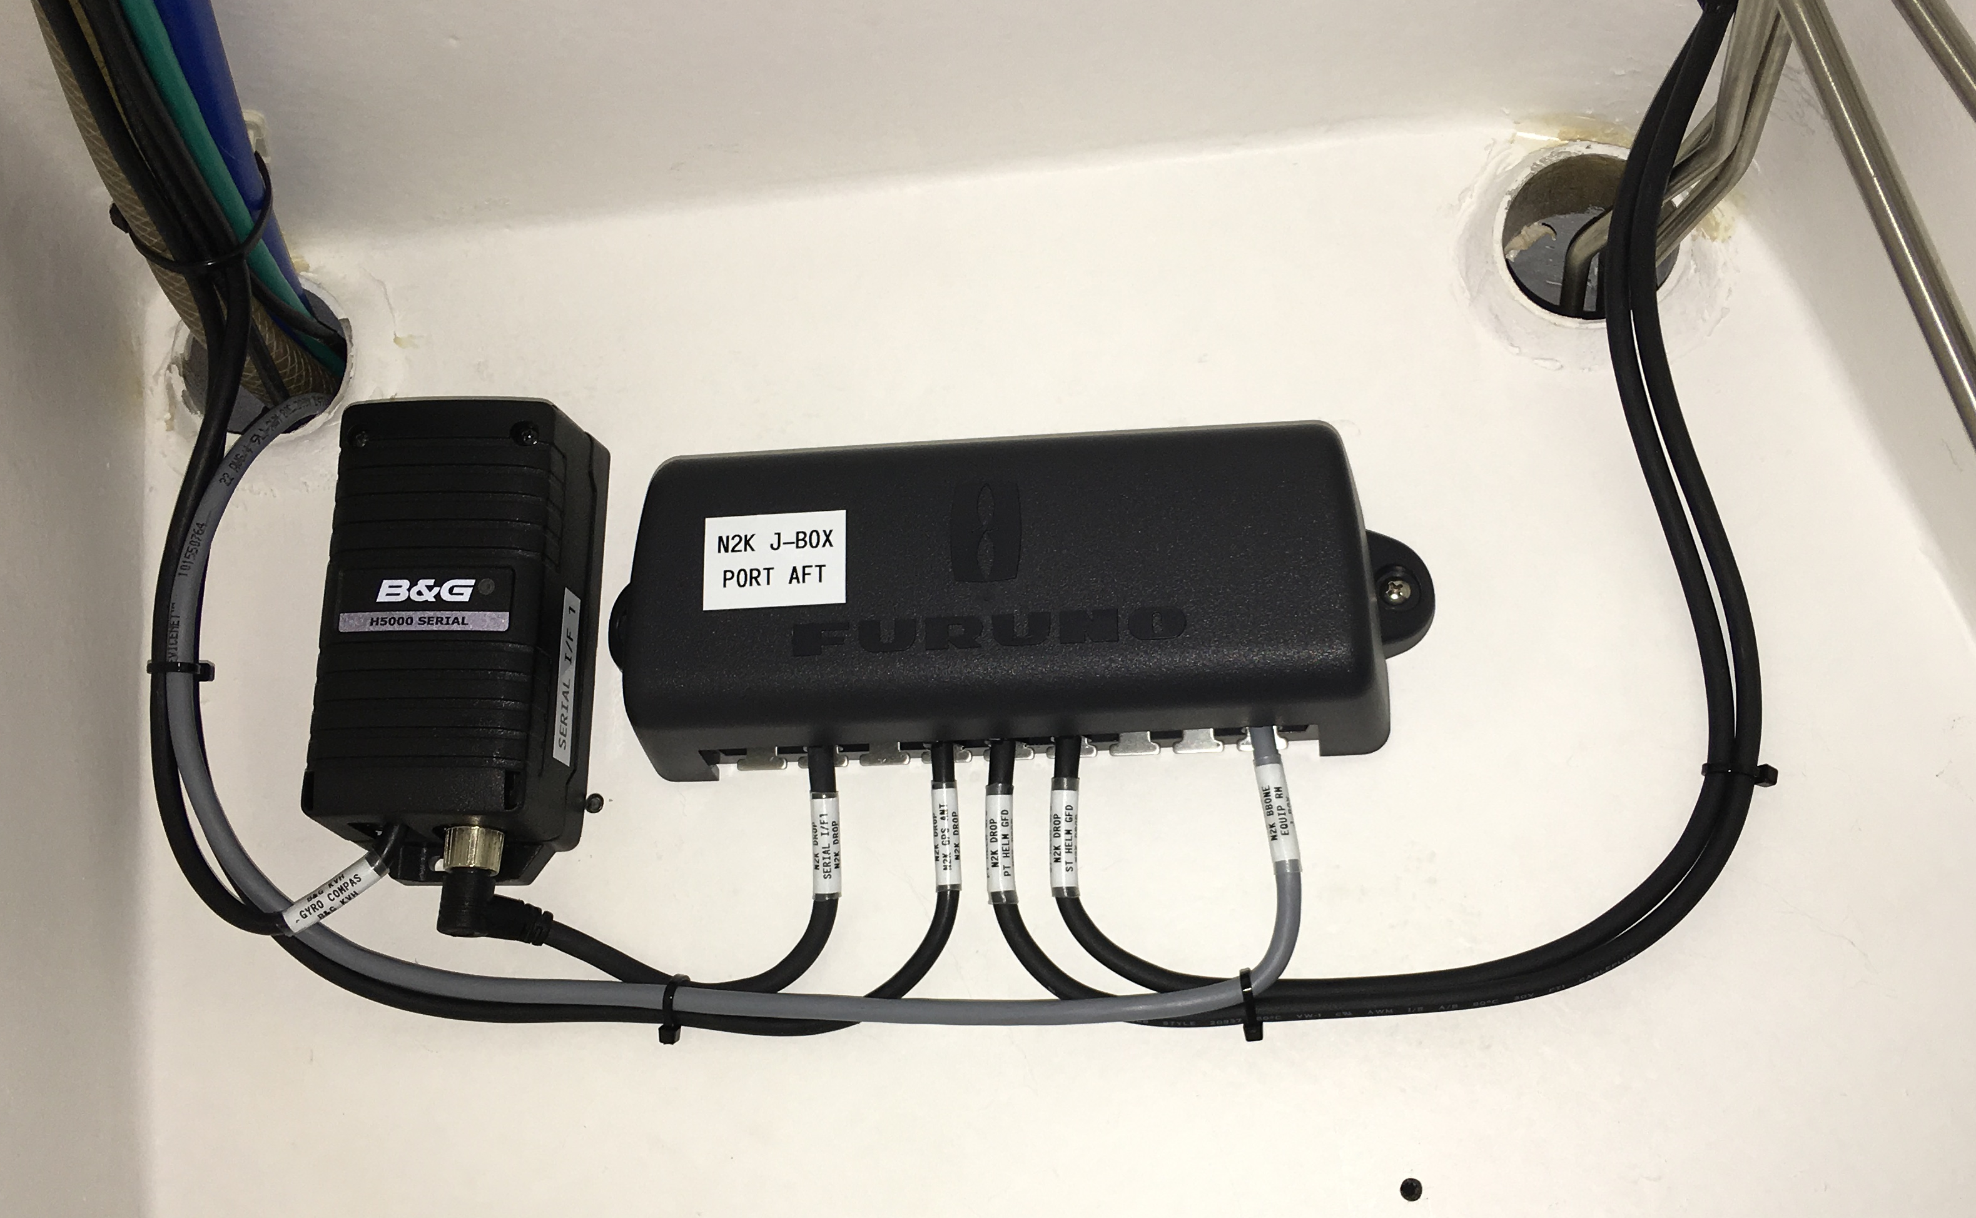
Peace and harmony

Slide 12
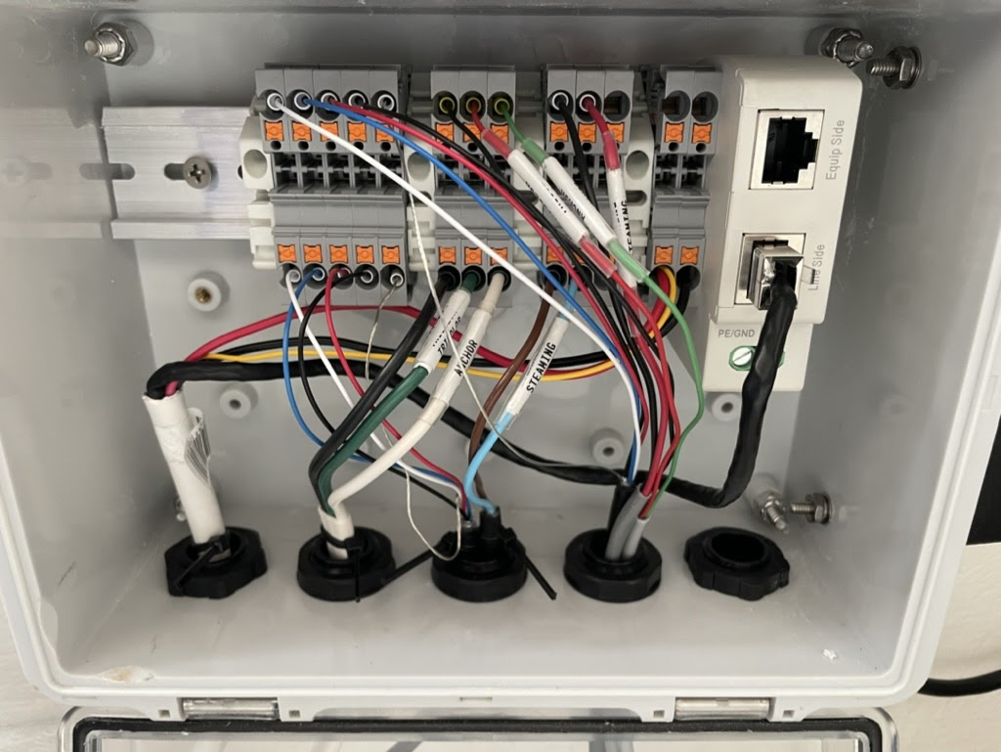

Slide 13
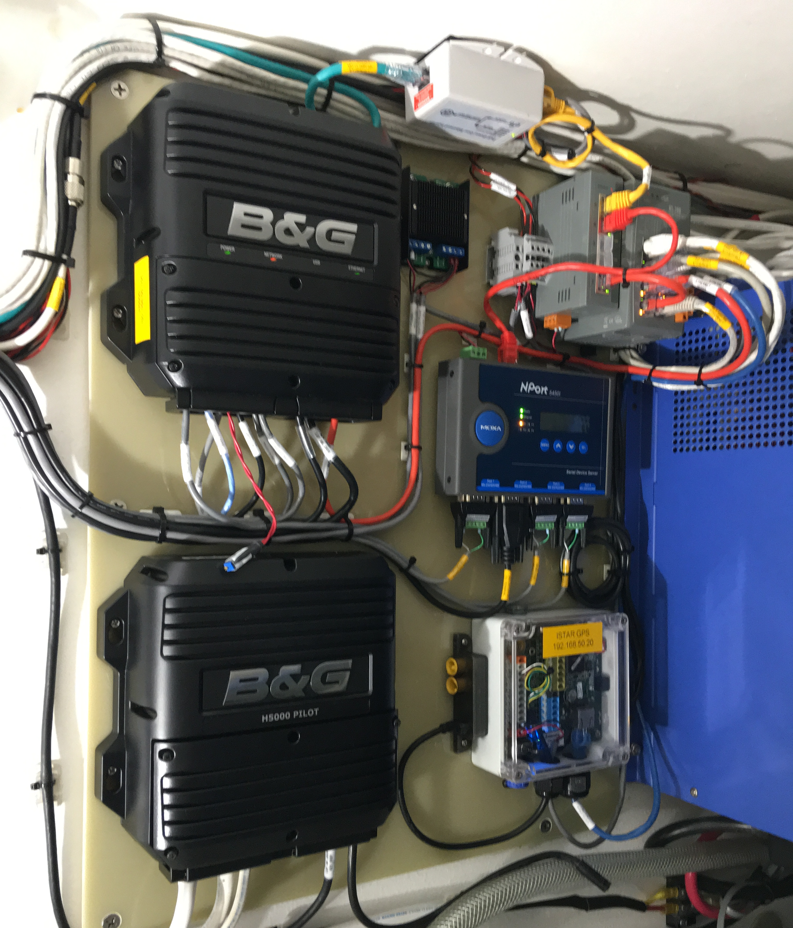
Ta Da

Slide 14
Common Problems and Solutions
80% of failures are installation related
If it were a car, we would call it a lemon
Keep the water out
Inspect everything
EVERYTHING
Workmanship
Dishes in your cupboard (whaaat?)
Keep complexity below your pain threshold
Know your systems, labels and drawings are helpful!

Slide 15
Common Problems and Solutions
80% of failures are installation related
If it were a car, we would call it a lemon
Keep the water out
Inspect everything
EVERYTHING
Workmanship
Dishes in your cupboard (whaaat?)
Keep complexity below your pain threshold
Know your systems, labels and drawings are very helpful!

Slide 16
Pac Cup Power Plan
Power Plan Template
www.pacificcup.org >
RESOURCES >
Knowledgebase >
Energy Management
How to find the information you need
Forget the spec sheets, test it yourself
Energy monitor with shunt
Appropriate redundancy/contingency/spares
Wire offcuts, connectors, tape, tools, belts, shear pins
Power production issues , failures

Slide 17
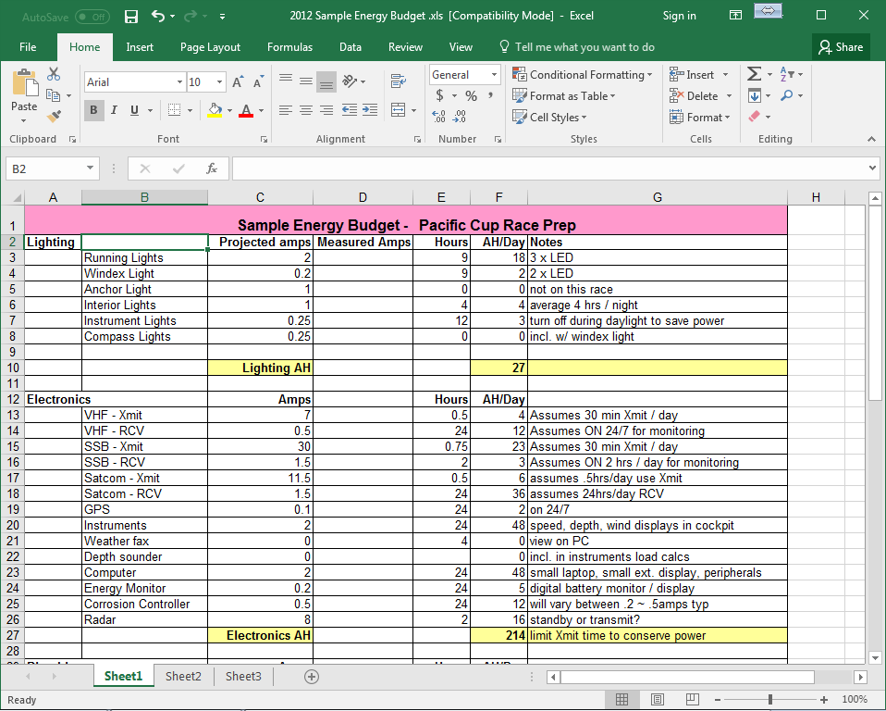
2012 Sample Energy Budget.xls

Slide 18
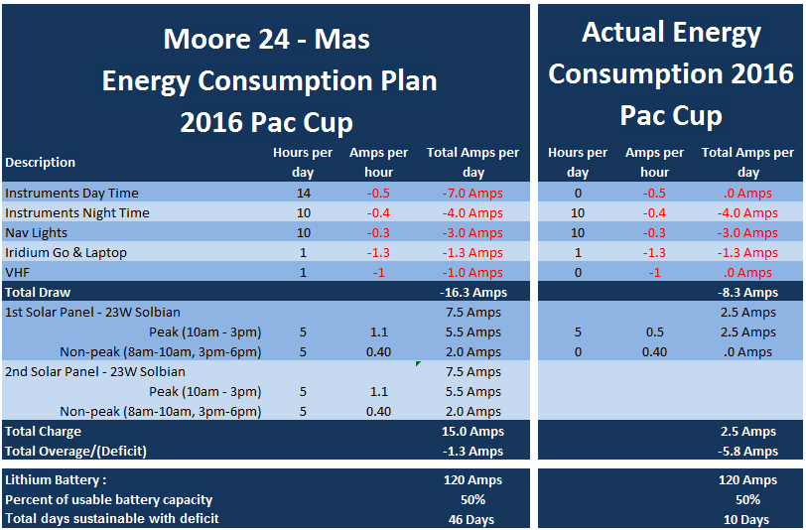
Mas

Slide 19
Pac Cup Power Plan
Template
www.pacificcup.org >
RESOURCES >
Knowledgebase >
Energy Management
How to find the information you need
Forget the spec sheets, test it yourself
Energy monitor with shunt
Appropriate redundancy/contingency/spares
Wire offcuts, connectors, tape, tools, belts, shear pins
Power production issues , failures

Slide 20
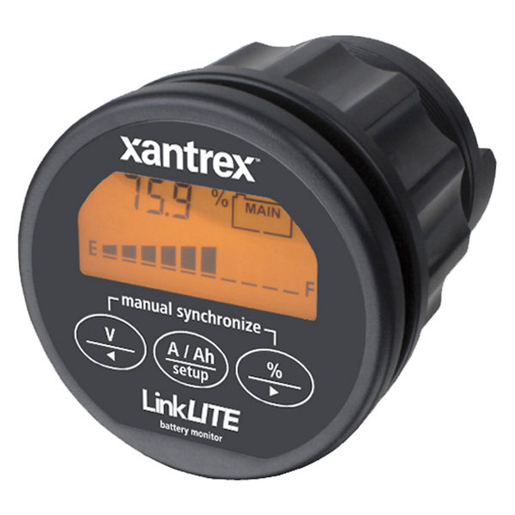
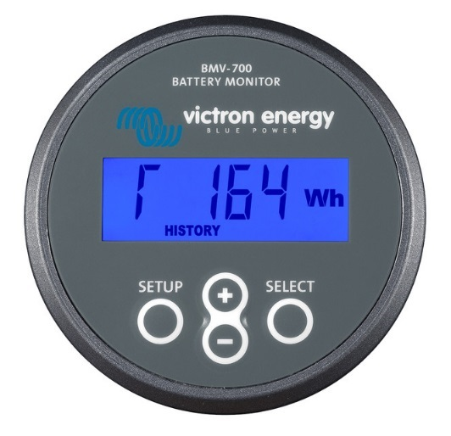
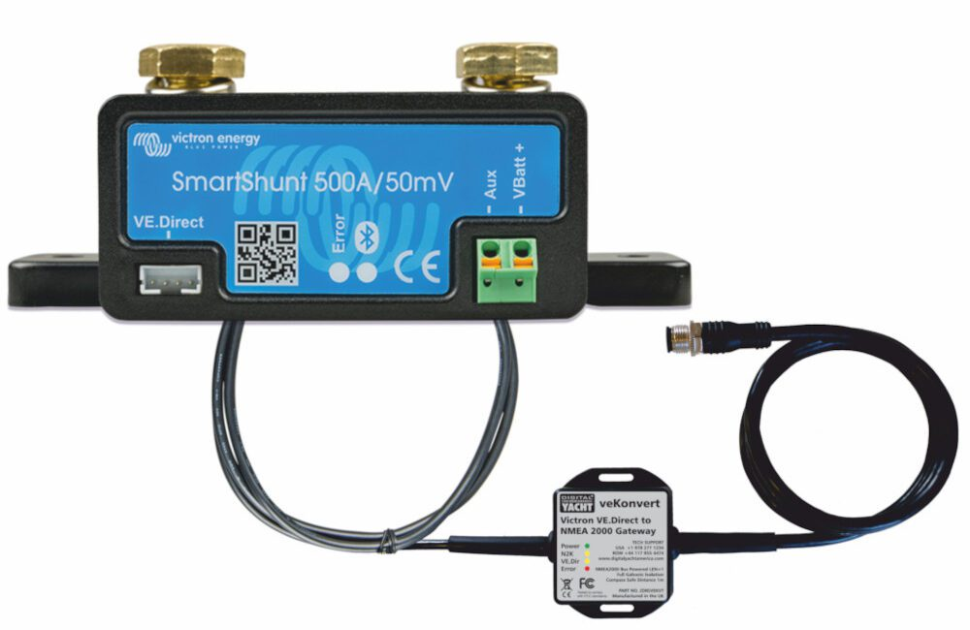
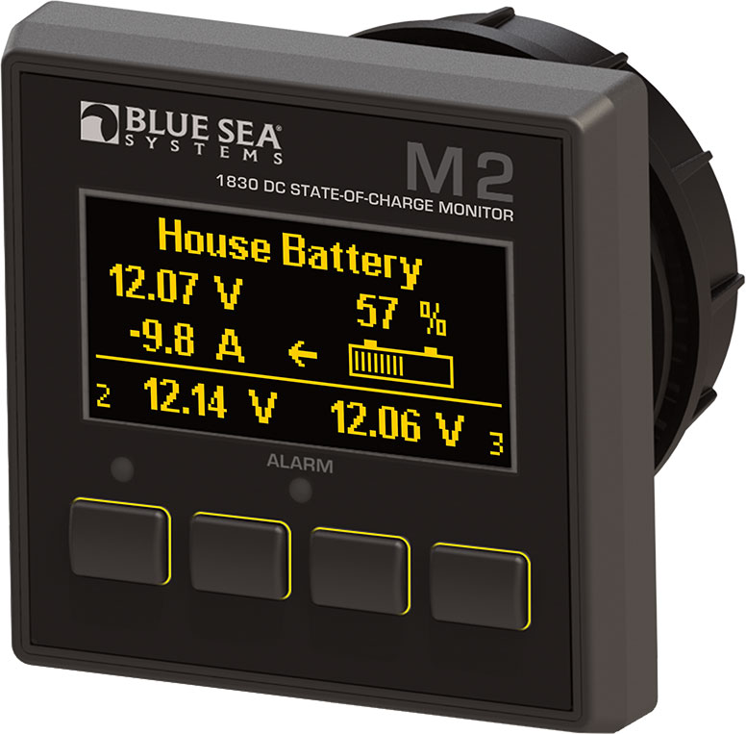
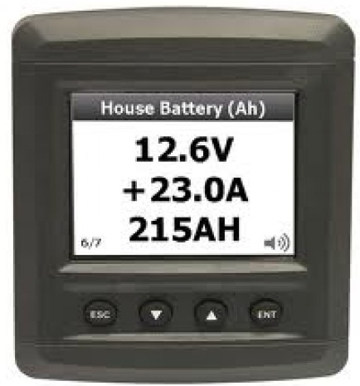

Slide 21
Pac Cup Power Plan
Template
www.pacificcup.org >
RESOURCES >
Knowledgebase >
Energy Management
How to find the information you need
Forget the spec sheets, test it yourself
Appropriate redundancy/contingency/spares/tools
Wire offcuts, connectors, NMEA2000, tape, tools, belts, shear pins
Multimeter, clamp meter
Power production issues , failures

Slide 22
Pac Cup Power Plan
Template
www.pacificcup.org >
RESOURCES >
Knowledgebase >
Energy Management
How to find the information you need
Forget the spec sheets, test it yourself
Appropriate redundancy/contingency/spares
Wire offcuts, connectors, tape, tools, belts, shear pins
Power production issues, failures

Slide 23
Testing and Seatrials
Test test test
Alternator output rating
Seatrials
Seat time, email, radios, AIS, computer
Get it done early

Slide 24
Testing and Seatrials
Test test test
Alternator output rating
Seatrials
Seat time, email, radios, AIS, computer
Get it done early

Slide 25
Communications
Satellite
Starlink
Flat High Performance
Iridium
GO! Email / text / phone
GO Exec Email / text / phone / internet (IP)
Certus Email / text / phone / internet (IP)
Inmarsat
SSB and Modem
Not monitored in 2024, useful for emergency
VHF and AIS
Not required 24/7, but a good idea
DSC
Emergency antenna required
Coax loss calculator

Slide 26
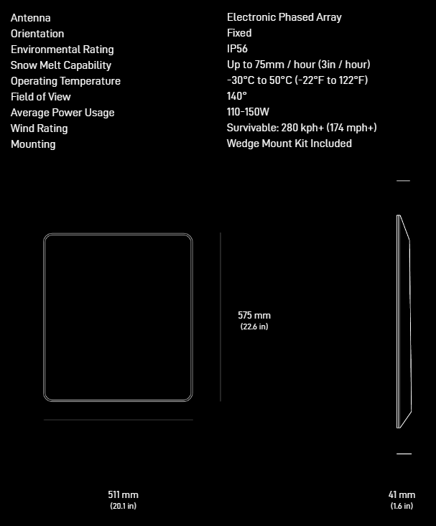
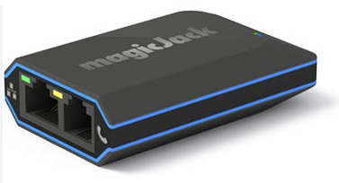
Communications
Satellite
Starlink
Big
100w
Extra parts for DC
Voice comms
VOIP/SIP
Wifi calling

Slide 27
Communications
Satellite
Starlink
Iridium
GO! Email / text / phone
GO Exec Email / text / phone / internet (IP)
Certus Email / text / phone / internet (IP)
Inmarsat
SSB and Modem
Not monitored in 2024, useful for emergency
VHF and AIS
Not required 24/7, but a good idea
DSC
Emergency antenna required
Coax loss calculator

Slide 28
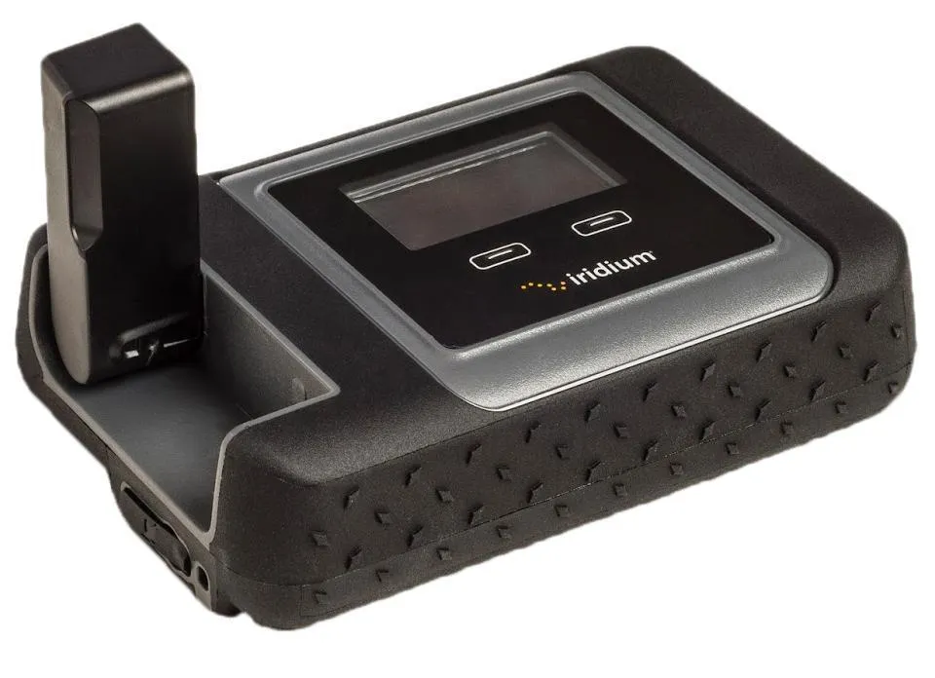
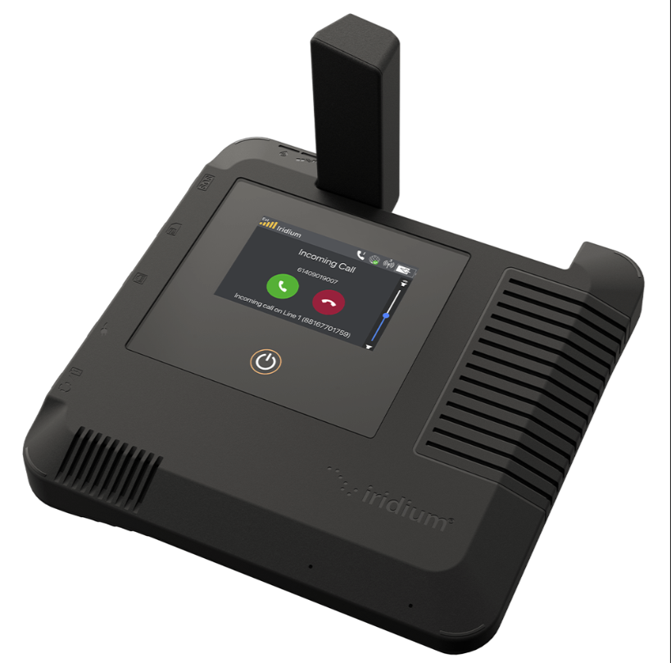
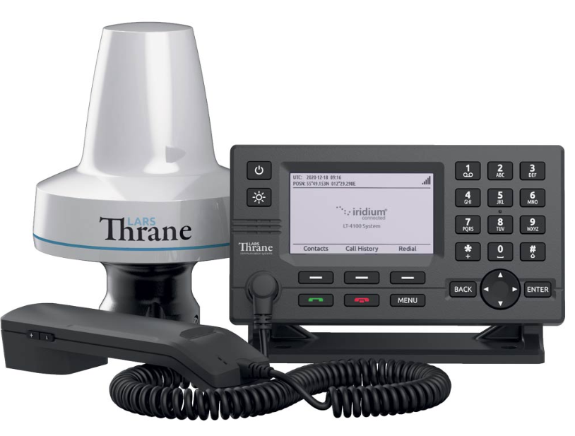
Communications
Satellite
Iridium
GO!
GO Exec
Certus

Slide 29
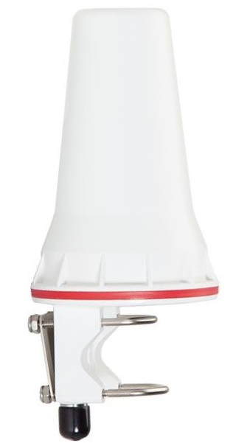
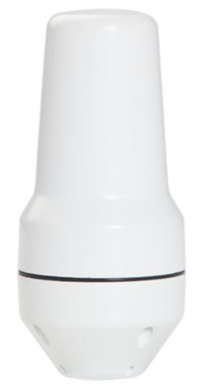
Communications
Satellite
Iridium
GO!
GO Exec
Certus 100
use LMR-400 coax

Slide 30
Communications
Satellite
Starlink
Iridium
GO! Email / text / phone
GO Exec Email / text / phone / internet (IP)
Certus Email / text / phone / internet (IP)
Inmarsat
SSB and Modem
Not monitored in 2024, useful for emergency
VHF and AIS
Not required 24/7, but a good idea
DSC
Emergency antenna required
Coax loss calculator

Slide 31
Communications
Satellite
Starlink
Iridium
GO!
GO Exec
Certus
Inmarsat
SSB and Modem
Not monitored in 2024, useful for emergency
VHF and AIS
Not required 24/7, but a good idea
DSC
Emergency antenna required
Coax loss calculator

Slide 32
Communications
Satellite
Starlink
Iridium
GO!
GO Exec
Certus
Inmarsat
SSB and Modem
Not monitored in 2024, useful for emergency
VHF and AIS
Not required 24/7, but a good idea
DSC
Emergency antenna required
Coax loss calculator

Slide 33
Notes
Lemon Law requires a vehicle manufacturer that is unable to repair a vehicle … after a reasonable number of repair attempts to replace or repurchase the vehicle.

Slide 34
Thanks!
info@farallon.us

