Slide 1

Sail Selection
For 2016 Pacific Cup
Kame Richards / Pineapple Sails
October 17, 2015

Slide 2
Wind Mix Table from 2008

Slide 3
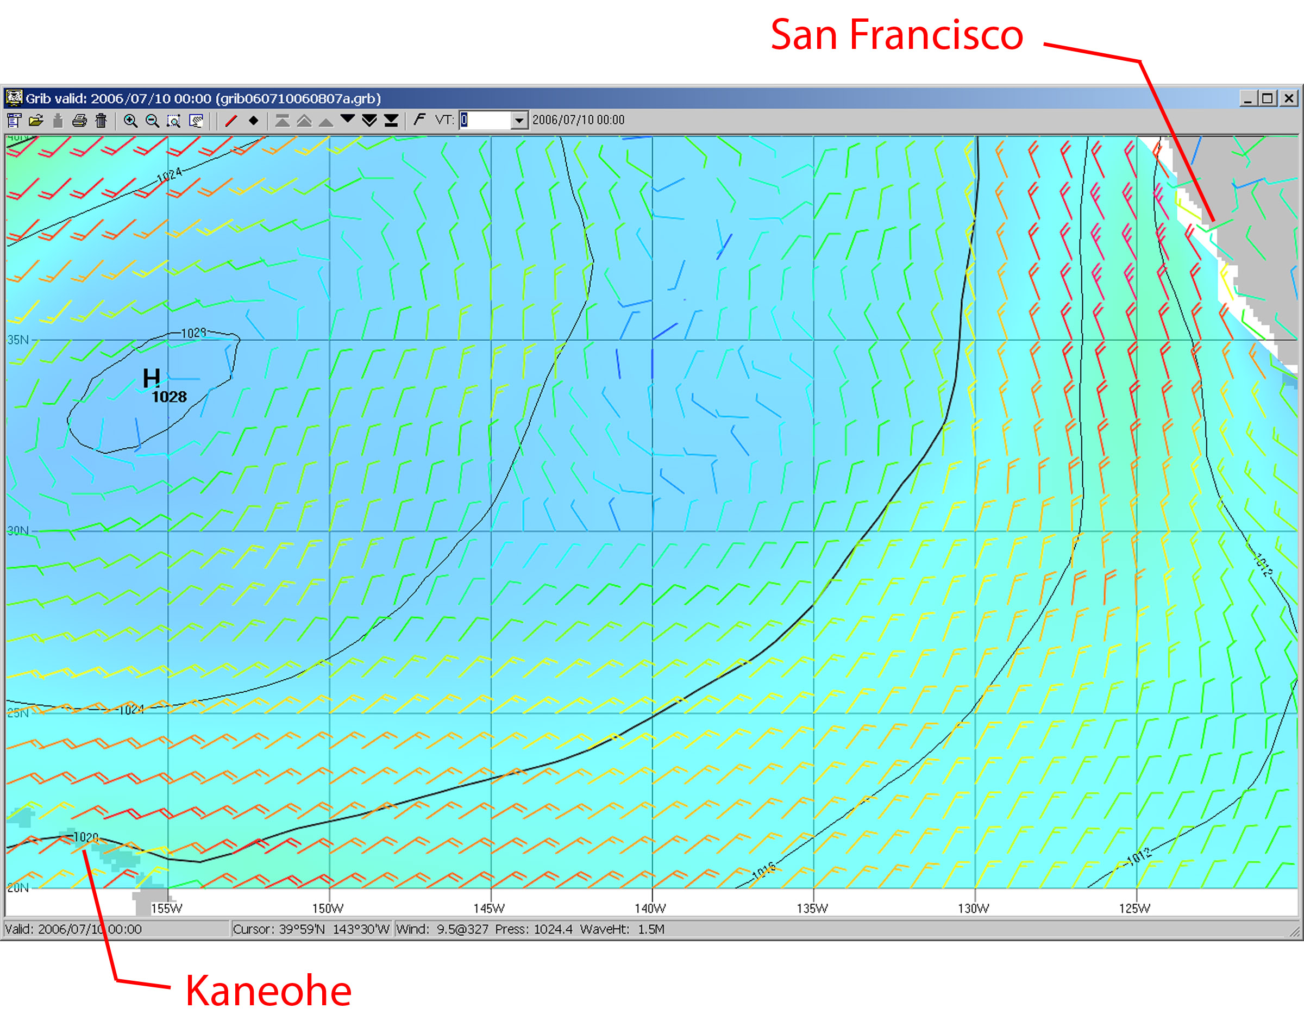
“Typical…” July 10, 2006

Slide 4
“Typical…” July 2015 LA – Honolulu

Slide 5
LEVEL OF PERSONAL COMMITMENT
  Have you done this before?
  Is this a prelude to going cruising?
  How badly do you need/want to win
  Minimum and maximum efforts
  The event should be a LOT of FUN

Slide 6
BUDGETING / PRIORITIES
  Short range / long range
  Upwind sails
  Reaching sails
  Downwind sails

Slide 7
SAIL SELECTION
  Your boat’s performance envelope
  How long/fast is your boat?
  Mainsail: batten length, sail cloth, reefs
  Jibs/genoas: hanks/furling, sail cloth, twin headsails
  Spinnakers: symmetric, asymmetric, reaching, running, sail cloth, spinnaker socks

