Slide 1
Pacific Cup Communications Why, How, When, Who
Michael Moradzadeh
2024 Pacific Cup Communications Chair and Principal Race Officer

Slide 2
Why Communicate?
Safety
Weather
Race Administration
Amusement/Family

Slide 3
WHY Communicate?
Safety
AIS
Make/Receive Distress Calls
Weather information
Medical/Repairs
Rescue Coordination
Weather
Go faster
Avoid bad weather
Race Administration
Daily Reports
Special Reports
Non-Emergency assistance
Instructions
Amusement/Family
Send Updates
Get News
Social Media
Sportsball scores
Fleet Newsletter

Slide 4
Safety
AIS
Good idea all of time. Required w/in 100 mi of finish
May only receive AIS through your own AIS antenna, no relay
Make/Receive Distress Calls
VHF or Cell near shore
EPIRB, Satphone, or SSB offshore
Have USCG numbers and email programmed in
PCYC and others will help how they can
Weather information
NOAA is best source. Must be free and freely available per rules
Medical/Repairs
We allow. Must log. Who YOU gonna call? Pac Cup includes med service
Rescue Coordination
Getting or receiving help… cannot do it in silence

Slide 5
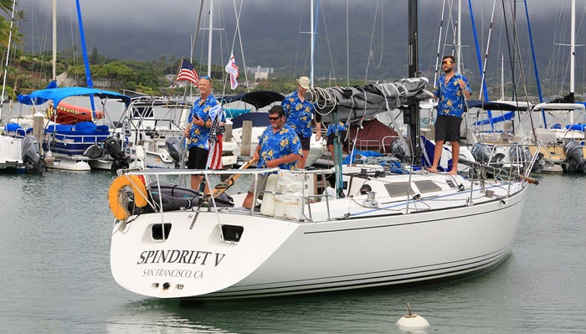
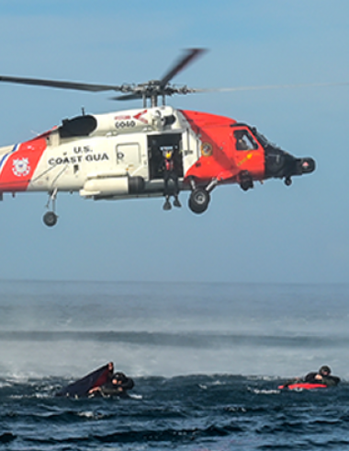
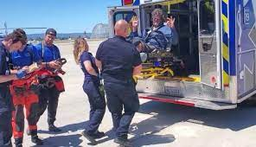
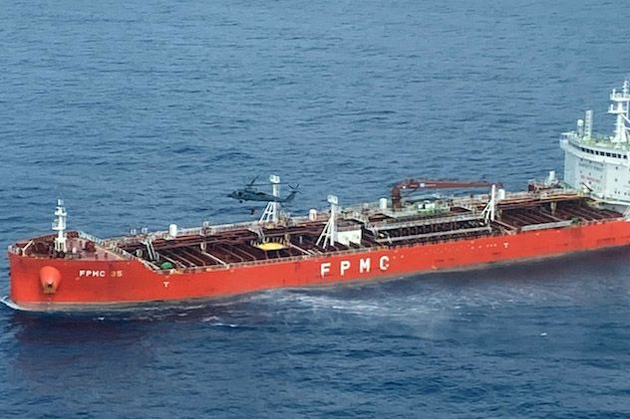
Scary Story to Illustrate my Point

Slide 6
Weather
Go faster
Download GRIBs or Surface Forecasts to see where the good wind will be. Go there.
Reasonable GRIB download is 50kb. 2x/day if casual, 4x or more per day if harder core
Use a visualizing or routing program to help select course
Expedition, OpenCPN, ViewFax, etc.
Avoid bad weather
Watch out for dangerously heavy weather
Watch out for lows,
especially “cut-off” lows
which will suck all the joy out of your day as you bob helplessly
For several days until you finally decide to start the motor, in which case
The wind will pick up
Or you will run out of fuel

Slide 7
Race Administration
Daily Reports
Required by NOR and SI: 0800 position plus some sort of report
Reports of interest will go into “fleet newsletter”
If your YB tracker fails, we will require more frequent
Special Reports
PCYC may send out special reports
You may need to log protest, or med assistance etc
Non-Emergency assistance
Keep PCYC informed of developing conditions not amounting to mayday
Instructions
We may need to instruct you to do something, like do not finish if there’s a storm

Slide 8
Amusement/Family
Send Updates
They want to hear from you. So do we.
Get News
How is Aunt Sadie?
Social Media
Post directly to your SM of choice
Sportsball scores
How did Wrexam do in their footie match against MU?
Fleet Newsletter
Replacement for “Children’s Hour” it’s a virtual sharing of experiences

Slide 9
Right Tool – Right JoB
Near shore / Boat to Boat
VHF
Up to 75 mile range with masthead
It’s expected
Leave on with DSC
Cellphone also works
Offshore
Sat Device
Iridium Go
Iridium Exec
Starlink
SSB
Does not meet telephone requirement
Inreach
Awesome tool. Does not meet email requirement
Great for social and texting
SPOT
Does not reliably reach all the way to Hawaii
Emergency Comms
EPIRB
VHF
Offshore Comm System

Slide 10
Cautions
Pick and get to know your systems NOW!
Iron out the nits
DO NOT be the only one that knows how it all works
DO NOT have the sole access be via a password-protected device
And do not keep that device in your damn pocket
Pay for that extra month or two and practice using the system
Some vendors (e.g OCENS) have monthly plans, others, annual.

Slide 11
Computer
Need for weather routing and email, generally
Windows has greatest range of compatibility
If password needed, post on computer.
Try for low power and rugged. ASUS student computers make sense. Cheap, too.
Full advice on KB paper. https://pacificcup.org/kb/pc

