Slide 1
2018 PACIFIC CUP OFFSHORE ACADEMY MARINE WEATHER BASICS

Slide 2
Notes:
As a former mariner, I have over 70,000 nautical miles under my keel on various platforms from aircraft carriers to brigantines, to sail & power boats.
I go to sea EVERY YEAR to keep in touch with a mariner’s realities.

Slide 3
Lee Chesneau-Brief Bio
BS Meteorology (called Atmospheric Science today), University of Wisconsin, Madison, WI-Varsity Swimming & ROTC Scholarships.
U.S. Navy Fleet Officer of the Deck (Two Aircraft Carriers- USS Saratoga CV-60 & USS Guam LPH-9)-patrolled all major ocean basins of the world.
Ocean Routes, Inc, Palo Alto, CA-World wide commercial vessel Weather Forecasting & Routing.
NOAA’s Satellite Service, Anchorage, AK- Satellite Meteorologist.
USN Fleet WX Centers Rota, Spain, -Marine forecaster; Norfolk, VA & Honolulu, HI- Marine Forecaster & Ship Router
NOAA/NWS Forecast Office, Seattle, WA- Marine Forecaster
NOAA/NWS Ocean Prediction Center, Camp Springs, MD- Senior Marine Forecaster
Weather Trainer& Educator (MITAGS, PMI, STAR Center, Harry Lundeberg School of Seamanship, & other schools & trade shows tailored to the recreational cruising and boat racing community).
Author: HEAVY WEATHER AVOIDANCE, The use and application of 500 Mb Charts.
Authored numerous articles for trade publications and magazines.
Over 44 years experience predicting weather at sea as well on land.
Notes:
PhD of 44+ years of experience!

Slide 4
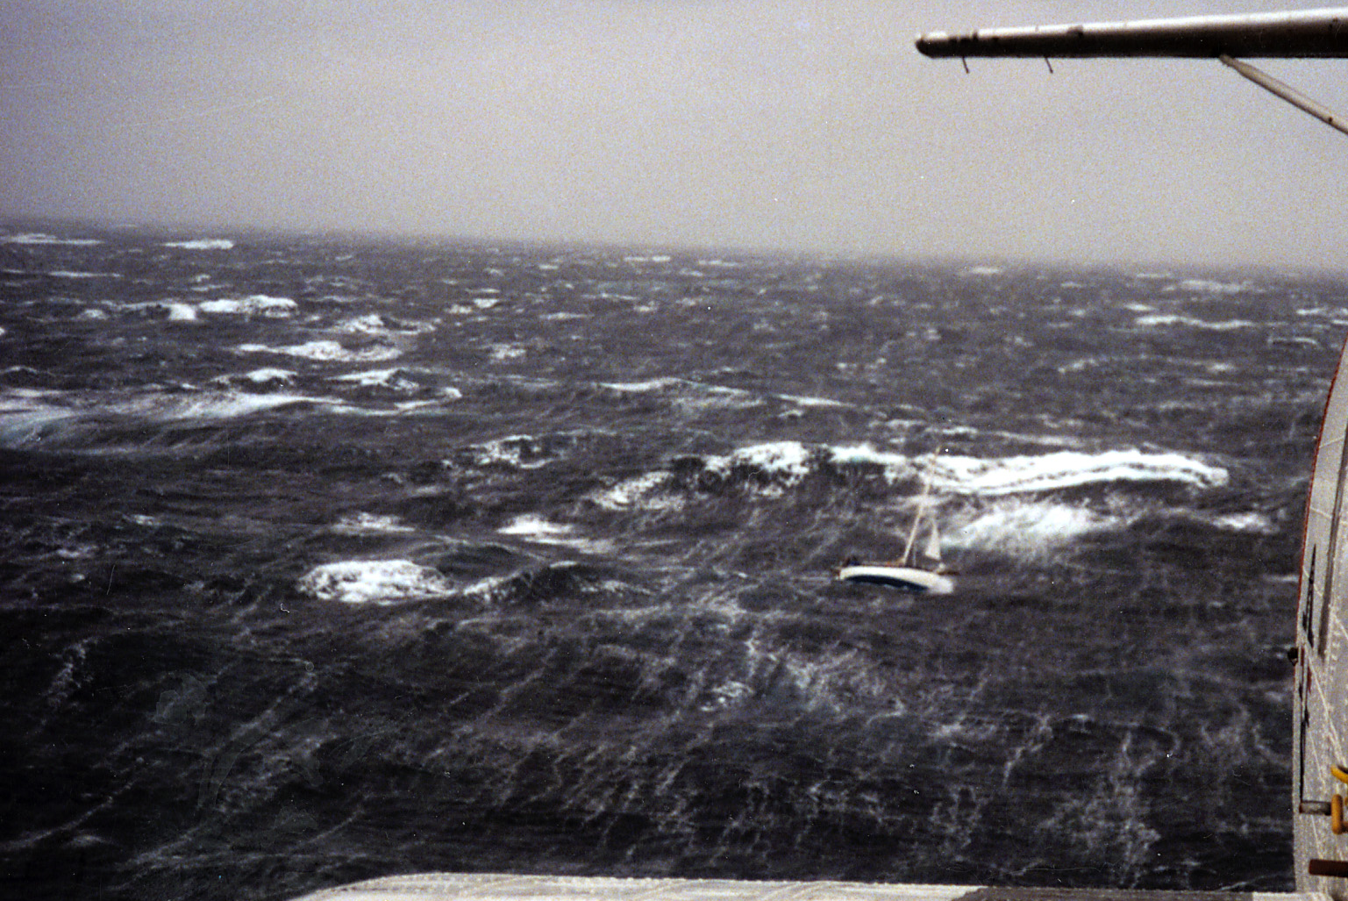
Why is this Important to You?
Notes:
As we you look at this picture, ask yourself “Is this a good decision”? This photograph was taken from a US Coast Guard rescue C-130 aircraft and the sailboat looks to be pretty serious weather. Of course not! You typically have forecasts available 4 to 5 days in advance to avoid this mess.
When the Coast Guard has to go out and rescue a bad decision, sometimes they lose assets too. You must understand time and motion with the weather, time and motion with your boat, your boat handling characteristics along with your seamanship skills. Because in the end it is about wind and waves and how your boat responds to the wind and waves. However, we are not concerned about Bluewater we are also concerned about anchorages. Anchorages that are exposed to the open sea.
So you must recognize, not only is this a bad decision, but its impacting an awful lot of people from love ones ashore to the Coast Guard that has to take the risk to go out and rescue a very bad decision.
This module describes the role of wind and wave formation. Forget Hollywood and all its meteorites crashing in to the sea and flooding of the Ohio Valley. Wind is the primary generator of moving water in the ocean and that moving water is a in the form of currents or it is in the form of waves.
The importance of wind force and wave formation will be discussed. The importance of wind duration in wind wave generation. The importance of a term call fetch in the growth of waves. The relationship between what you see locally as wind driven wave versus a wave that’s been generated by a storms distant wind and propagates and great circle paths to what is known as swell. Wind waves and swell waves do coexist almost 100% of the time in one fashion or another.
Wind waves, when they leave their source of origin and travel and great circle paths as swell waves don’t maintain their characteristic wave height, length and period, they begin the process of decay but they never completely eliminate themselves until they run into a direct opposing force and that is land. And most of the time, your boat is between the wave and land.

Slide 5
Marine Wind Advisories & Warnings
Never leave the dock without knowing which NWS marine advisories & warnings have been issued!!
Environment Canada- Strong Wind Advisory & U.S. National Weather Service (NWS)… Small Craft Advisory – Issued for local coastal & inland waters only, for 20-33 knots, sustained, seas (combined wind & swell waves – 5, up to 10 feet).
Gale Warning – 34-47 knots sustained.
Storm Warning – 48-63 knots sustained.
Hurricane Force Warning – 64+ knots.
Notes:
A mariner should…Never leave the dock without knowing which NWS marine advisories & warnings have been issued!!

Slide 6
Do You Understand Wind Flow Around Low and High Pressure Systems?
Northern Hemisphere
L
H
Southern Hemisphere
L
H
Notes:
6

Slide 7
The “Wind Feathers” represent the speed of the winds, and are located at the end of the “Staff”. (1.) 1.A full “Feather” indicates 10 knots (2.) A half “Feather” indicates 5 knots (3).A “Pennant” indicates 50 knots.

Slide 8
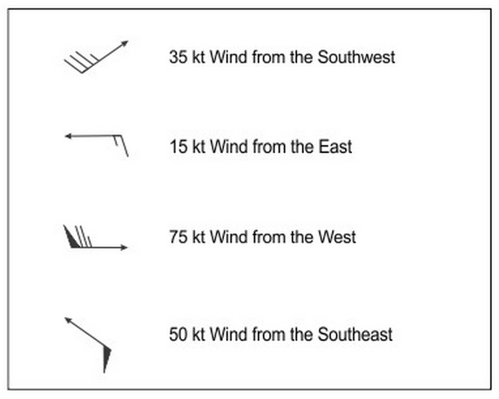
Interpretation of Wind Barbs…Feathers Always Point Toward Lower Pressure (Away From Higher Pressure)
Notes:
Feathers always point toward lower pressure values & away from high pressure values; both hemispheres.

Slide 9
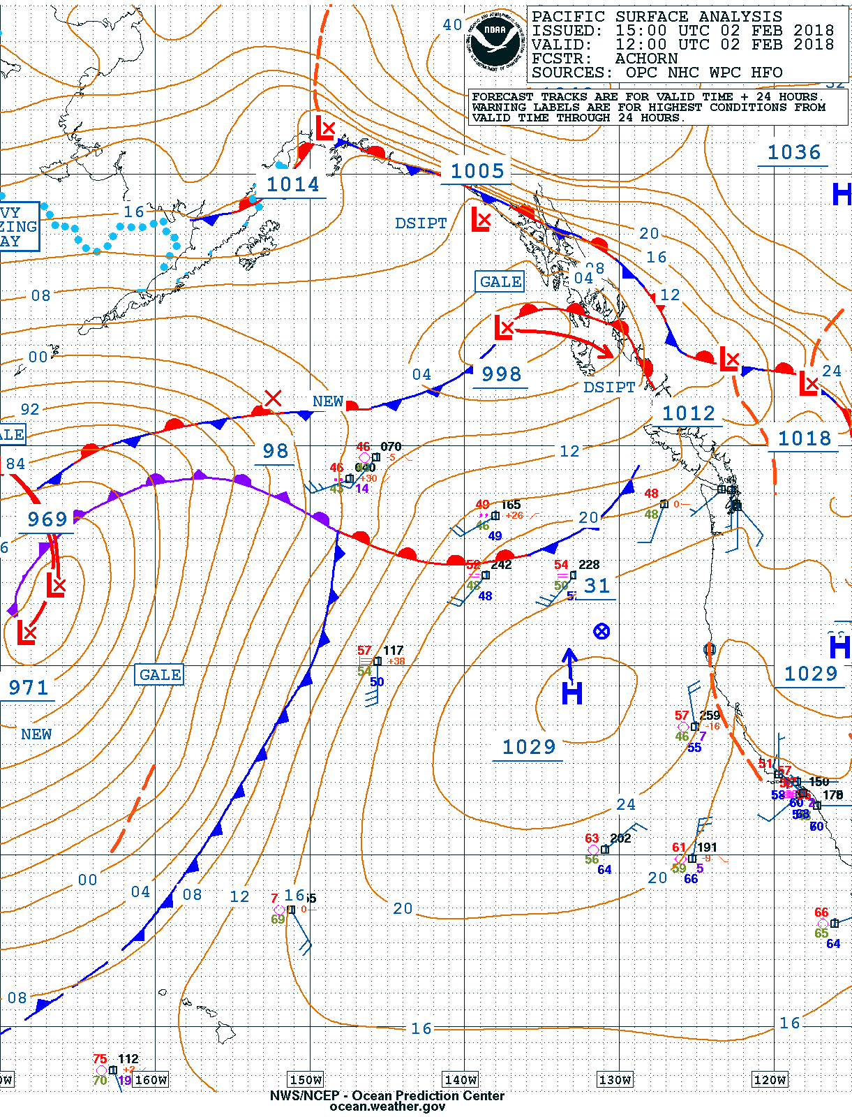
Where are Stronger Versus Weaker Winds?
TIP
The closer the isobars the stronger the winds around areas of low and high pressure sytems.
Notes:
We have established that the sun heats the earth unevenly
Temperature infers density differences
Density difference infers pressure differences
Pressure differences kick of the earths response to equalize = wind

Slide 10
Determining WIND Direction & Speed on real time surface pressure maps

Slide 11
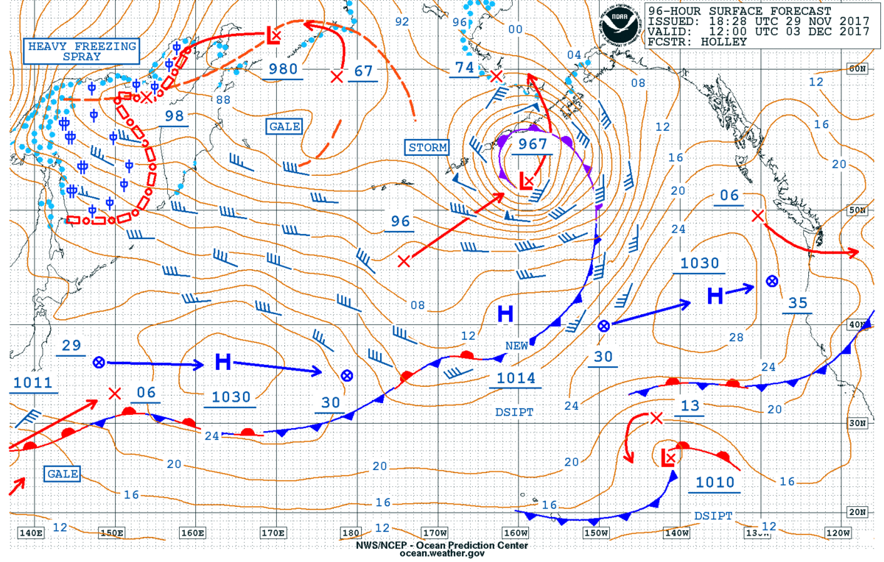
Surface Forecast Charts Show Winds Over 35 Knots
50-kts ENE
40-kts W
55-kts W
45-kts WSW
35-kts SW

Slide 12
Understanding Standard Surface Chart Symbols
Cold Front
Warm Front
Occluded Front
Stationary Front
Notes:
We continue introduce some of the surface map symbols for the weather features we discuss. Live internet will typically present weather symbols in color. At sea, the limited communications means that you are likely to see WeatherFax charts in black and white, so it is the shape and position of the symbols that is important, not the color.
Review:
Cold front are lines with pointed pips on one side. The pips point to the direction of movement of the front.
Warm fronts are lines with semi-circular mounds on one side. The mounds point in the direction of the movement of the front.
When alternating pips and the mounds appear on the same side of the line, that is called an occluded (mixed) front, and we will be discussing that shortly.
If the alternating pips and mounds appear on different sides of the line, that illustrates a stationary front (one that is not mixing), and more on that shortly too.

Slide 13
Other Common Surface Chart Symbols
Trough (TROF)
Trough (TROF)
Ridge
Ridge
Squall Line
Squall Line
ITCZ
ITCZ
Notes:
New symbols:
Troughs are dash lines.
Ridges are zig-zag lines.
Squall lines are alternating double dots and lines.
The ITCZ is a snaked ladder.

Slide 14
More Surface Chart Symbols (B/W)
TRPCL WAVE
Tropical Wave
Squall Line
Shear Line
ITCZ
MONSOON TROF
Monsoon Trough
Notes:
New symbols:
Troughs are dash lines.
Ridges are zig-zag lines.
Squall lines are alternating double dots & lines.
Shear lines are a series of solid lines, short space & a dot repeated again
The ITCZ is a snaked ladder.
Monsoon trough is a set of parallel lines
Tropical Wave a solid line that is arced.

Slide 15
Ocean Prediction Center (OPC) Surface Pressure Analysis and Forecasts

Slide 16
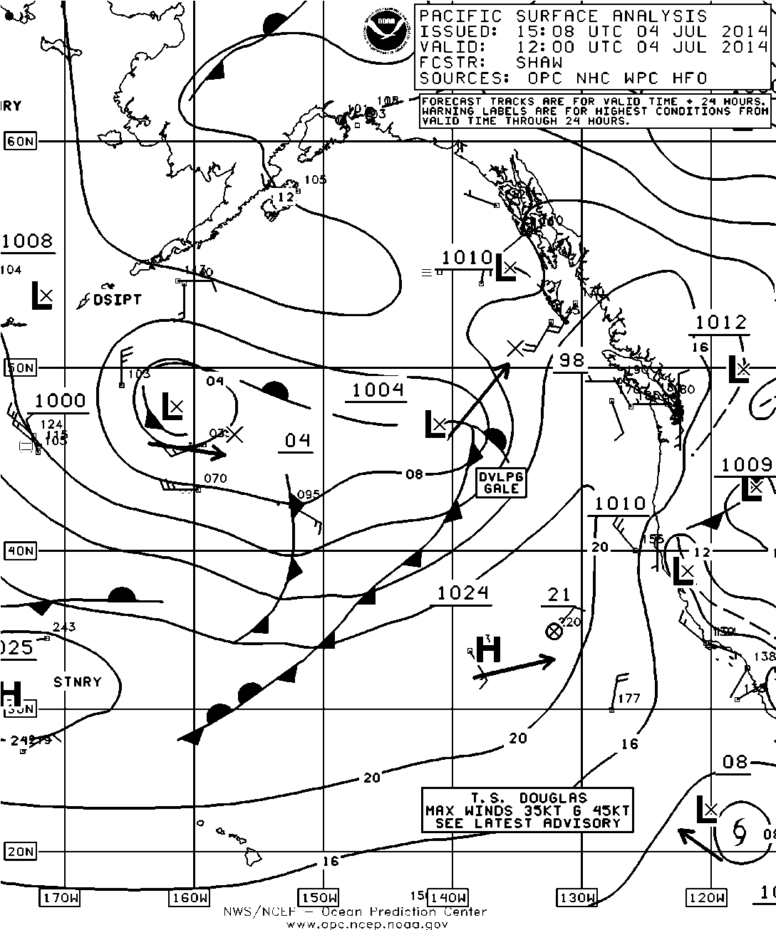
North Pacific SFC Analysis-Summer (Part 1)

Slide 17
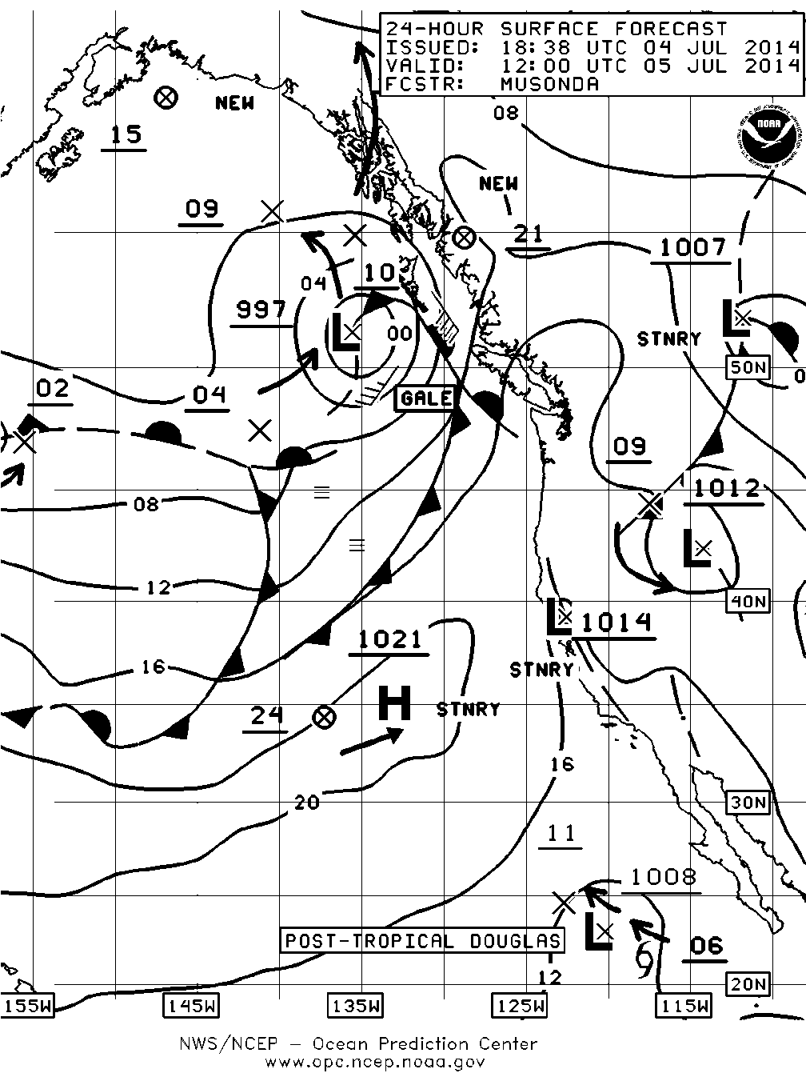
Regional 24- Hour Surface Forecast-Summer

Slide 18
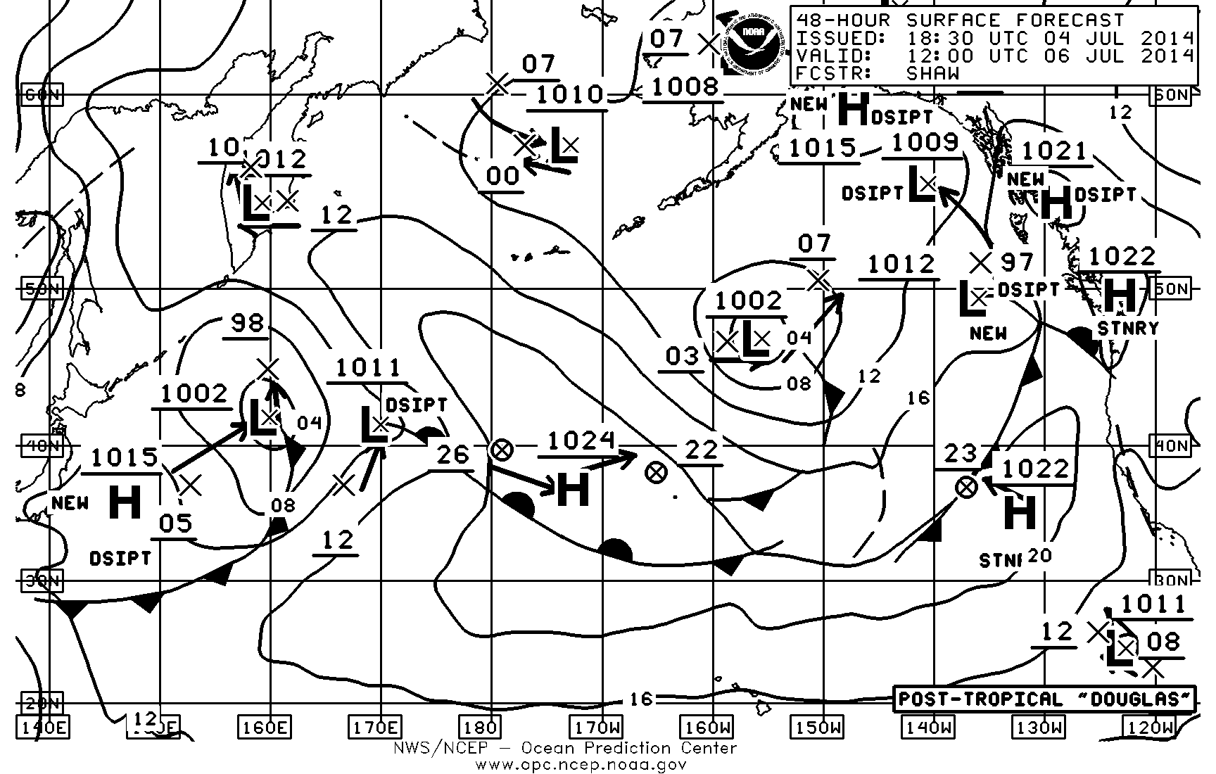
North Pacific 48-Hour Surface Forecast-Summer

Slide 19
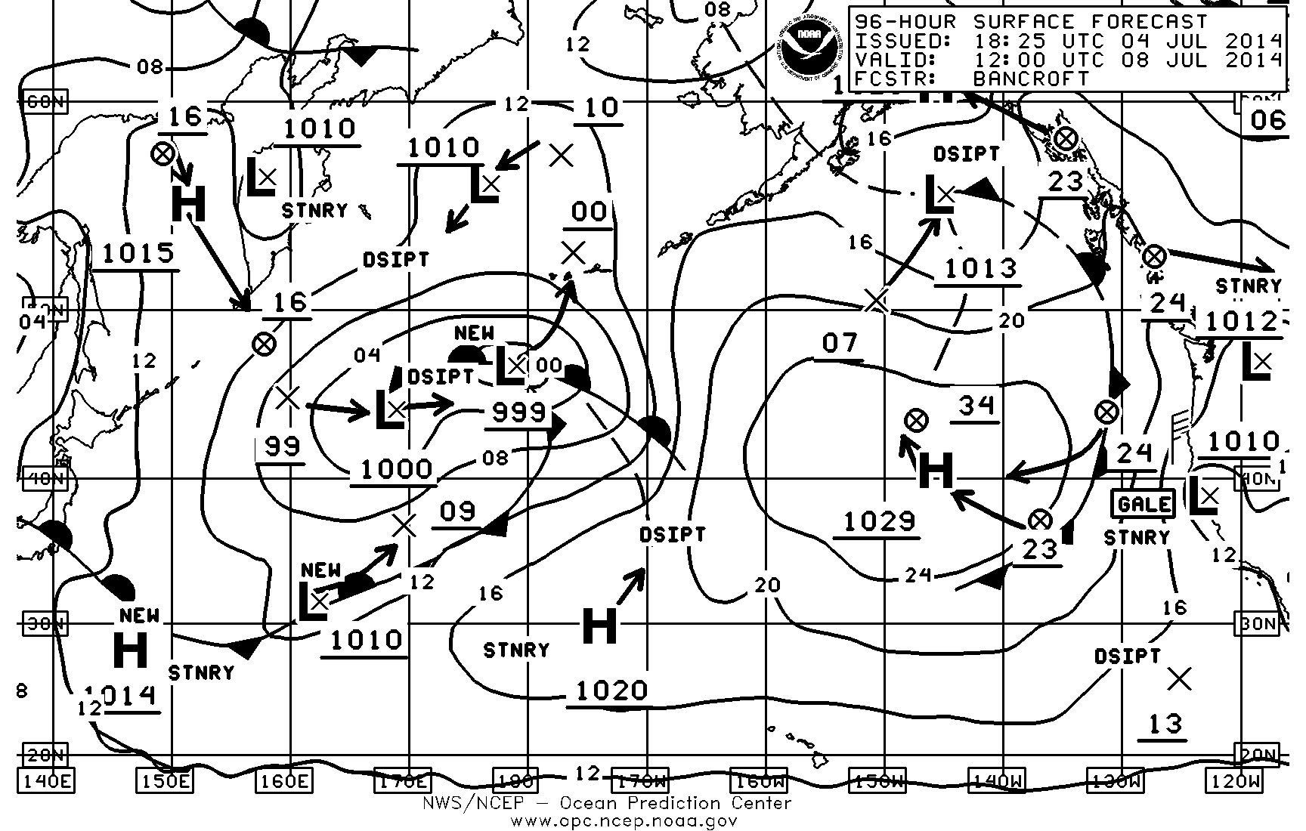
North Pacific 96-Hour Surface Forecast-Summer

Slide 20
Why do we Need Onboard Weather Observations?
Notes:
So: What is the difference between a typhoon and a hurricane?

Slide 21
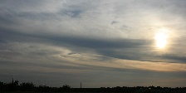
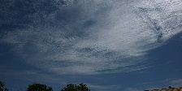
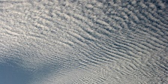
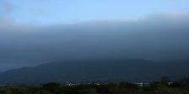
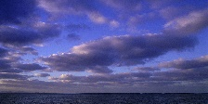
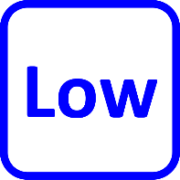
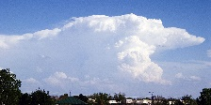
Do You Have a Roadmap to Classifying Clouds?
Cirrus
Cirrostratus
Cirrocumulus
Altostratus
Altocumulus
Stratus
+
Stratocumulus
+
Nimbostratus
Cumulus
+
Cumulonimbus
Notes:
When classifying or recording clouds:
First determine the height of the cloud-base because this immediately reduces the number of choices to classify:
High
Medium
Low
If high, is the form:
Cirro-form (curly, wispy) – Cirrus (Ci)
Strato-form (layer sheets) – Cirrostratus (Cs)
Cumulo-form (cotton balls) – Cirrocumulus (Cc)
If cloud-base is medium, is the form:
Strato-form (layered sheets) – Altostratus (As)
Columo-form (cotton balls) – Altocumulus (Ac)
If the cloud-base is low, is the form:
Strato-form (layered sheets, no rain) – Stratus (St)
Strato-form and Columo-form (layered cotton balls) – Stratocumulus (Sc)
Strato-form and Nimbo-form (layered sheets with rain) – Nimbostratus (Ns)
Columo-form (cotton balls, no rain) – Cumulus (Cu)
Columo-form and Nimbo-form (cotton balls and rain) – Cumulonimbus (Cb)

Slide 22
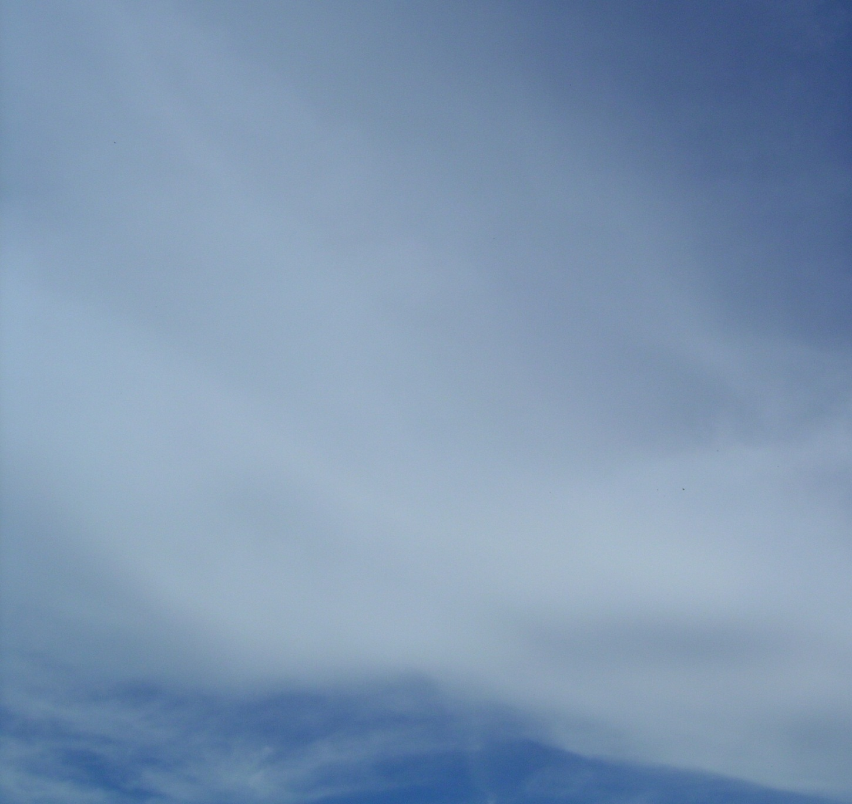
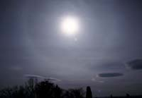
High Clouds (Cirrostratus)

Slide 23
Observations
Date: 03/07/2018
 | Position |  | Boat |  | Wind |  | Barometer | Clouds |  | Comment
Time | Lat | Lon | Speed | Course | Speed | Dir | Press | Type | Cover
00 | 31.8 | 74.8 | 5 | 270 | 11.7 | 180 | 1015
03 | 31.8 | 74.8 | 5 | 270 | 19.4 | 190 | 1014
06 | 31.8 | 74.8 | 5 | 270 | 23.3 | 190 | 1012
09 | 31.8 | 74.8 | 5 | 270 | 27.2 | 190 | 1008
12 | 31.8 | 74.8 | 5 | 270 | 29.2 | 200 | 1006
15 | 31.8 | 74.8 | 5 | 270 | 25.3 | 280 | 1005 |  |  | Pressure Min.
18 | 31.8 | 74.8 | 5 | 270 | 23.3 | 290 | 1007
21 | 31.8 | 74.8 | 5 | 270 | 23.3 | 280 | 1008
Date: 03/08/2018
 | Position |  | Boat |  | Wind |  | Barometer | Clouds |  | Comment
Time | Lat | Lon | Speed | Course | Speed | Dir | Press | Type | Cover
00 | 31.8 | 74.8 | 5 | 270 | 19.4 | 290 | 1010
03 | 31.8 | 74.8 | 5 | 270 | 15.6 | 300 | 1011
06 | 31.8 | 74.8 | 5 | 270 | 9.7 | 280 | 1011
09 | 31.8 | 74.8 | 5 | 270 | 3.9 | 300 | 1010
12 | 31.8 | 74.8 | 5 | 270 | 13.6 | 250 | 1010
15
18
21

Slide 24
Wave Characteristics

Slide 25
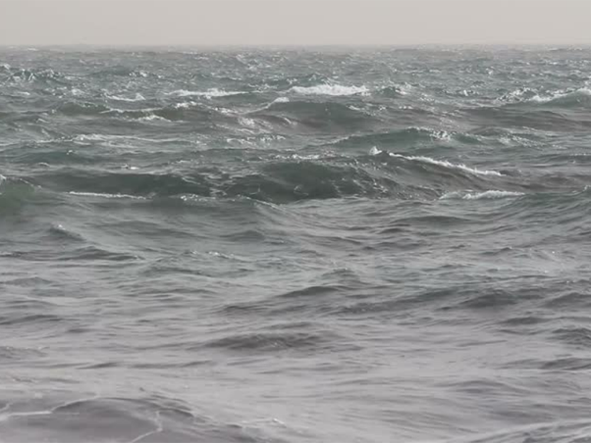
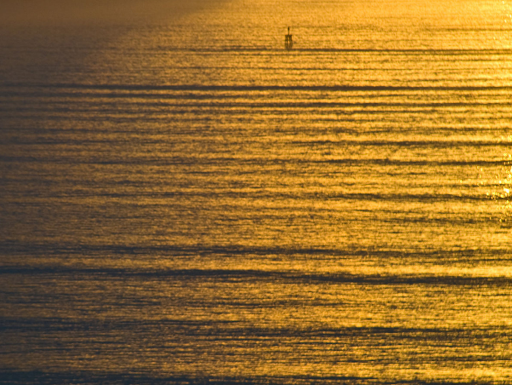
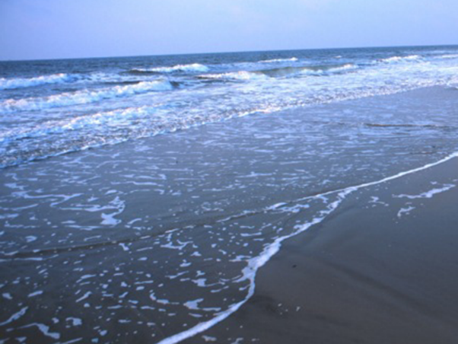
Wave Categories
Seas: Waves under the direct influence of generating winds
Swell: Waves which have left the generating area and are subject to decay.
Surf: Waves running into shallow water, getting steeper and breaking
Notes:
We discuss three types of waves. First, a wind driven sea, waves are under the direct influence of locally generated winds –and obviously you can see that taking place right before your very eyes from your cockpit or your wheelhouse.
Swell waves are waves that have been generated from a storm’s distant winds. They leave that generating area and propagate in great circle paths as a swell wave. Swell waves are subject to changing the characteristics or a decay phase. Then you run up or surf waves. Waves that run up a beach. There is a lot of variation here because the slope of the beach as you go from the shore offshore, or the shoreline offshore is going to dictate how the waves are going to encroach a given area in terms of height and terms of when they break. And if you are close to shore, between the shoreline and offshore, you can run into a heap of trouble. Because the surfers that surf the Hawaii and other areas around the globe are counting on certain wave heights that usually end up being twice the wave height when they run ashore than compared when they are in the open water.
So between wind driven waves, swell and surf waves, there’s a lot of complications or a lot of issues that need to be short resolved in terms of your planning of your anchorages, or planning your coastal cruising or further offshore, you bluewater crews.

Slide 26
Is This a Wind Wave or a Swell Wave?
Notes:
Why is this important for you to know the difference?
You will find out in Marine WX 11.

Slide 27
Wave Characteristics
TIP
The wavelength of a wave is the distance between one crest to the next crest or one trough to the next trough.
Direction of travel
A
B
Wave length (L)
Still water or calm sea level
Wave height (H)
Crest
Trough
Wave Frequency
The number of wave crests passing point A each second
Wave Period
The time required for the wave crest at point A to reach point B
Notes:
Wave height is measured from the bottom of the wave to the top of the wave. The bottom of the wave is known as the wave trough. The top of the wave is known as a crest. So the vertical distance measurement between trough and crest is wave height.
The horizontal distance between one wave crest and the next is called wavelength.
The time it takes for one wave to pass a stationary point followed by the next wave, that time in seconds is the wave period.
So we have wave height, wavelength and wave period to consider in terms of how this will impact a sailing vessel regardless of the size of the vessel.
Every vessel is to have a certain characteristic because there are six degrees of freedom of motion in a seaway, and every boat owner has to understand how a boat behaves or performs in various types of wind driven sees or swell. And knowing wave height, wavelength and wave period goes a long way in determining your comfort in a seaway.

Slide 28
Significant Wave Height (H_{s})
Significant wave height is:
average height of the highest 1/3 of waves
human perception of observed wave height
what the National Weather Service forecasts
what the Beaufort Scale is based on
TIP
Significant wave height is the average height of the highest 1/3 of waves observed.
Notes:
When mariner’s observe waves, they are perceive wave height as the average of the highest one-third of the waves. This is the standard for reporting and forecasting wave heights. This is what is forecasted and this is what is observed by professional mariners. They observe the range of wave height called significant wave height. The definition of significant wave height is the average of the highest one third of the waves present. The National Weather Service (NWS) and other government agencies around the world forecasted significant wave height and the Beaufort scale is best used to estimate significant wave height in various ranges. The Beaufort scale, the standard for reporting wind and sea state conditions is based on the mariner’s perception of wave height, so it also based on significant wave height. The Beaufort scale has been around a long time, over two centuries, since the days of Sir Francis Admiral Beaufort developed the scales during the days of tall sailing ship in around 1806..

Slide 29
2018 opc north Pacific Ocean Sequence 2
Notes:
Some older North Pacific Ocean examples from the OPC.

Slide 30
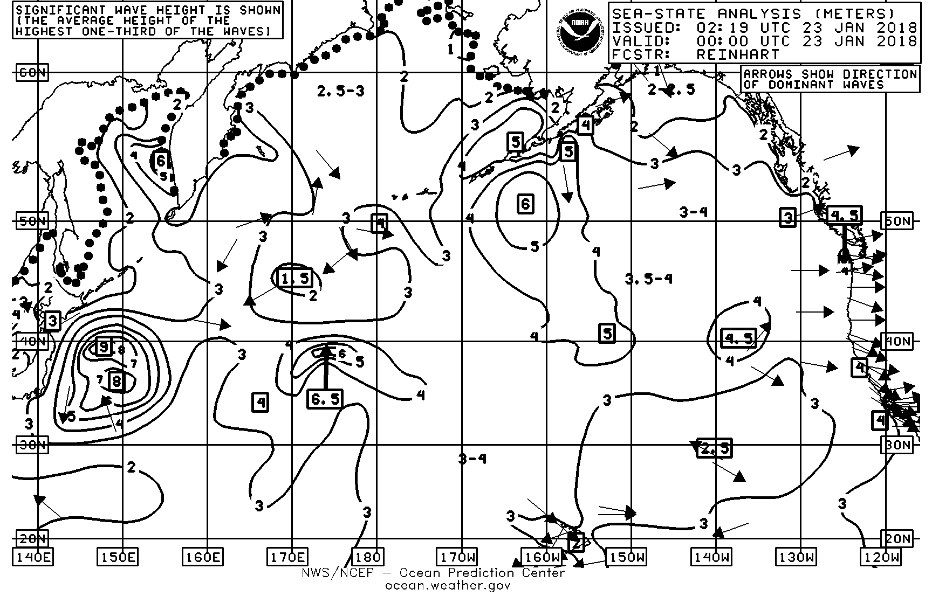
North Pacific Sea-State Analysis

Slide 31
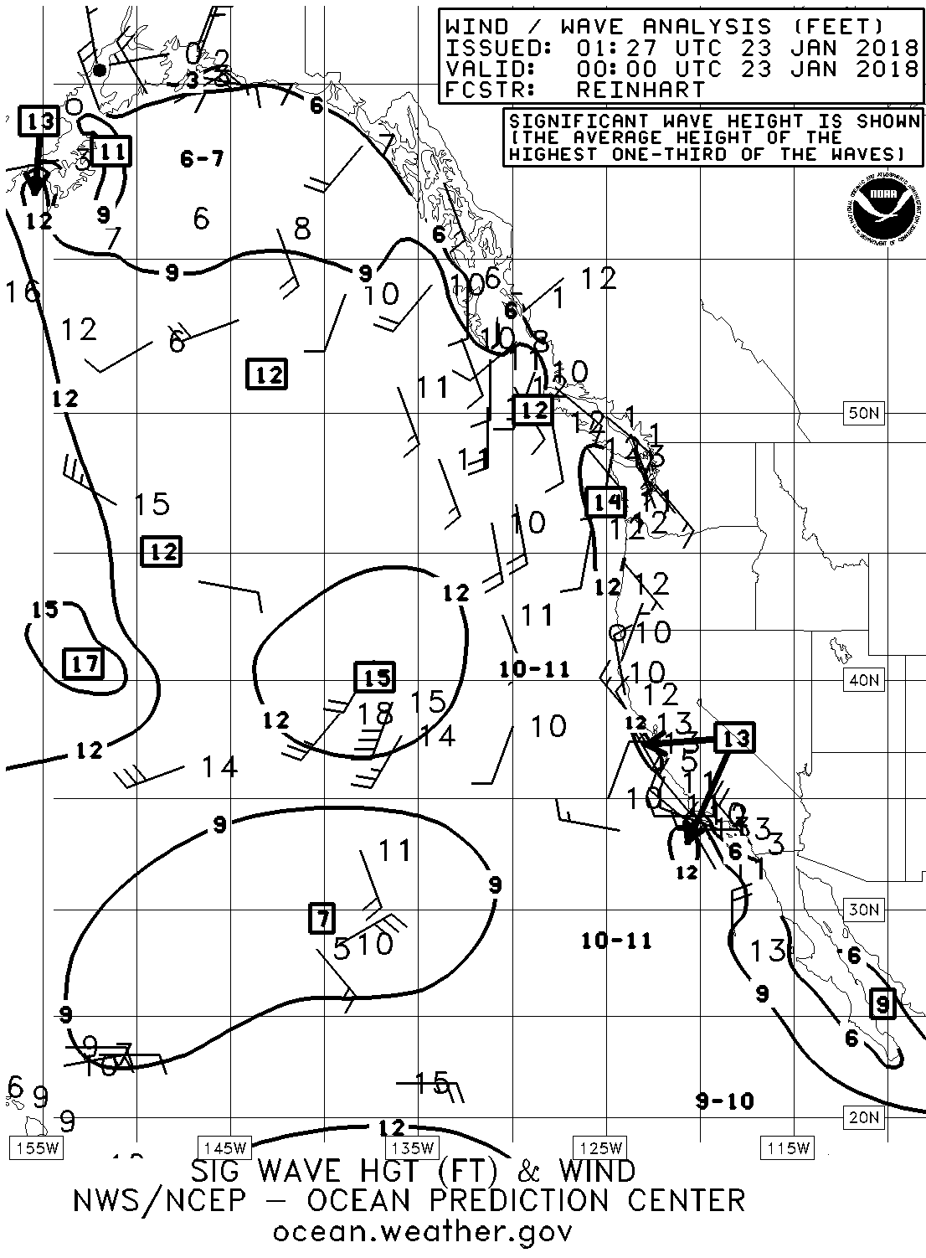
Northeast Pacific Wind/Wave Analysis

Slide 32
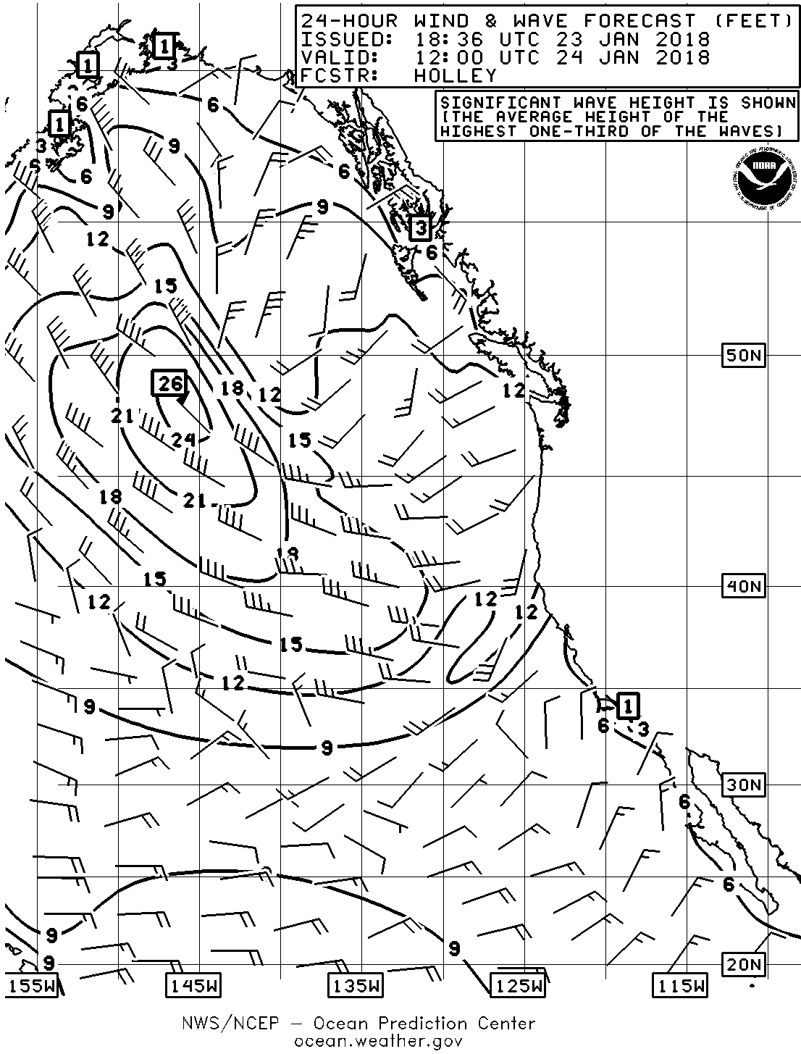
Northeast Pacific 24-hr Wind & Wave Forecast
Notes:
This is the 24-hour wind and wave forecast, again regional wave heights are shown in increments of 3-feet. You can see that the long stretch of 20 to 25 knot southerly winds is generating a combination of wind wave and swell waves. A lot of this is swell as 25 knot winds are generally not a recipe for generating 21-feet seas, so a lot of this is swell energy.

Slide 33
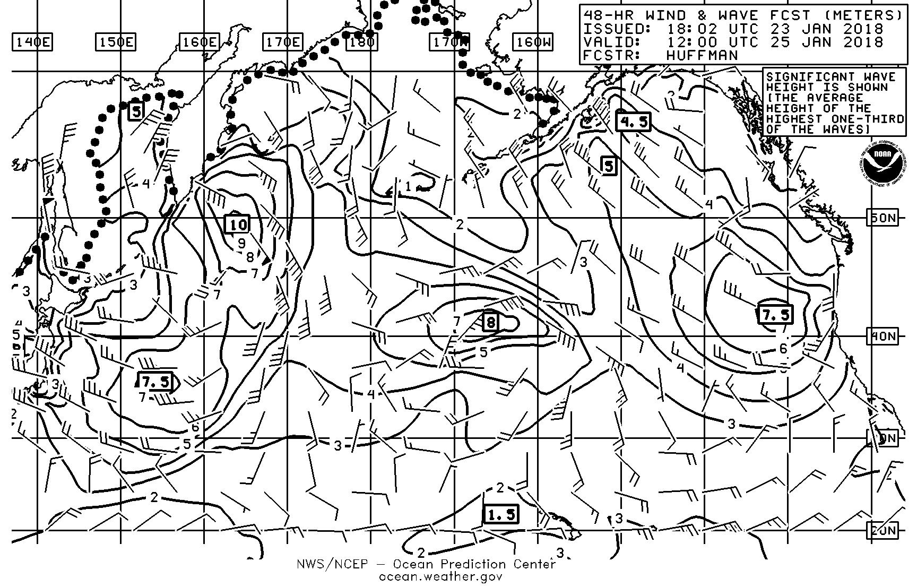
North Pacific 48-hr Wind & Wave Forecast

Slide 34
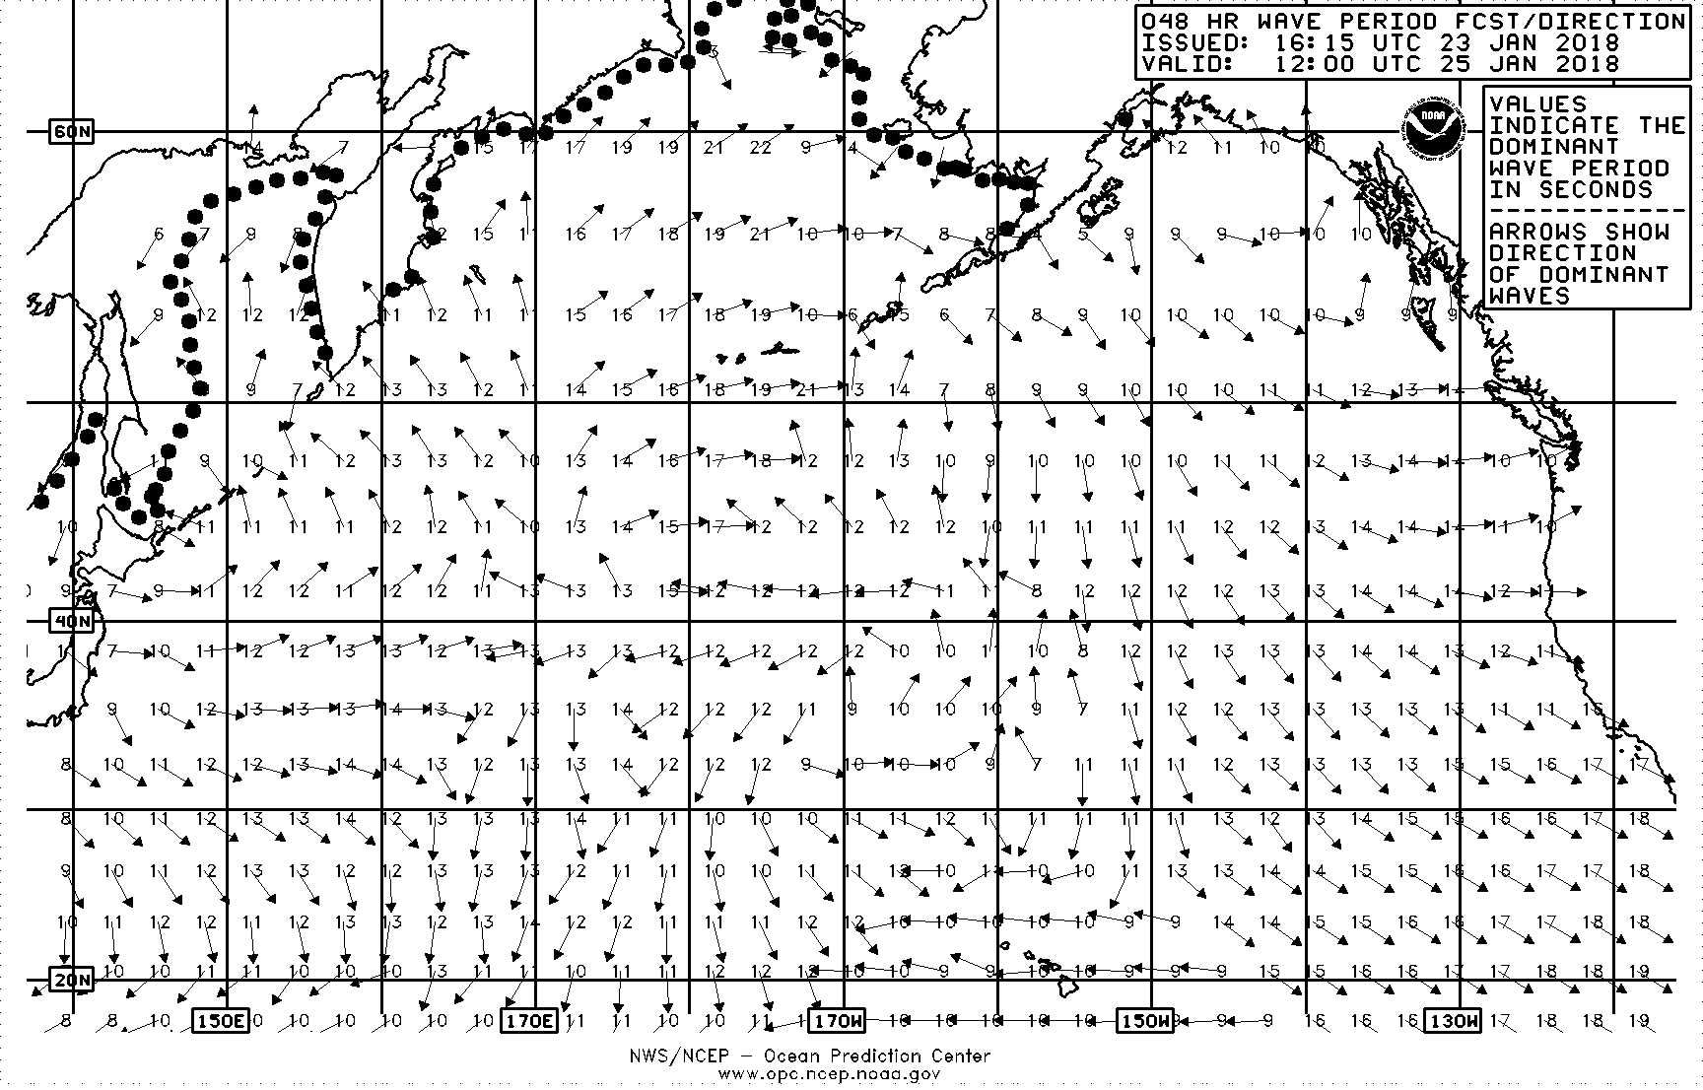
North Pacific 48-hr Wave Period/Direction Forecast

Slide 35
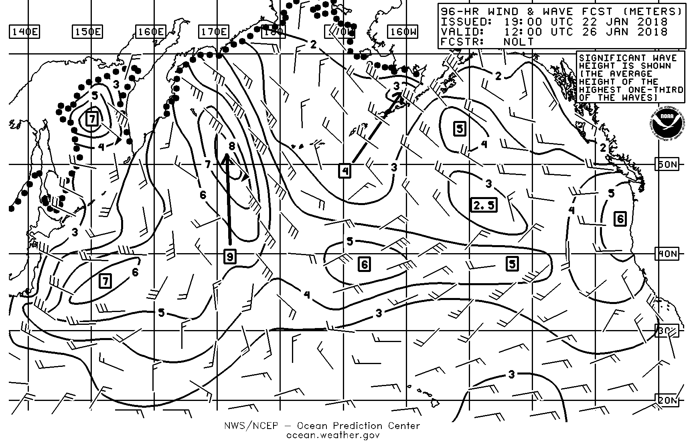
North Pacific 96-hr Wind & Wave Forecast (Meters)
Notes:
So you use the surface forecast charts in conjunction with the wind and wave charts. The surface charts tell you where the fronts are, how the isobar is line up to give you 9 meter seas. You can see several areas of significant fetch. You are not going to see the area of freezing spray on today’s wind and wave charts, you are going to see that on the surface pressure maps - the ball and chain it represents freezing spray on this older wind and wave chart.

Slide 36
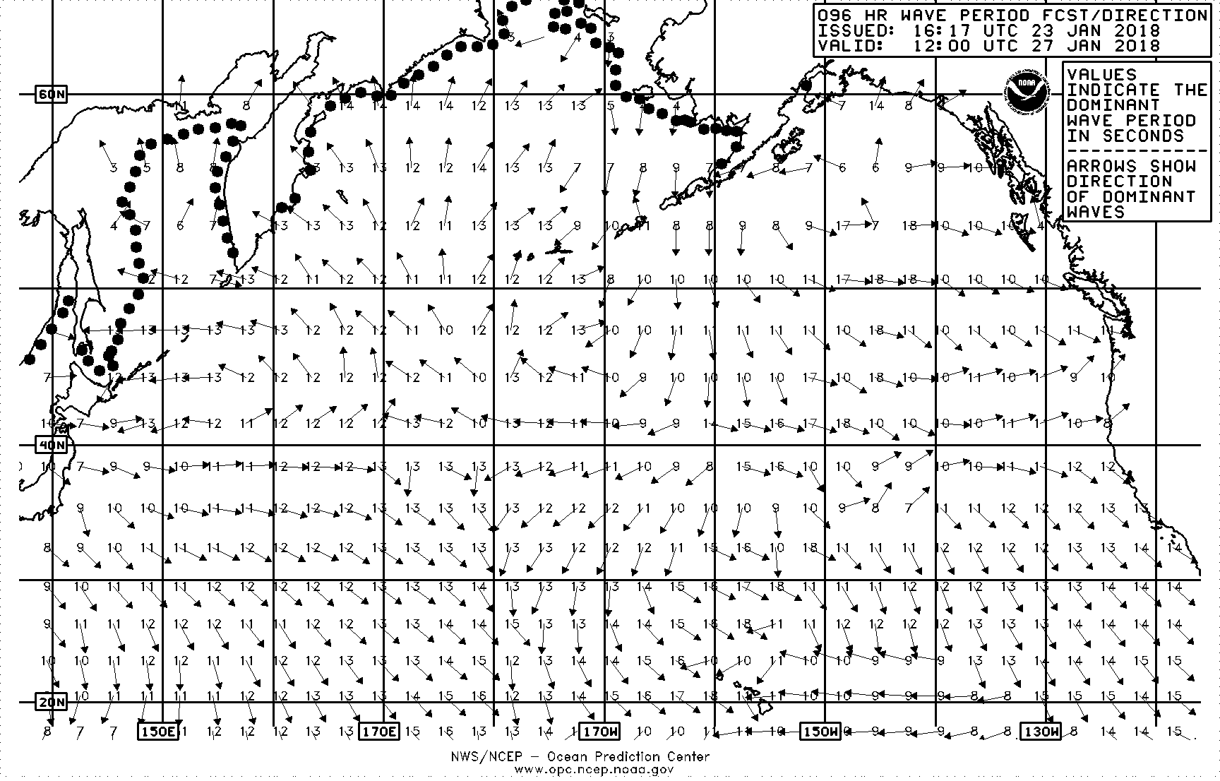
North Pacific 96-hr Wave Period/Direction Forecast

Slide 37
What is a Tropical Cyclone?
Notes:
So: What is the difference between a typhoon and a hurricane?

Slide 38
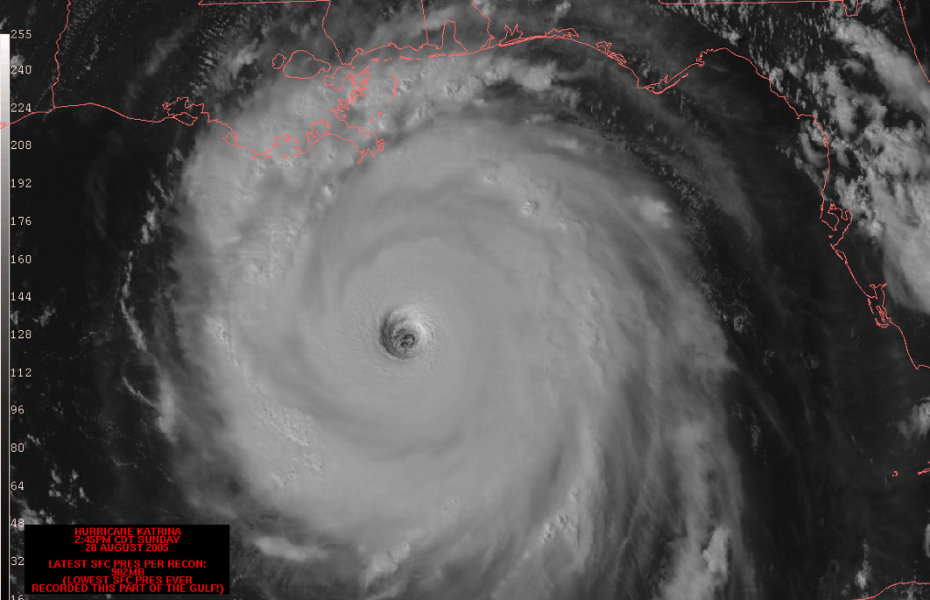
Strongest Storms on Earth
Notes:
Tropical cyclones are the strongest storms on earth, that is, they possess the most energy of all meteorological systems.
They are very strong low pressure systems that originate in tropical latitudes.
While there are some similarities between mid-latitude lows, the formation and structure of tropical cyclones is fundamentally different than that of mid-latitude lows.

Slide 39
Extratropical vs Tropical Cyclones
Extratropical
Tropical
L
L
H
Cold Core
Warm Core
L
L

Slide 40
Tropical Cyclone Classifications
Stages of Tropical Cyclone Development
Tropical Wave | Organized cluster or line of thunderstorms
Tropical Depression | Closed circulation, winds less than 34 knots
Tropical Storm | Sustained winds of 34 to 63 knots
Hurricane | Sustained winds at least 64 knots

Slide 41
Hurricane Classifications
Saffir/Simpson Hurricane Intensity Scale
Category 1 | 64 – 82 knots; storm surge 4-5 ft
Category 2 | 83 – 95 knots; storm surge 6-8 ft
Category 3 | 96 – 113 knots; storm surge 9-12 ft
Category 4 | 114 – 135 knots; storm surge 13-18 ft
Category 5 | 136 knots and higher; storm surge greater than 18 ft

Slide 42
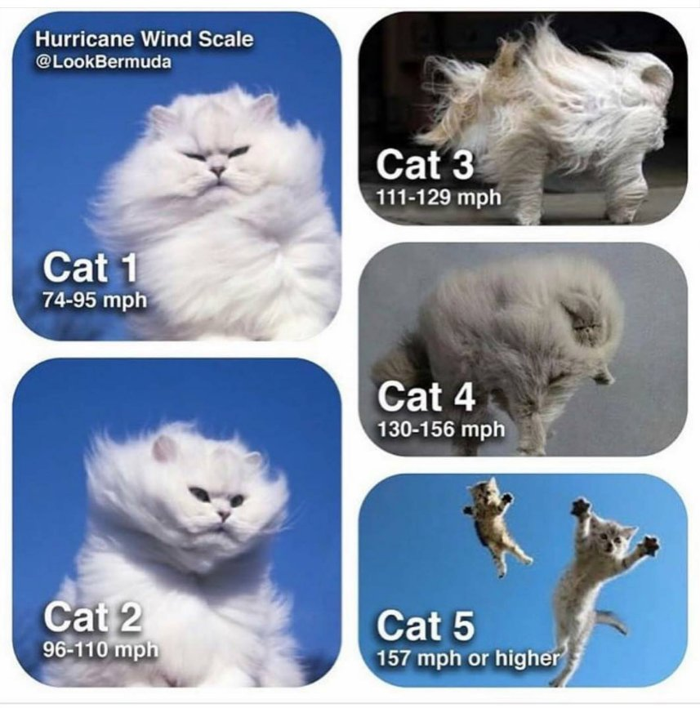
Hurricane Classifications
Notes:
For a mariner…does it really matter what category of hurricane the NHC uses to assign a category?

Slide 43
Tropical Cyclone Symbols & Features
L
Tropical
Depression
T.D. #12
Max winds 25 knots
See Latest NHC Advisory
Tropical
Storm
T.S Carlotta
Max Winds 55 knots
See Latest NHC Advisory
Hurricane/
Typhoon
Hurricane Carlotta
Max Winds 80 G 105 knots
See Latest NHC Advisory
ITCZ
TRPCL WAVE
Monsoon Trough
Tropical
Wave
Notes:
Tropical Depression:
Development of Rotary Circulation (counter-clockwise in Northern Hemisphere).
Sustained Winds of less than 34 knots.
A closed isobar may or may not be present.
Tropical Storm:
Sustained winds between 34 and 63 knots.
One or more closed isobars.
System is assigned a name.
Hurricane:
Sustained winds of 64 knots or greater.
Several (perhaps many) closed isobars.
Termed Typhoons in the western Pacific,
Cyclones in the Indian Ocean ( Willy-Willies around Australia).
Further categorized using the Saffir-Simpson scale (next slide).
Note, the central pressure are often not given for tropical cyclones, except with some analyses charts if a hunter aircraft is able to measure the storms central pressure at the synoptic time.

Slide 44
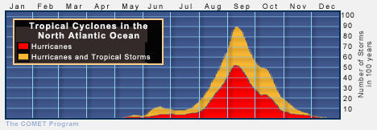
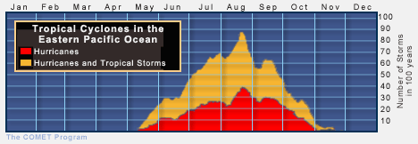
Eastern Pacific and Atlantic Seasons

Slide 45
Tropical cyclones Frequency & tracks- Eastern North Pacific
Notes:
So: What is the difference between a typhoon and a hurricane?

Slide 46
1949-2015 Climatological Eastern Pacific Tropical Cyclone Tracks

Slide 47
The Active 2014 Eastern Pacific Hurricane Season
Notes:
So: What is the difference between a typhoon and a hurricane?

Slide 48
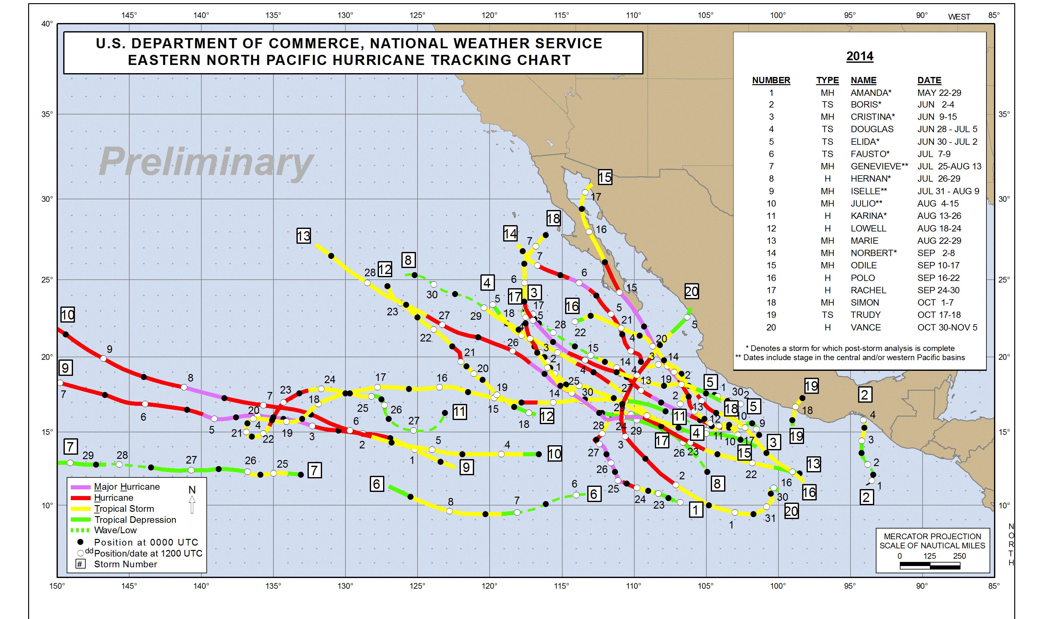
NHC Eastern Pacific Tracks 2014

Slide 49
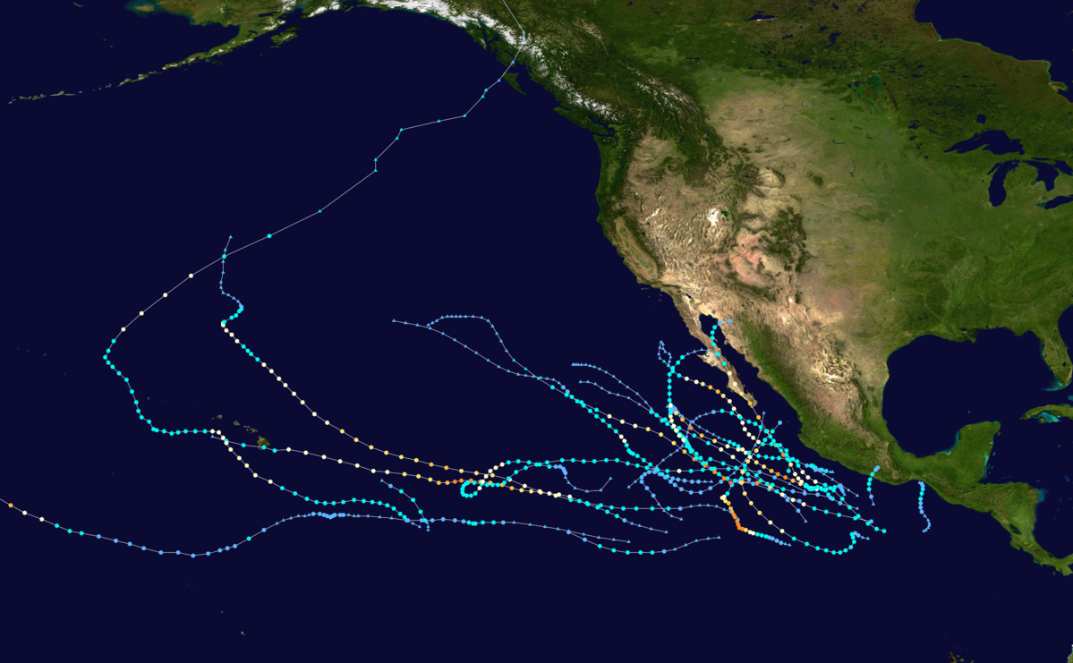
Tracks Crossing Into the Central Pacific

Slide 50
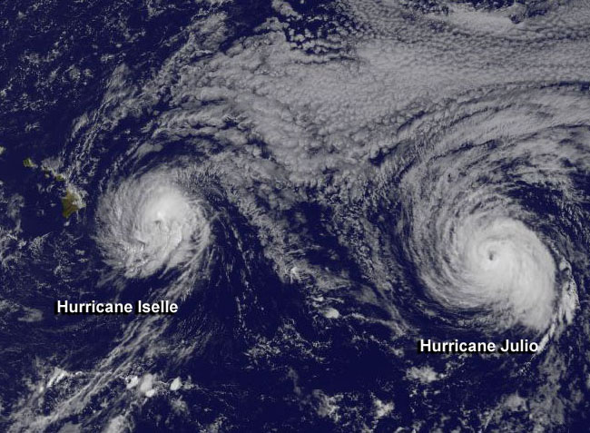
Back To Back Storms Threatening Hawaii

Slide 51
NHC/CPHC Tracks Of Julio August, 2014

Slide 52
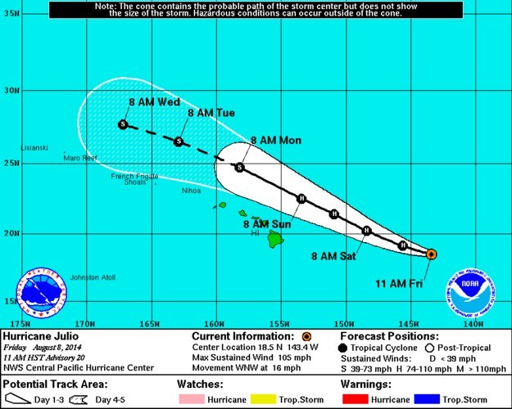
CPHC Track Forecast Track of Hurricane Julio

Slide 53
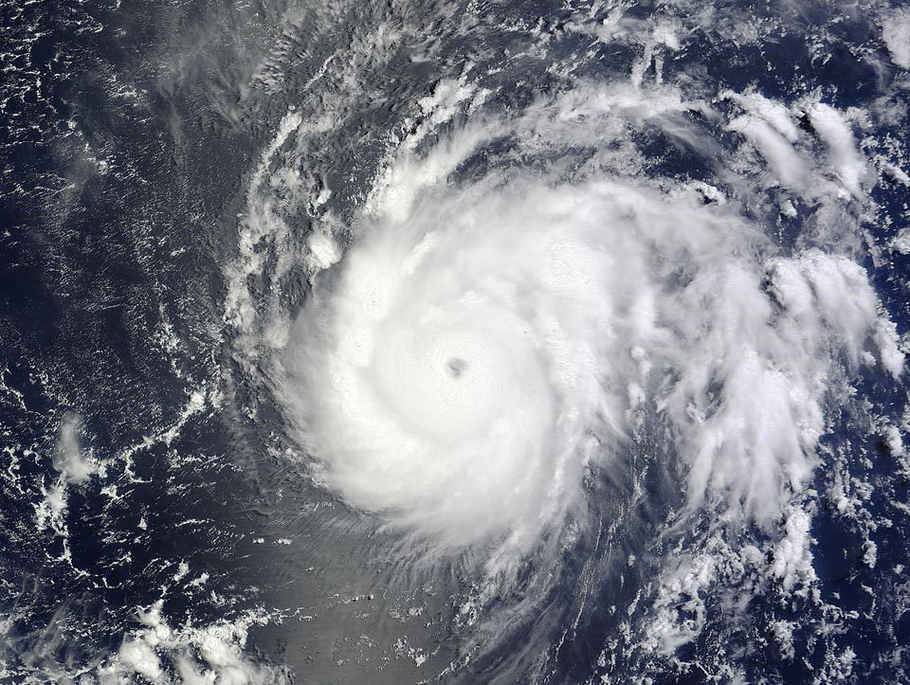
Cat 3 Hurricane Julio

Slide 54
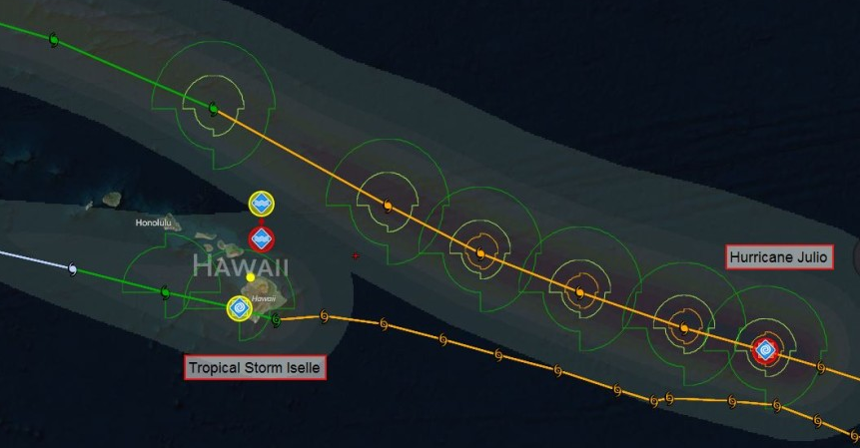
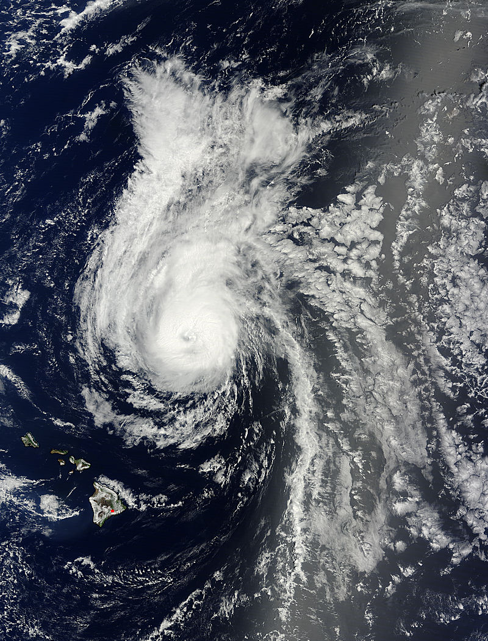
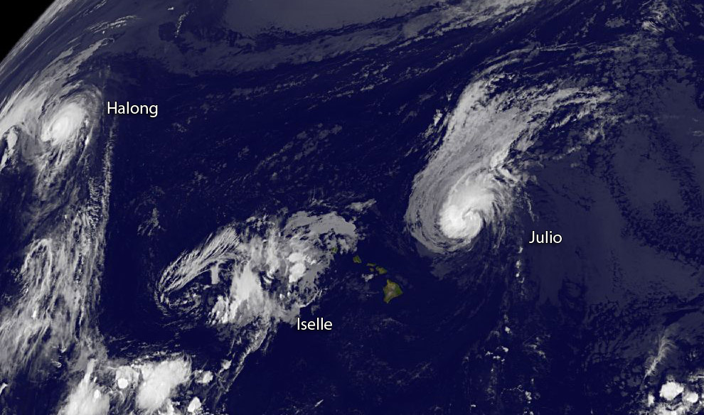
Hurricane Julio Tracking North of Hawaii… Intact

Slide 55
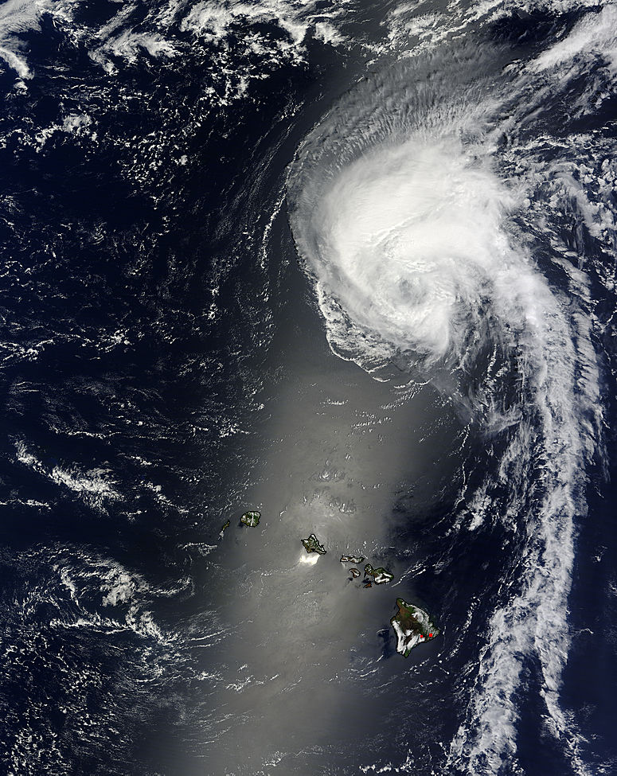

Slide 56
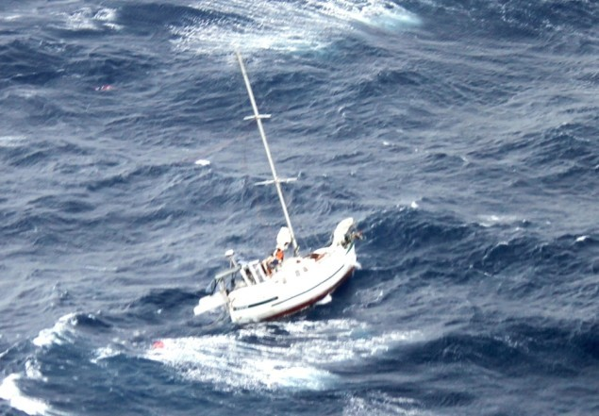
???????????????

Slide 57
Tropical Cyclones Avoidance
Notes:
Tropical Cyclone Avoidance begins with accessing and understanding advisories as issued in alpha-numeric message of which formats are not necessarily friendly from an ocean navigator perspective.

Slide 58
NHC Tropical Cyclone Message (TCM)
Notes:
The slides that follow highlight in detail how to properly interpret the poorly formatted NHC Tropical Cyclone Message(TCM) that is transmitted routinely every 6-hours.
highlight in detail how to properly interpret the poorly formatted National Hurricane Center (NHC) alpha-numeric text…Tropical Cyclone Message (TCM) that is transmitted routinely every 6-hours.
NHC message format is different and has to be explained in detail (slides that follow)

Slide 59
Advisory Name and #
ZCZC MIATCMEP4 ALL
TTAA00 KNHC DDHHMM
HURRICANE DORA FORECAST/ADVISORY NUMBER 8
NWS NATIONAL HURRICANE CENTER MIAMI FL EP042017
2100 UTC MON JUN 26 2017
THERE ARE NO COASTAL WATCHES OR WARNINGS IN EFFECT.
HURRICANE CENTER LOCATED NEAR 17.8N 107.3W AT 26/2100Z
POSITION ACCURATE WITHIN 15 NM
PRESENT MOVEMENT TOWARD THE WEST-NORTHWEST OR 295 DEGREES AT 11 KT
ESTIMATED MINIMUM CENTRAL PRESSURE 981 MB
EYE DIAMETER 25 NM
MAX SUSTAINED WINDS 80 KT WITH GUSTS TO 100 KT.
64 KT....... 20NE 15SE 10SW 15NW.
50 KT....... 40NE 30SE 20SW 30NW.
34 KT....... 70NE 50SE 40SW 50NW.
12 FT SEAS..120NE 90SE 90SW 90NW.
WINDS AND SEAS VARY GREATLY IN EACH QUADRANT. RADII IN NAUTICAL
MILES ARE THE LARGEST RADII EXPECTED ANYWHERE IN THAT QUADRANT.
REPEAT...CENTER LOCATED NEAR 17.8N 107.3W AT 26/2100Z
AT 26/1800Z CENTER WAS LOCATED NEAR 17.6N 106.8W
FORECAST VALID 27/0600Z 18.4N 108.7W
MAX WIND 75 KT...GUSTS 90 KT.
64 KT... 20NE 15SE 10SW 15NW.
50 KT... 40NE 30SE 20SW 30NW.
34 KT... 70NE 50SE 40SW 50NW.
FORECAST VALID 27/1800Z 19.0N 110.4W...NEAR SOCORRO ISLAND
MAX WIND 65 KT...GUSTS 80 KT.
64 KT... 10NE 0SE 0SW 10NW.
50 KT... 20NE 15SE 15SW 20NW.
34 KT... 60NE 50SE 40SW 50NW.
FORECAST VALID 28/0600Z 19.5N 112.3W
MAX WIND 55 KT...GUSTS 65 KT.
50 KT... 20NE 15SE 0SW 20NW.
34 KT... 60NE 50SE 40SW 50NW.
FORECAST VALID 28/1800Z 19.8N 113.7W
MAX WIND 45 KT...GUSTS 55 KT.
34 KT... 60NE 50SE 30SW 40NW.
FORECAST VALID 29/1800Z 20.3N 116.5W...POST-TROP/REMNT LOW
MAX WIND 30 KT...GUSTS 40 KT.
EXTENDED OUTLOOK. NOTE...ERRORS FOR TRACK HAVE AVERAGED NEAR 100 NM
ON DAY 4 AND 150 NM ON DAY 5...AND FOR INTENSITY NEAR 15 KT EACH DAY
OUTLOOK VALID 30/1800Z 20.5N 119.4W...POST-TROP/REMNT LOW
MAX WIND 20 KT...GUSTS 30 KT.
OUTLOOK VALID 01/1800Z...DISSIPATED
REQUEST FOR 3 HOURLY SHIP REPORTS WITHIN 300 MILES OF 17.8N 107.3W
NEXT ADVISORY AT 27/0300Z
$$
FORECASTER STEWART
Advisory Issued Time
Advisory Time Location
Synoptic Time Wind Radius
Synoptic Time Location
24-hr Forecast Location
24-hr Forecast Wind Radius
48-hr Forecast Location
48-hr Forecast Wind Radius
72-hr Forecast Location
72-hr Forecast Wind Radius
Next Advisory Issued

Slide 60
The 1-2-3 Rule for Tropical Cyclone Avoidance

Slide 61
Bowditch Version Dangerous/Navigable Semicircle (N.H.)
NOTE!
Some refer to the less dangerous semi-circle as “Navigable”.
Don’t be fooled - it is all dangerous!!
Right Side of Topical Cyclone
A
85 kts + 15 kts = 100 kts
Hurricane moving west at 15 kts
Hurricane’s average winds are 85 kts
B
85 kts - 15 kts = 70 kts
Left Side of Tropical Cyclone
Notes:
Dangerous semicircle of a hurricane in the Northern Hemisphere:
Located to the right of the storm’s track
Effective wind speed is the sum of the actual wind speed & the speed of motion of the tropical cyclone
Dangerous semicircle of a tropical cyclone in the Southern Hemisphere: Located to the left of the storm’s track
Effective wind speed is the sum of the actual wind speed & the speed of motion of the tropical cyclone

Slide 62
Plotting the Danger Area to Avoid using The 1-2-3 Rule for Tropical Cyclone Avoidance

Slide 63
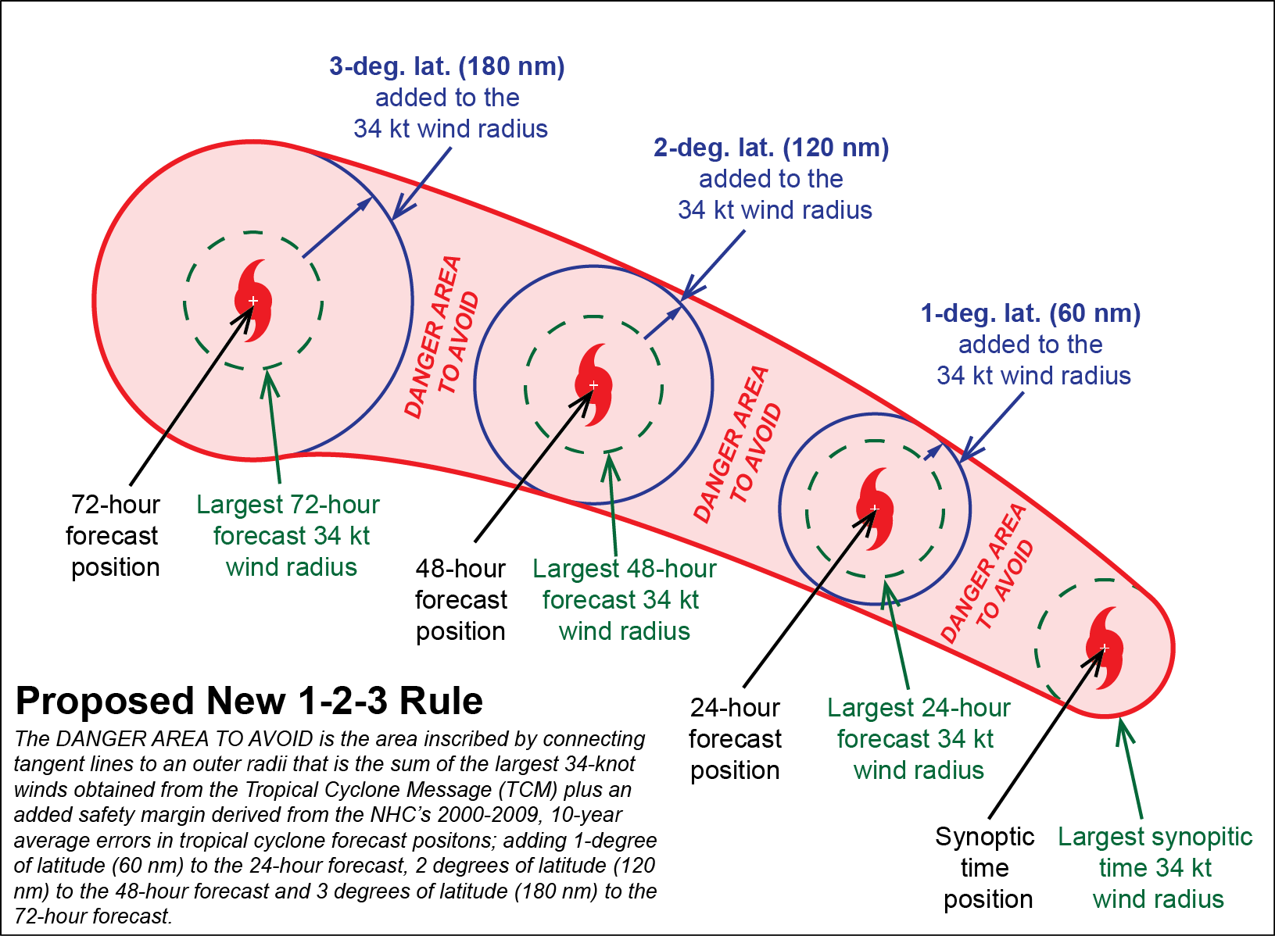
Proposed New 1-2-3 Rule
Notes:
When the 1-2-3 rule was first devised, the error statistics were such that adding 100, 200, and 300 nautical miles as error estimates to the 24, 48, and 72 hour forecasts was reasonable.
As forecasts have improved, using 2000-2009 statistics, the average errors in TC forecast center have decreased, and more reasonable error estimates would be 1 degree of latitude (60 miles), 2 degrees of latitude (120 miles), and 3 degrees of latitude (180 miles) for the 24, 48 and 72 hour forecasts.

Slide 64
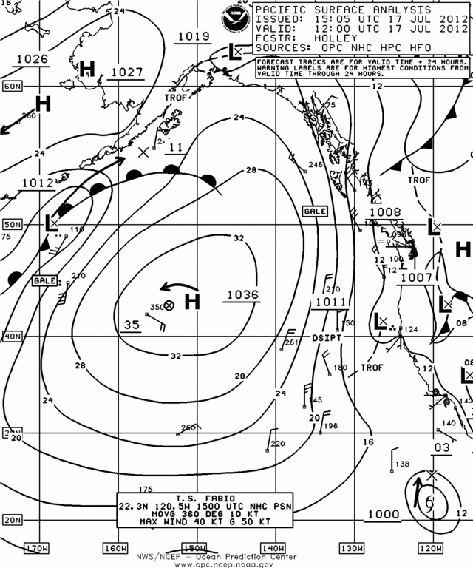
Hey….Stan, how do we get a southerly
wind & moderate rain for the Bay Area in
the middle of July?

Slide 65
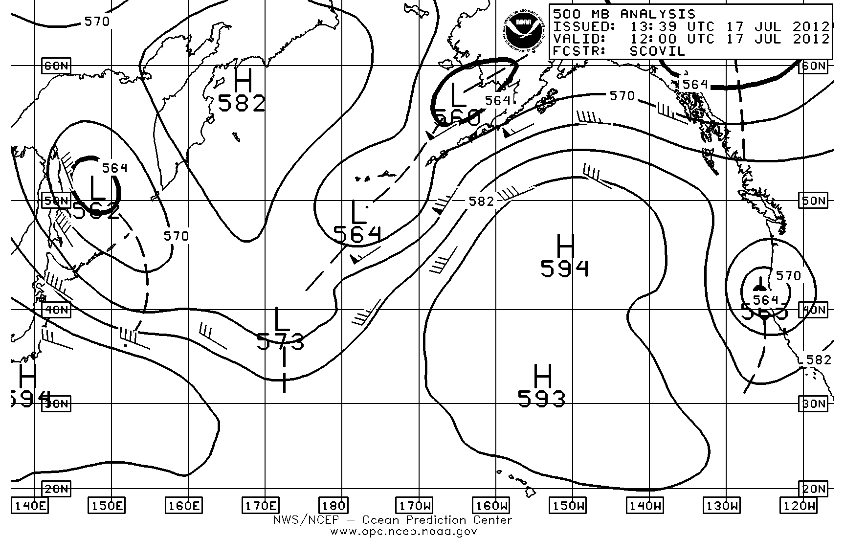
When there is a rare cut-off low over California!

Slide 66
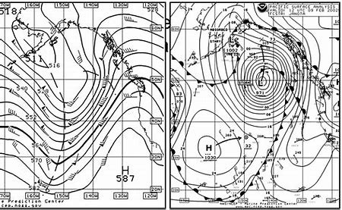
How do we get to 59 degrees F in Honolulu?

Slide 67
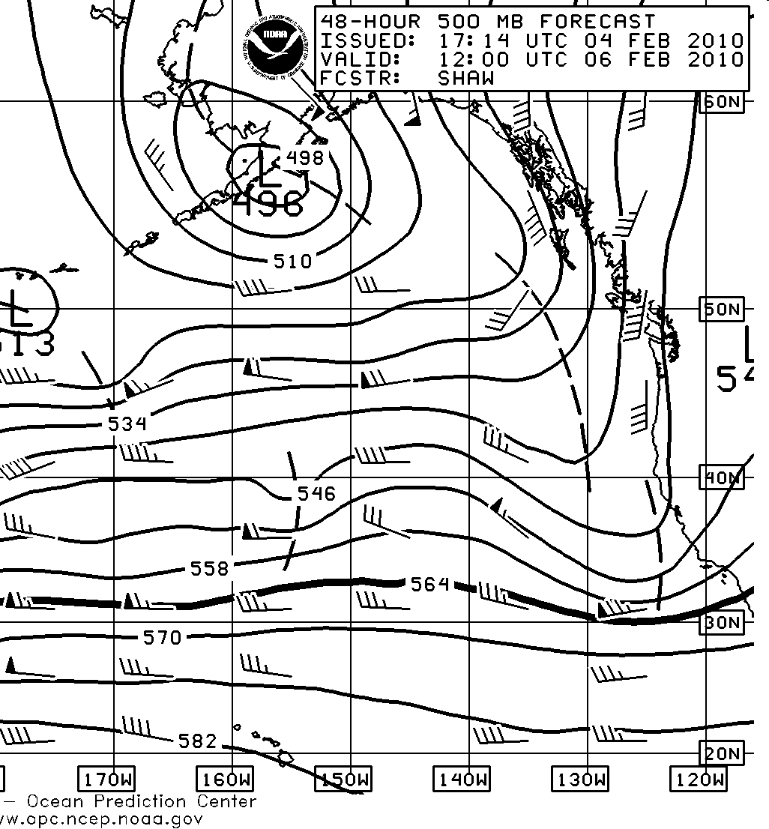
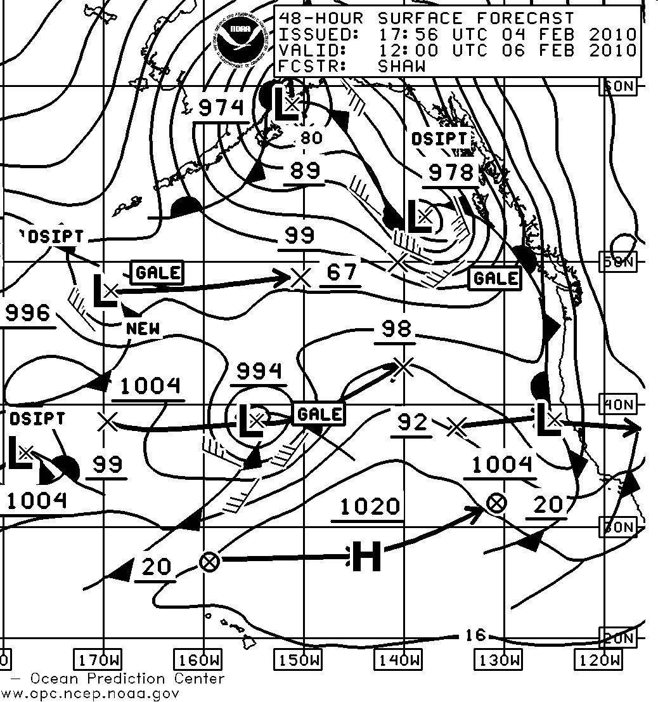
Prior to Nov 13th, 2017…NOAA/NWS OPC’s 12 UTC 48-Hour 500 mb North Pacific Ocean Forecast with TROF(s) Axes & its Reflection on the Associated Surface Pressure Forecast Chart
Notes:
The 500 mb axes of maximum vorticity (TROFs) line up consistently with the reflective surface low pressure systems & their associated fronts..

Slide 68
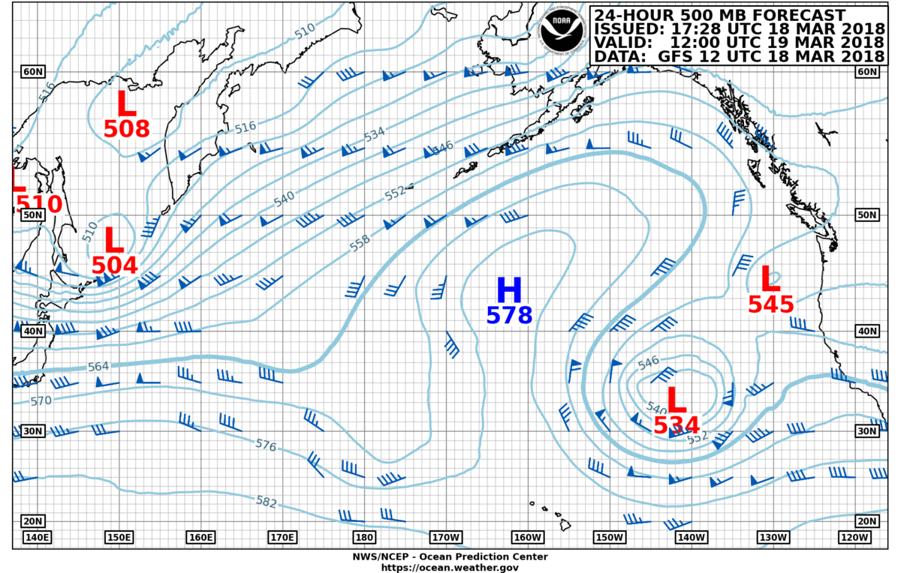
500mb 12-UTC March 19, 2018

Slide 69
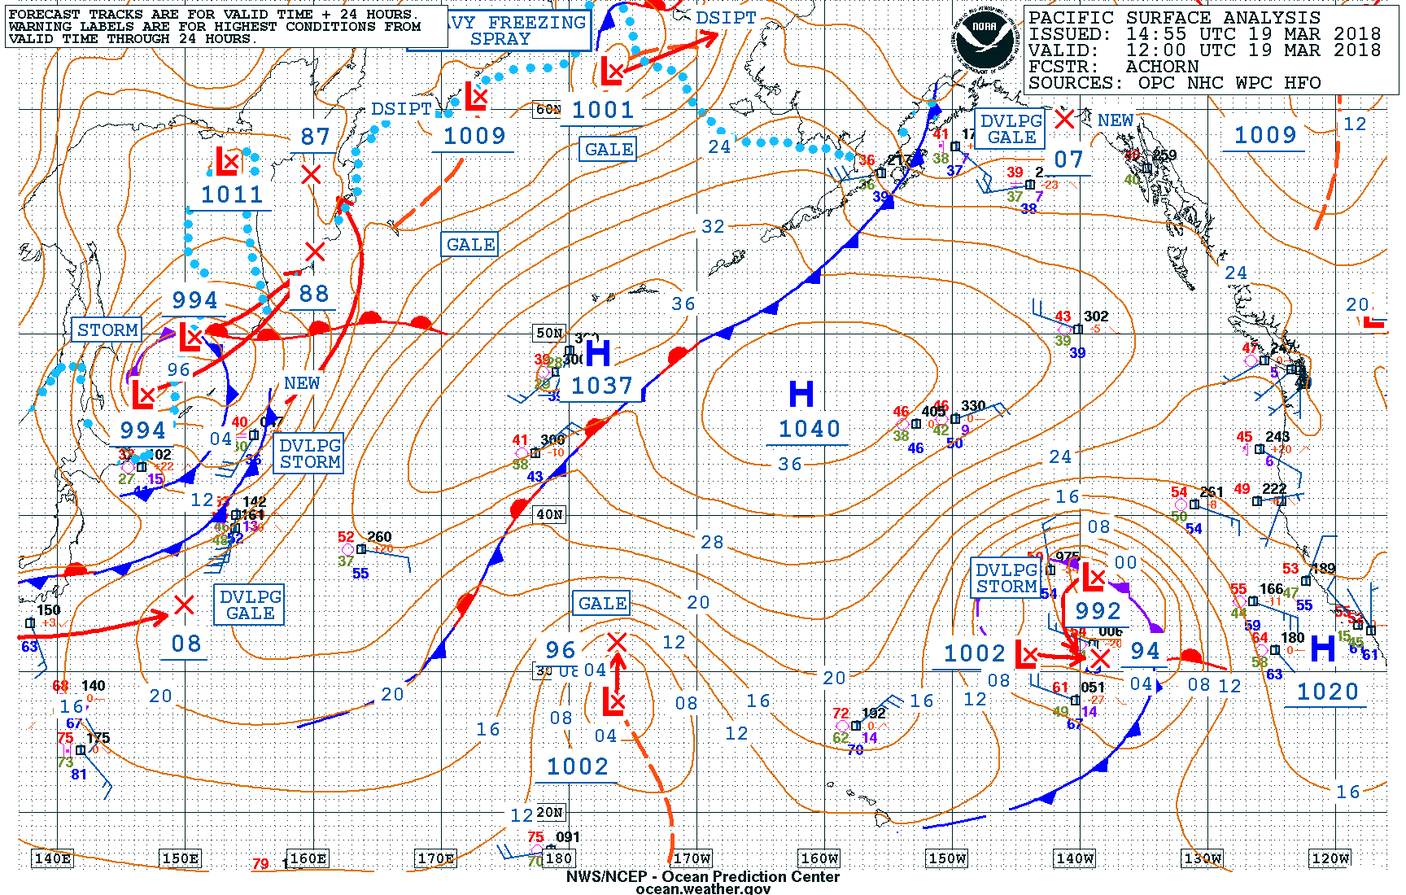
Surface Analysis 12-UTC March 19, 2008

Slide 70
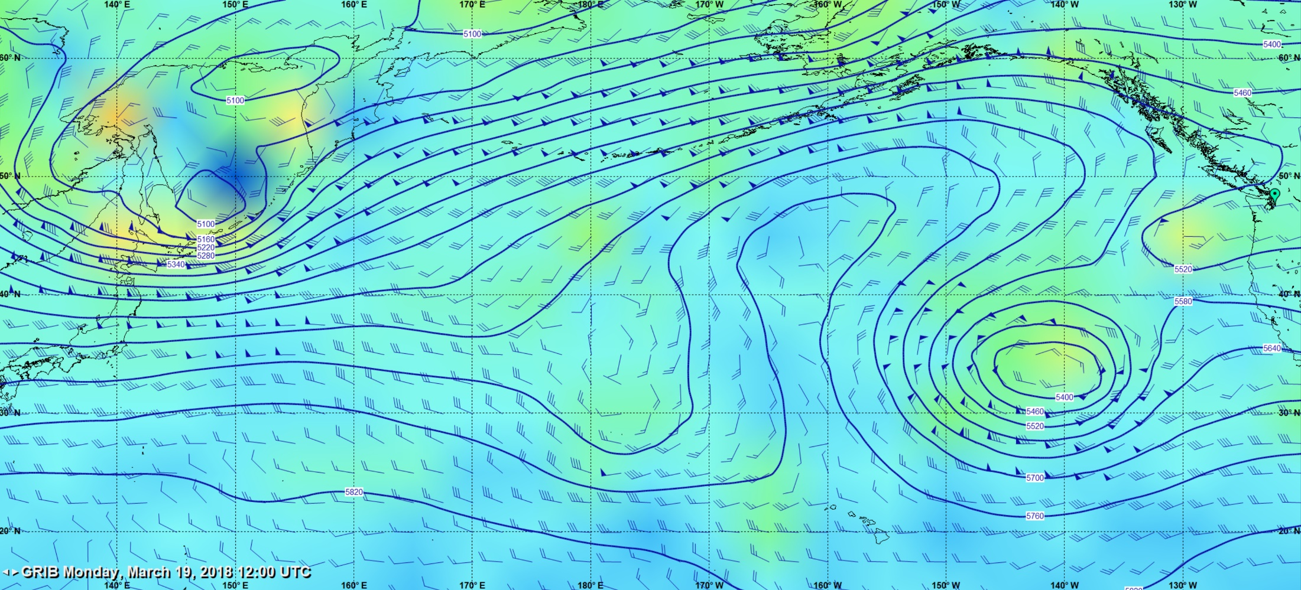
500mb 12-UTC March 19, 2018

Slide 71
500mb 12-UTC March 19, 2018

Slide 73
Be Like Mike!

