Slide 1
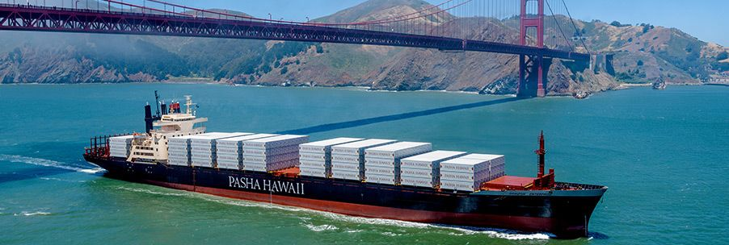
Ship your Gear to Hawaii… and Back to California!

Slide 2
Thank you Pasha for many years of support!!!
Looking to ship your boat?
Contact Cathy Nugent at Pasha Hawaii:
Catherine_Nugent@pashanet.com
(415)-927-5570

Slide 3
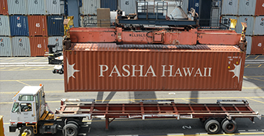
Shipping container
40ft Pasha shipping container :
Richmond Yacht Club → Kaneohe Yacht Club
Kaneohe Yacht Club → Richmond after the race.
Space in the container can be reserved for each leg of the trip.
Load / unload by appointment based on vessels’ anticipated finish times (Last gear in, First gear out).

Slide 4
California → Hawaii
Pre-Race loading appointments June 30th through July 8th at Richmond YC
Container expected in Kaneohe on approximately July 20th.
Unload appointments start 27th of July.
Price: $300 (Additional charge for loads over 6’x4’)
We understand that unloading is harder to schedule and will accommodate you!

Slide 5
Hawaii → California (post race)
Container loading begins on July 29th.
Final appointments after the awards ceremony on Saturday August 3rd.
Price: $400 (Additional charge for loads over 6’x4’)
Unloading in Richmond August 20th - Sept 1st.

Slide 6
Arrangements
Reservations on website, including an inventory of items you plan to ship
After payment, you’ll receive an email form to schedule loading / unloading appointments

Slide 7
Notes on container contents
Fuel jugs must be completely empty and bone-dry. Outboard engines must also be completely emptied of fuel.
Hazardous cargo must be declared BEFORE loading, because hazmat paperwork needs to be done well in advance.
If it has not been OK-ed prior to your loading appointment, it cannot go in the container.
If you are in doubt whether something is deemed hazardous, please reach out to shipping.azimuth@gmail.com.
Examples: chemicals, propane tanks, batteries, fire-extinguishers. (link for list of hazardous goods)
If you have gear that is fragile or heavy, it is your responsibility to bring the proper means to secure and protect it during transit, ie. ratchet straps, padding, or boxes.

Slide 8
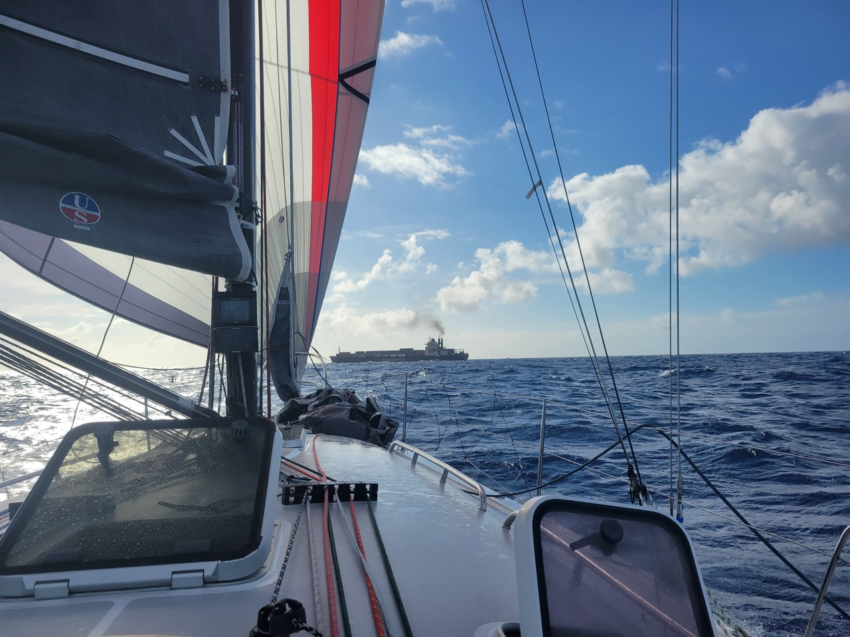
THANK YOU PASHA! For your many years of logistical and financial support!
Questions?
Contact Katie Cornetta
Azimuth Sailing
shipping.azimuth@gmail.com
Looking to ship your boat?
Contact Cathy Nugent
Pasha Hawaii
Catherine_Nugent@pashanet.com
(415)-927-5570

