Slide 1
Winning sail Strategies for Pacific CUP Efficient Utilization of Your Sail Inventory

Slide 2
Sail Types
Jibs & genoa’s are used to sail high angles. (J1-J4 & jib top) for non-overlapping jibs.
155% to 95% & jib tops. For boats with overlapping headsails.
Reaching sails are used to sail intermediate (reaching) angles; Asymm kites (A0, A1, A3, A5, A7); Symm kites (S1, S3,S5 ).
New style reaching sails: BRO, FRO, R1, R2, MHG.
Spinnakers are used to sail low angles. Asymm kites (A 1.5,A2, A2.5, A4); Symm kites (S1.5, S2, S4, S5).

Slide 3
Sails for navigation
Offshore navigation requires that you sail an optimum wind angle to the finish.
In order to sail to the optimum wind angle you will need a variety of sails.
Different sails are designed for different wind angles. You want to have sails that covers all of your potential wind angles.

Slide 4
Gaps in sail Inventory
When planning for your race, look at the likely angles you will be sailing. (40-155)
Evaluate your current sail inventory to see what sails you have to fit those angles.
Determine what “Gaps” you have in your current inventory by looking at what angles are not currently covered.

Slide 5
Fill the Gaps
Once you have completed your “Gap” analysis decide what angles are the most important to you. The speed of your boat will determine how you fill the “Gaps.” Polar%.
Rating considerations must be determined as a certain sail may have a positive or negative effect on your rating.
Take the sails which will give you the most impact over the duration of the race.

Slide 6
BENETEAU 473
135% or larger furling genoa (you can furl down to smaller headsail)
Storm jib
A/P Cruising A-Kite
A3 Reaching A-Kite
A5 Reaching/Shy Kite
With most cruising kites that tack to bow. The luff lengths are short enough to be able to add a spinnaker pole set up to allow you to square back.

Slide 7
EXPRESS 37
155% Genoa
155% Jib Top
100% Jib ( or J 4 )
S1
S2
S3
S5 Hvy Reacher/Shy
Spinnaker Staysail

Slide 8
SANTA CRUZ 50
155% Genoa
155% Jib Top
100% Jib (or J 4)
Genoa Staysail
A 1.5
A 2
A3 (Instead of a Code 0; small gap between A0 & A3)
A4
A5 Hvy Reacher/Shy
Spinnaker Staysail

Slide 9
J/125 SPORT BOAT
155% Genoa
140% Jib Top
J 4 Jib
Genoa Staysail
BRO: Blast Reaching 0
A 1.5
A 2
A 2.5
A 4
A 5 Hvy Reacher/Shy
Spinnaker Staysail

Slide 10
R/P 45
J 2
J 4
Genoa Staysail
MHG: mast head genoa tacked to stem
A 1.5
A 2
A 2.5
A 4
A 7 frac/Shy
Spinnaker staysail

Slide 11
TP 52 2015 INVENTORY
J2 Jib
J4 Jib
Genoa Staysail
MHG: Mast Head Genoa Tacked to Stem
R1: Mast head Reaching Genoa Tacked to end of Prod
R2: Frac Reaching Genoa Tacked to end of Prod
A1.5
A 2
A 2.5
A 7 Frac/Shy

Slide 12
Reefing
Make sure your systems make it easy to reef.
Using your reefs offshore is faster than changing your headsail at times.
A reefed mainsail with a jib top is when we have hit some of our fastest speeds offshore.
Remember its all about balance having the right sail combo to allow the boat to be easy to drive while staying powered up on your reaching course.

Slide 13
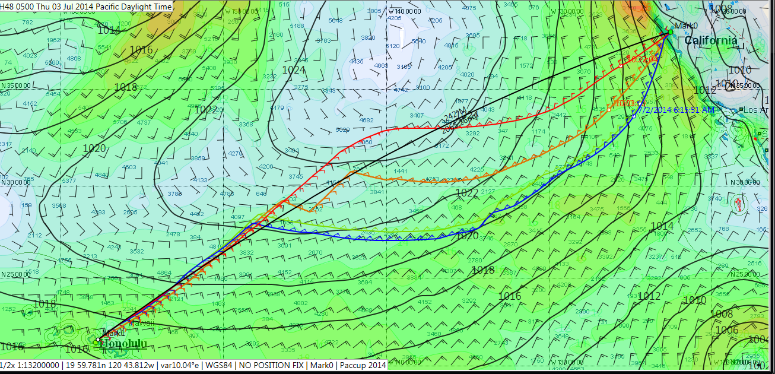

Slide 14
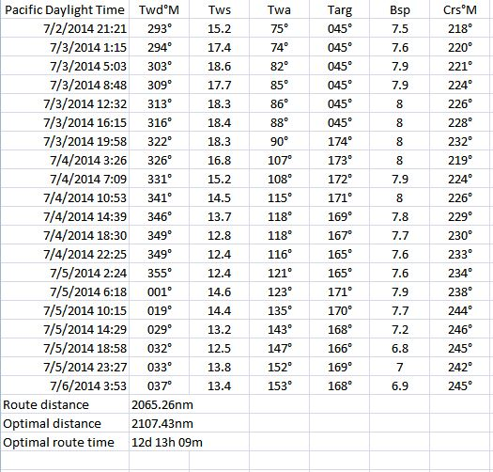

Slide 15
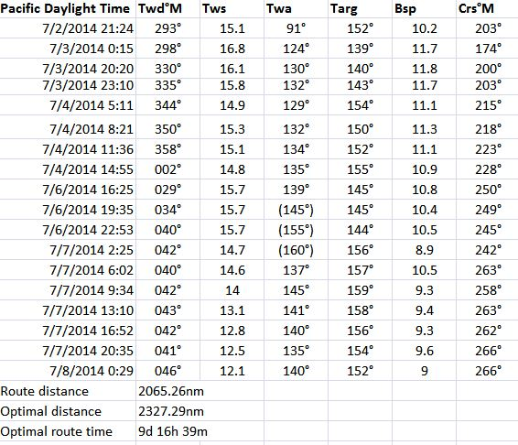

Slide 16
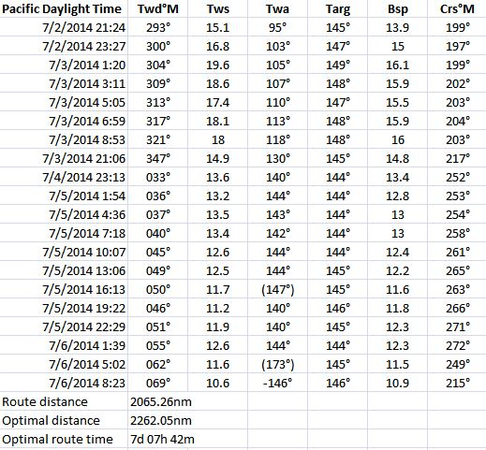

Slide 17
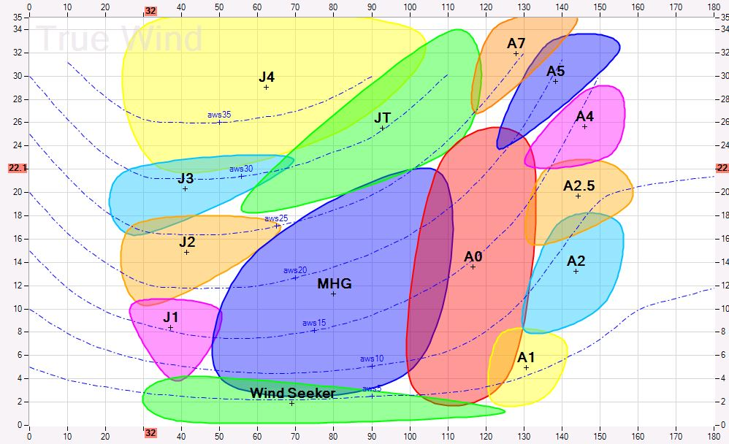

Slide 18
Contact Us
Consult with Quantum Sails on how to best build and utilize your sail inventory.
Office: 510-234-4334

