Slide 1
Getting Inspected

Slide 4
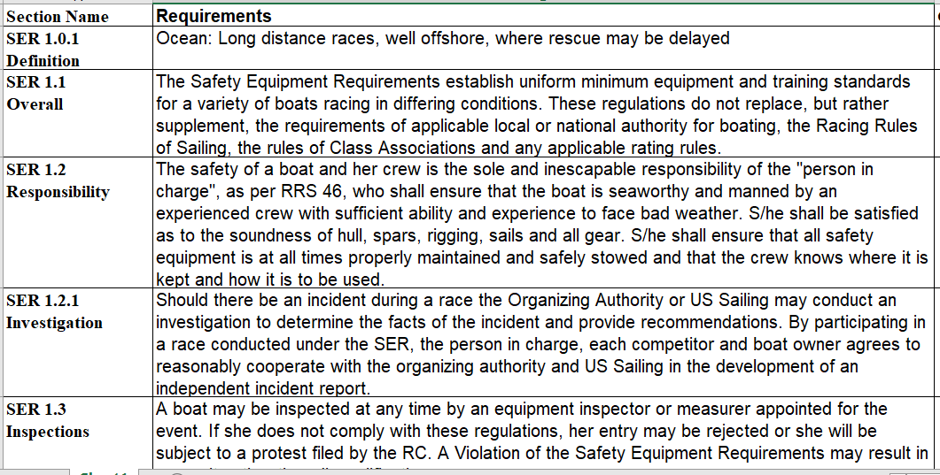

Slide 6
Long Lead Time Items
Crew SAS training (minimum 30% 2 day and 30% online)
150 nm voyage
Masthead VHF
Emergency steering
AIS Transponder (receive and send)
Comms (Iridium, StarLink, etc.)
Liferaft

Slide 7
Odd Things that are not as hard as they sound
Heavy weather sails
Companionway securing inside and outside
Second set of nav lights

Slide 8
Long Lead Time Items
Not required
When did you last drop your rudder?
When is the last time you ran the boat a few days without shore power?
Insurance (likely requires out of water survey and “in the air” rig inspection)
How are you getting the boat home?
100% ready before the first ocean race at March end so time for crew practice
Lodging not too far from Kaneohe

Slide 9
Get Started!

Slide 10
Get Inspected!

