Slide 1
Going Green to Hawaii (and Back)
Pacific Offshore Academy
6 May 2018
Rowena Carlson

Slide 2
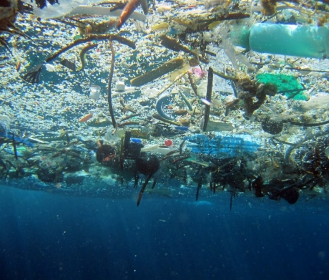
Turn The Tide on Plastics
According to the Volvo Ocean Race 2017-2018 Sustainability Programme, there will be more plastic than fish in the ocean by 2050
What you can see
What you can’t see
Microplastics
Microfibers

Slide 3
Sailing Instructions
1.6 A boat shall not intentionally put trash in the water, except as follows:
(a) Boats may discard or discharge biodegradable sail stops when setting a sail.
(b) Beyond 12 nm from the nearest shore, boats may discharge biodegradable paper products, food waste, and sewage.
(c) This changes RRS 55

Slide 4
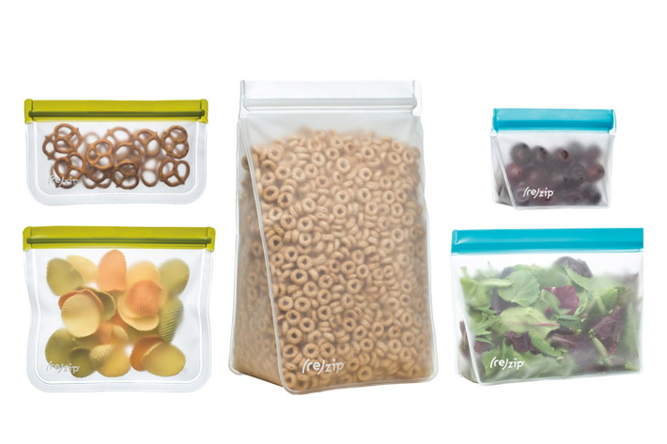
Reduce Single Use Plastics
Utensils and dishes
Use washable and reusable
Personal Water bottles
Ask crew to bring their own favorite refillable water bottle
Zip lock plastic bags
Use reusable silicone bags
Plastic shopping bags
Use reusable bags
Remove as much packaging as possible before departure

Slide 5
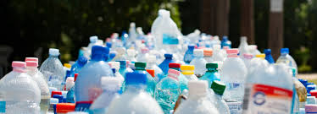
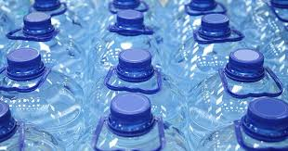
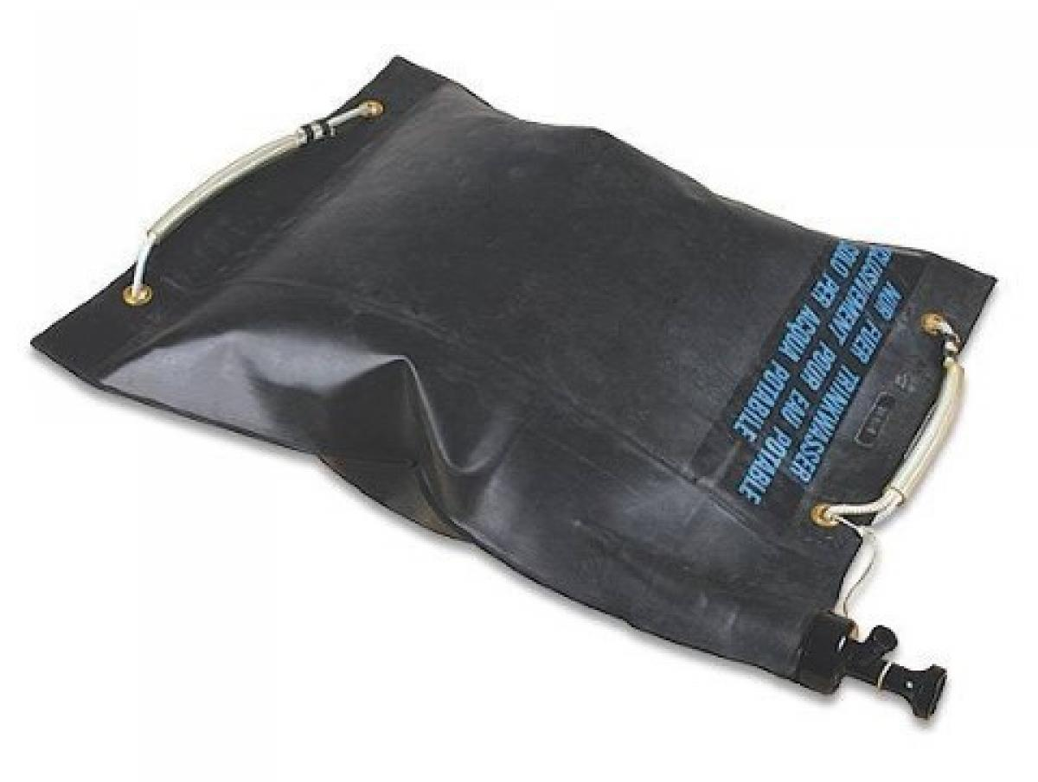
Water Storage
Try to dump less plastic for recycling at Kaneohe YC
Reusable bladders instead of plastic water jugs
Swiss Water Bladder recommended by delivery skipper Holly Scott
Note - Emergency water in factory sealed containers is required

Slide 6
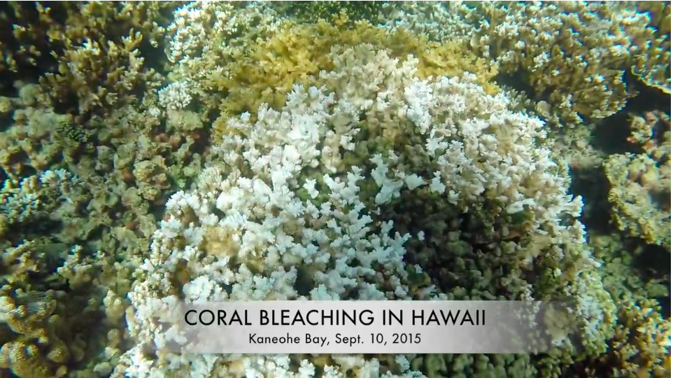
Ocean Pollutants
Use “Reef Safe” Sunscreen
2015 study of coral reefs in Hawaii, US Virgin Islands and Israel found that oxybenzone “leaches the coral of its nutrients and bleaches it white. It can also disrupt the development of fish and other wildlife.” Archives of Environmental Contamination and Toxicology
Hawaii has sent a bill to their governor to ban the sale of sunscreens containing oxybenzone and octinoxate to take effect 2021

Slide 7
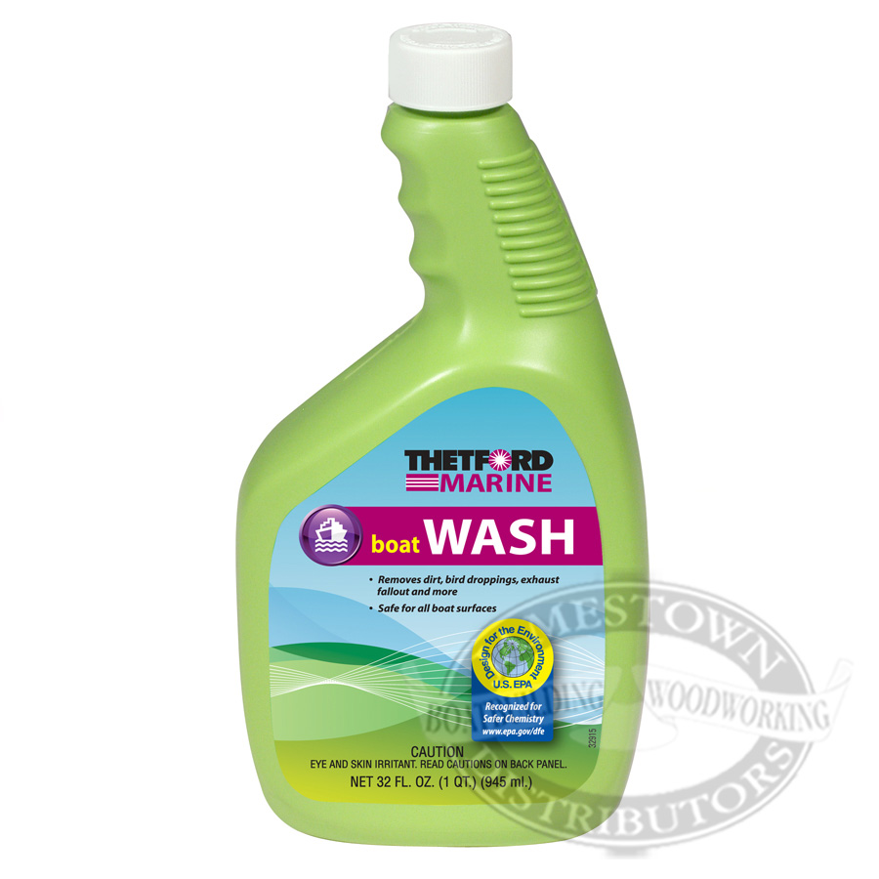
Ocean Pollutants
Boat Soaps
Look for “Safer Choice” labels from the EPA
See list in Sailors for the Sea Green Boating Guide

Slide 8
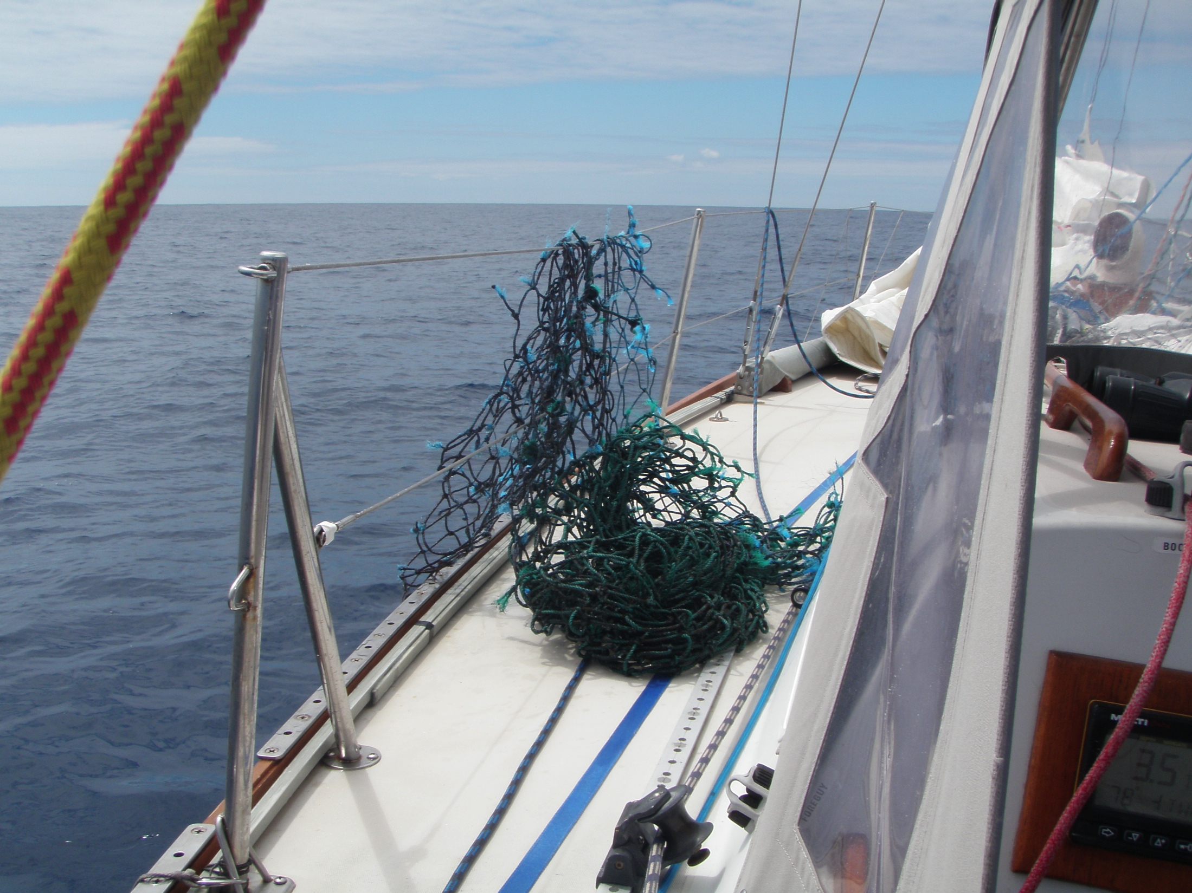
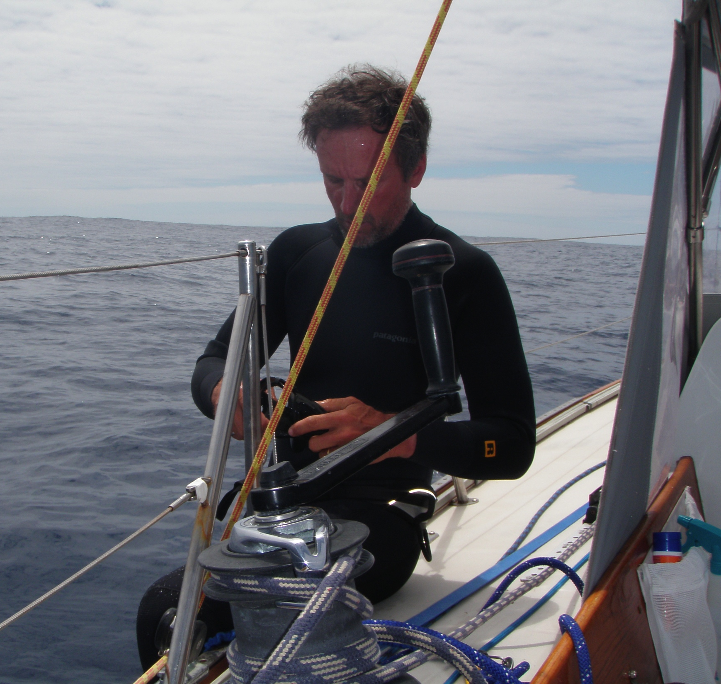
Marine Debris Can Be An Issue for Race and Delivery
Fishing nets and other polypropylene based items
Wraps around props when under power
Bring a good knife and diving mask

Slide 9
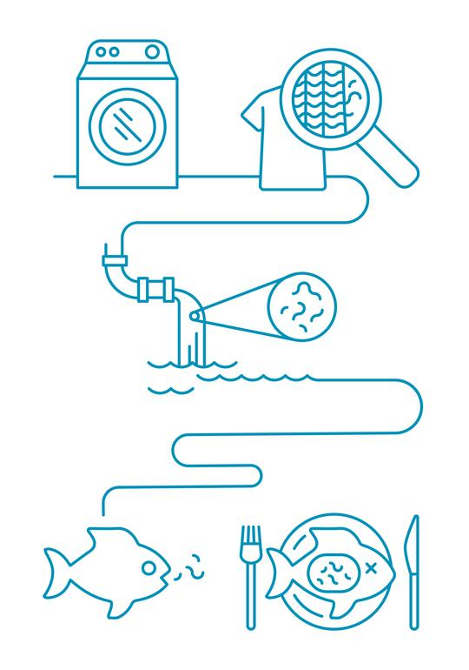
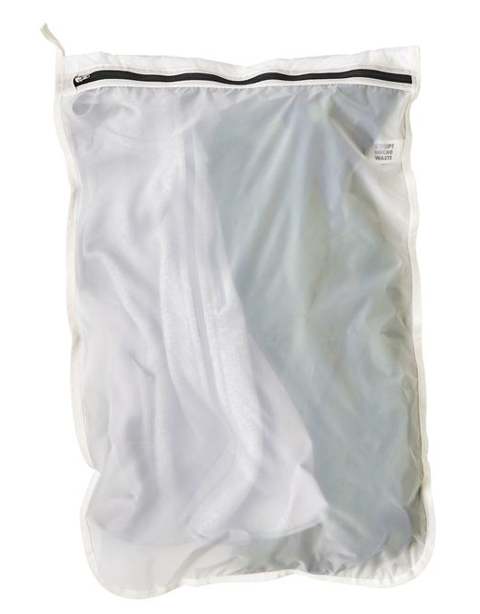
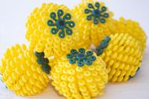
On Shore
Microfiber from fleece jackets, etc. is getting in to the ocean
More following on this from Bill Robberson from the EPA
Until filters can be put on washing machines, use:
Cora Ball (coraball.com)
GuppyfriendTM washing bags (Patagonia.com)
No more plastic straws!
Paper, pasta or reusable

Slide 10
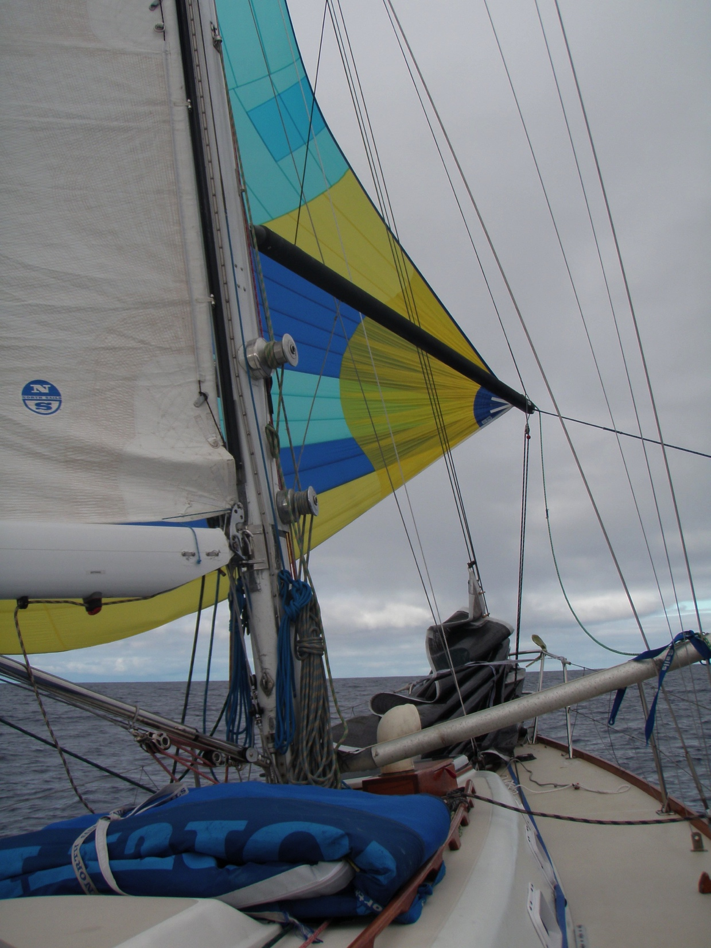
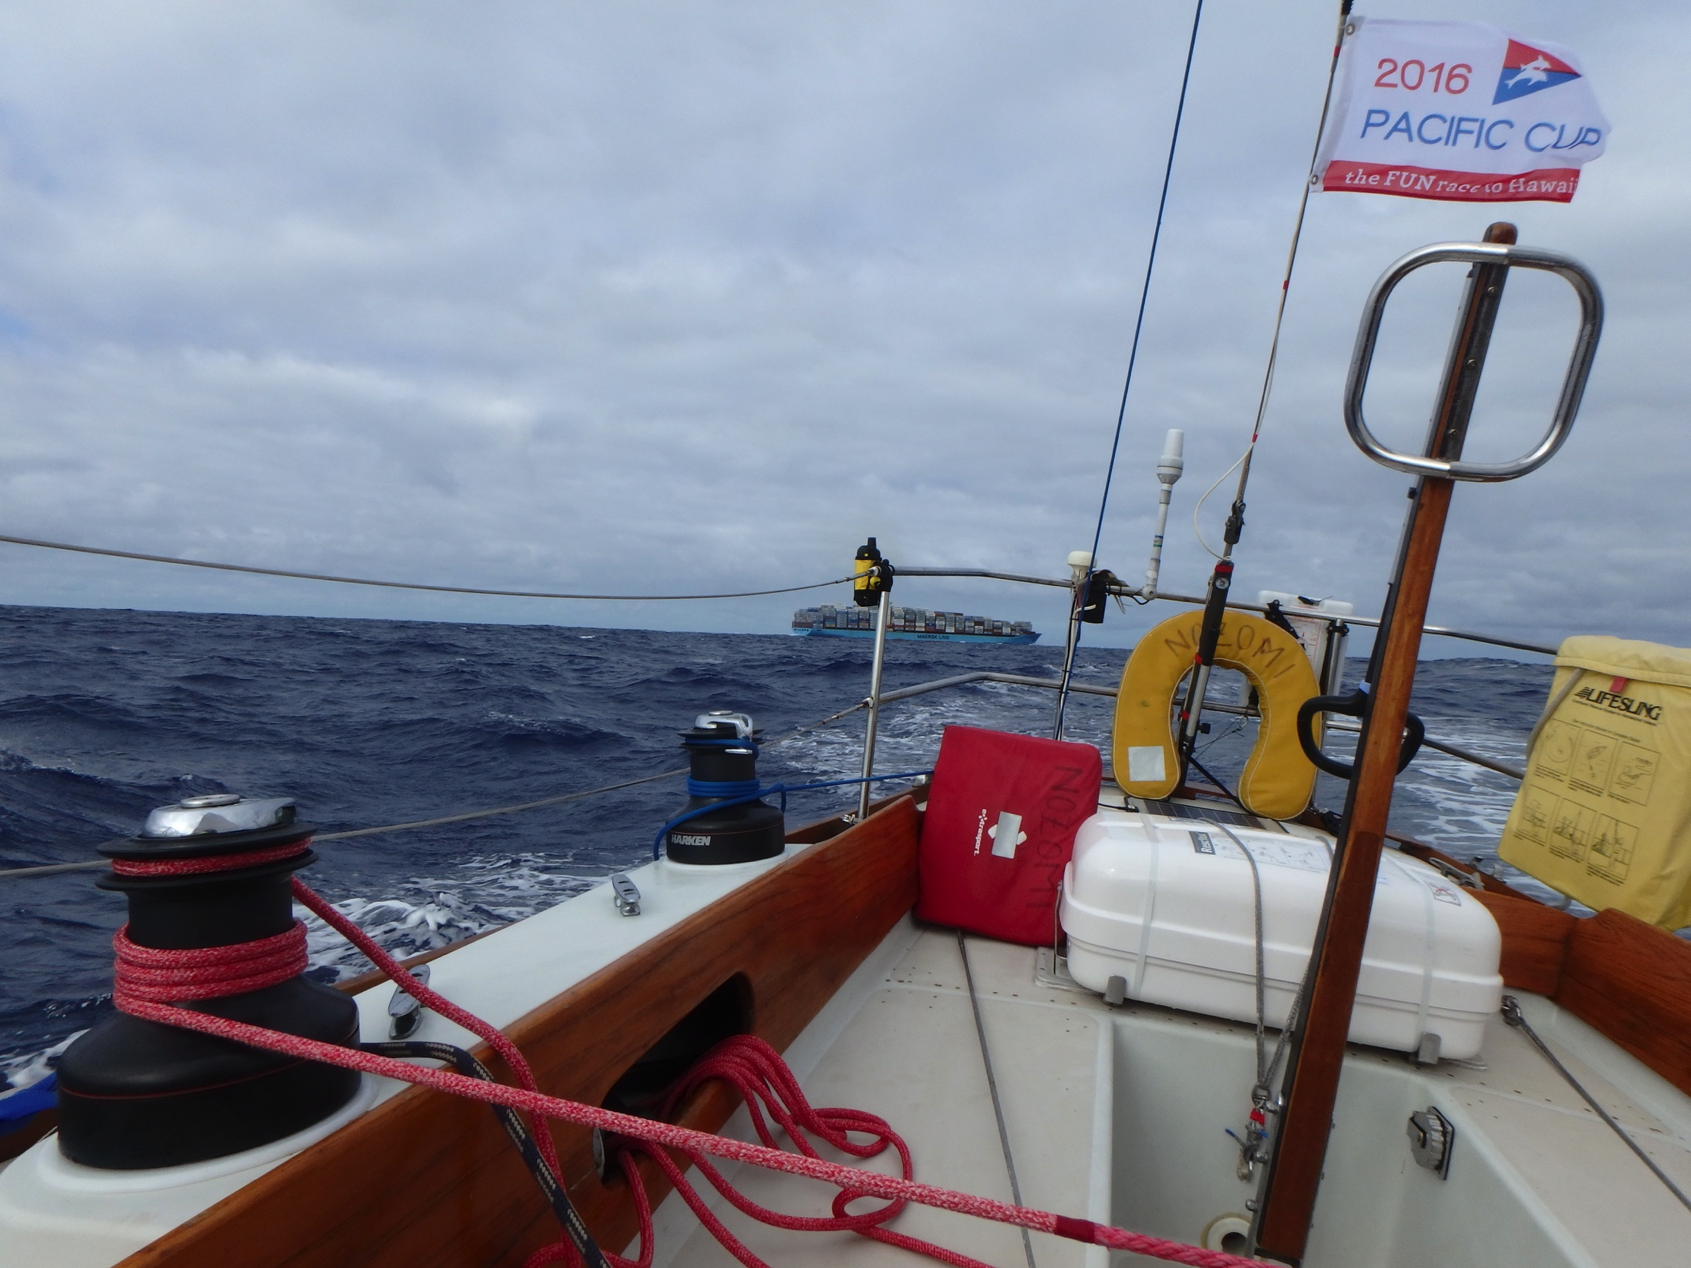
Questions? See us at the breakout table.
Sources for Green Boating info
https://www.volvooceanrace.com/en/sustainability.html
https://www.epa.gov/trash-free-waters
Sailors for the Sea
11th Hour Racing
Ocean Conservancy
NOAA Marine Debris Program
The 5 Gyres Institute

