Slide 1
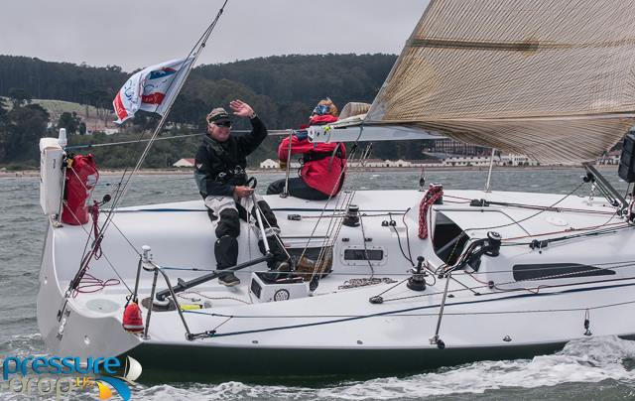
Provisioning for Pac Cup Fully Crewed Double Handed
Melinda Erkelens
Michael Moradzadeh

Slide 2
Thank You Our Sponsor

Slide 3
Provisioning depends on…
Boat/Galley type and size
Goal for the Race
Comfort vs Speed

Slide 4
Provisioning Steps
Figure out the following ….
Expected length in days
Type of Trip (full race…cruise)
Crew likes/allergies etc

Slide 5
TIME
How long will it take to get there?
You likely have an estimate already of how long your boat will take.
Weather possibly +2 days
Breakdown possibly +5 or 6 days

Slide 6
Philosophy
This is a bad time to experiment
Have an idea of whether you and rest of crew like the stuff
Learn about allergies and strong preferences
It’s 2020: there are many commercial options
It’s just a week or two, not a trip to the North Pole
Storage and preservation need not be super-exotic
“Rightsize” your stores.
You don’t need a 5 gallon can of olives

Slide 7
TYPE OF TRIP
Full Race boat – Freeze dried food!
Racing but not counting every ounce– pre-prepared meals in seal a meal, super cold freeze then store in dry ice.
Cruiser – may have an oven or even a microwave!

Slide 8
Water: How Much?
Ideally, at least a gallon per person per day
Daily Drinking (and food content):
2.7 liters women; 3.7 liters men
Other uses: dishwashing, personal hygiene
Race Requirement:
10 gallons minimum per person
Plus one gallon emergency
Factory sealed
If you drink it, you lose the race, but are not dead.
Plus water in liferaft
Unless you are fast, you will need more.

Slide 9
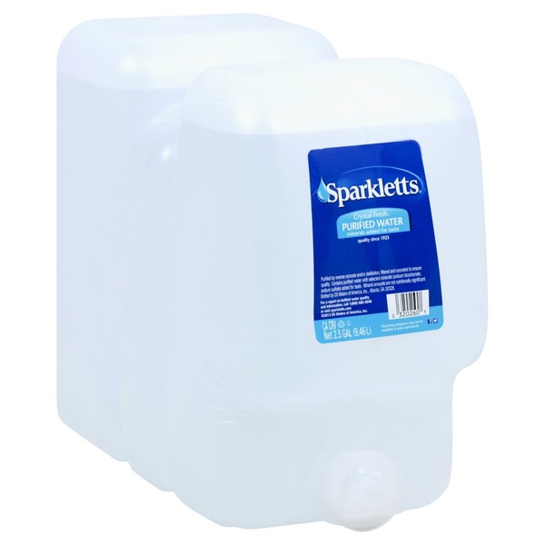
Tankage
Main Storage: DO NOT LOSE YOUR WATER!
Divided tanks/containers
Turn off (disconnect) pressure water pump
Maybe some in individual bottles (but wrestle with your conscience about single-use plastic.
Emergency Water:
Factory-Sealed
Will be inspected
If you get to this water, you are alive, but you messed up
Pack carefully so it does not chafe through
Those 2-gallon containers are flimsy. Not good for EW

Slide 10
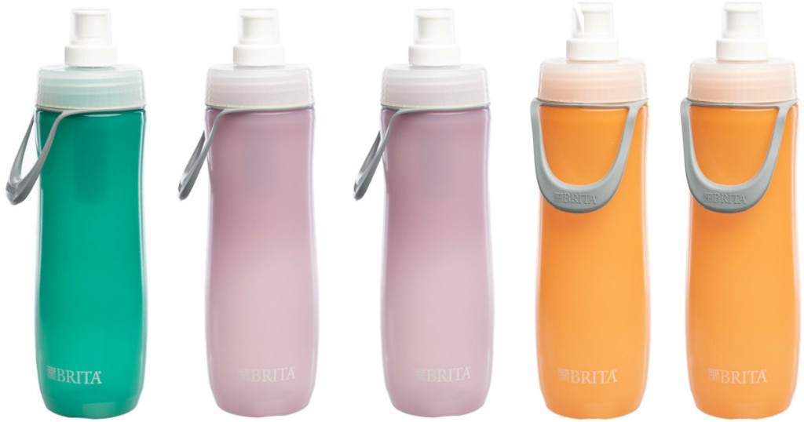
Fight Dehydration
Make water tasty
Clean your tanks
Add mixes or flavorings
Get a carbonator (e.g. Sodastream®)
Daily consumption: Stay hydrated
Encourage crew to drink
“Can I get anyone a refill?”
Drink holders
Bottles
These bottles have carbon filters
to fight “icky tank taste”

Slide 11
WATERMAKER!
I love my Spectra® watermaker
Not a substitute. A supplement
Be sure you know how it works
Pro-tip: The water coming out of the watermaker is tasty and colder
Provides great security.

Slide 12
Determine Crew Likes and Allergies
Respect Allergies
Find out specific likes or dislikes – preferred breakfast foods etc.
Find out Caffeine requirements – this helps make the boat go fast!
Now you know about how much and what kind of food you will need…..
Next Look at the Trip Beginning/middle/end

Slide 13
Stages of the Trip
Beginning: Wet Windy Cold.
Several crew may be sick and not eat, or not eat much. Bring SIMPLE food (Crackers, Bars, Small individual meals for those who can eat)
Bland Food / smaller portions
Middle: Generally dryer and Flatter. Appetites return and easier to cook.
Larger portions / heavier meals ok
End: It can be hot. Limit oven use?
serve ‘lighter’ meals

Slide 14
Your galley may look like this

Slide 15
Or this

Slide 16
Whatever you have, be creative with storage and make sure it will all fit

Slide 17
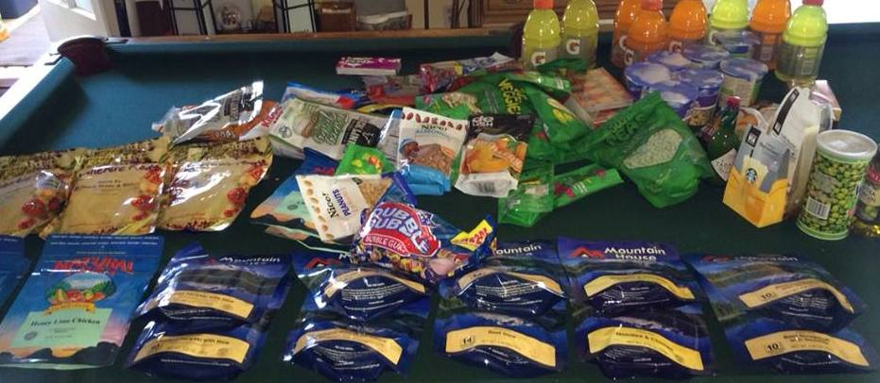
Get Organized
Numbered day bags with all food for the day
Make decisions for daily meals before the race
“Decant the Day bag each day”

Slide 18
Plan, plan, plan
Make sure the system is set up so everyone knows to open today’s Day bag only, and knows where they are (you might be sleeping)
Emergency food: Work out how long the passage is likely to be, then add 5-7 extra days of Dehydrated food (dehydrated snacks, or no snacks for the emergency days)
Emergency food can be less tasty

Slide 19
Prepared Food options
5 minute rice / instant mashed potatoes / etc
Hot Dogs, lunch meats
Fresh eggs don’t need refrigeration
Milk – UV milk or other boxed milk
Produce like apples, oranges, Jicama, carrots
Hot sauces to change up the flavors
Preserved bread lasts a scary long time

Slide 20
Cruiser – microwave, oven, refrigeration
Have a lot of options for food and drink
Think about storage – make sure it all fits
Think about refrigeration – a cooler sealed with dry ice will keep extra meals cold
Juices
Alcohol?
Fresh eggs
Cooking in the oven can be really easy. Casseroles in pans (frozen before departure)
Seal a meal

Slide 21
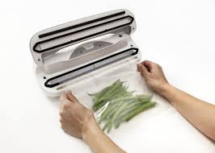
Race Boat but not planning on Freeze dried
Seal a meal
Pre-Freeze your meals in a commercial freezer
Look for ease of preparation
Seal frozen meals in one cooler which is opened once a day. Keep the defrosting meals in another cooler for day use (keeps drinks cold)- Good for Cruisers too

Slide 22
Crew Contribute?
Each Crew contribute a dinner
Check preferences and allergies
Make sure you know the internal dimensions of your oven
Or give them the tray to fill
Have them prepare and freeze
Make sure they know what the eating utensil story will be
Aka: you can’t eat pancakes out of a mug
No bananas

Slide 23
Dinner Entrees
Entrees that have worked well for us:
Lasagna
Enchiladas
Cassoulet (my specialty)
Beef stew. Or any stew.
Ratatouille
Roast chicken legs and thighs
Chinese food is particularly suitable, as it’s already bite-sized typically
Burritos
Honorable mention to Grilled Cheese sandwiches.
Restaurant food from Indian, or Chinese or Italian (or whatever) place, packaged and frozen. You don’t HAVE to cook it yourself

Slide 24
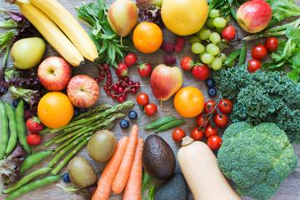
Boat-Friendly Produce
Fruits: Tasty healthy treats!
Apples
Citrus of all types. Don’t forget the grapefruits!
NO BANANAS! These are bad luck.
Pineapple (though that seems kinda… dumb)
Pears are good for a week if carefully stowed
Melons of any type
Grapes
(a little fragile, and they are not as long-lasting, but soooo convenient)
Vegetables: great variety here.
Hard veggies: Carrots, radish, jicama
Cabbage and cauliflower
A little more fragile: squashes and zucchini (courgettes)
Onions, garlic
Potatoes, yams, sweet potatoes
Lettuce should be (a) iceberg or (b) that fancy stuff that is still growing or (c) probably consumed pretty quickly
Peppers.
And, for fun,
Corn on the Cob or Artichokes.
Tomatoes:
Are they a fruit? Are they a vegetable? Hard to keep

Slide 25
Food Tips for all boats
Bring LOTS OF SNACKS and make them available. Energy bars, trail mix, candy bars, crackers, fruit, popcorn if you have a microwave, instant oatmeal, cereal bars
Electrolytes.
Coffee, hot chocolate, (or tea if you have tea drinkers), sugar, milk as needed.
Brings lots of water. Seasickness is dehydrating – Gatorade, electrolytes, ginger are all good.
Individual water bottles marked with names with caribiner

Slide 26
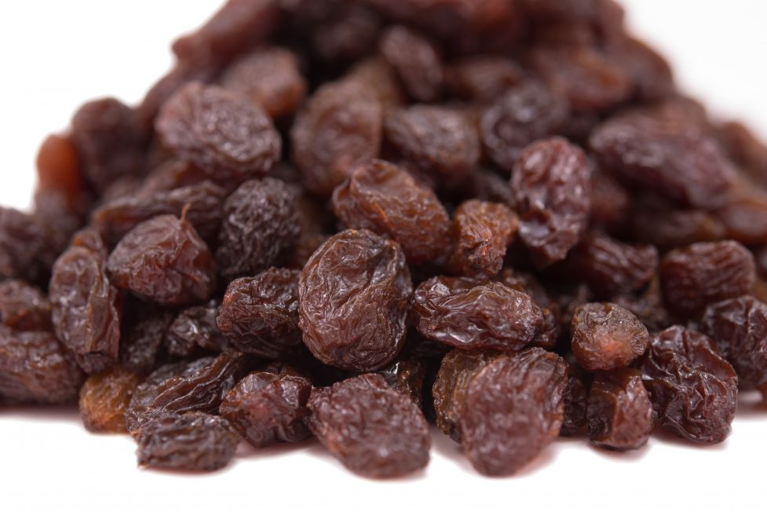
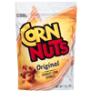
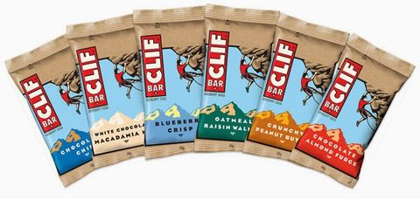
Snacks
Don’t Go Crazy
Don’t have someone who does not believe in snacks go shopping
Generally, unless you screwed up the food, these are a distraction, not a meal.
Figure about a handful of food per person per day.
Maybe 3-4 items: candy bar, some nuts, an orange or two tangerines per watch
Consider Plastic
If crew have some sort of snack pouch, have bulk nuts etc, rather than all that plastic

Slide 27
Washing Up
Make clear before departure
Is clean-up in the watch schedule?
Alternatives:
Everyone wash their own Breakfast, Lunch, Coffee stuff
On-watch team cooks, off-watch team washes
May cause resentment if watches do not rotate
Rotating “housekeeper” position
Maybe the navigator has spare time
NEVER LEAVE DISHES IN THE SINK

Slide 28
Race Boat with Freeze dried
Plenty of good options
Alpine Air, Mtn. House, Backpacker’s Pantry
Try before you buy for the whole trip.
Add-ins are good

Slide 29
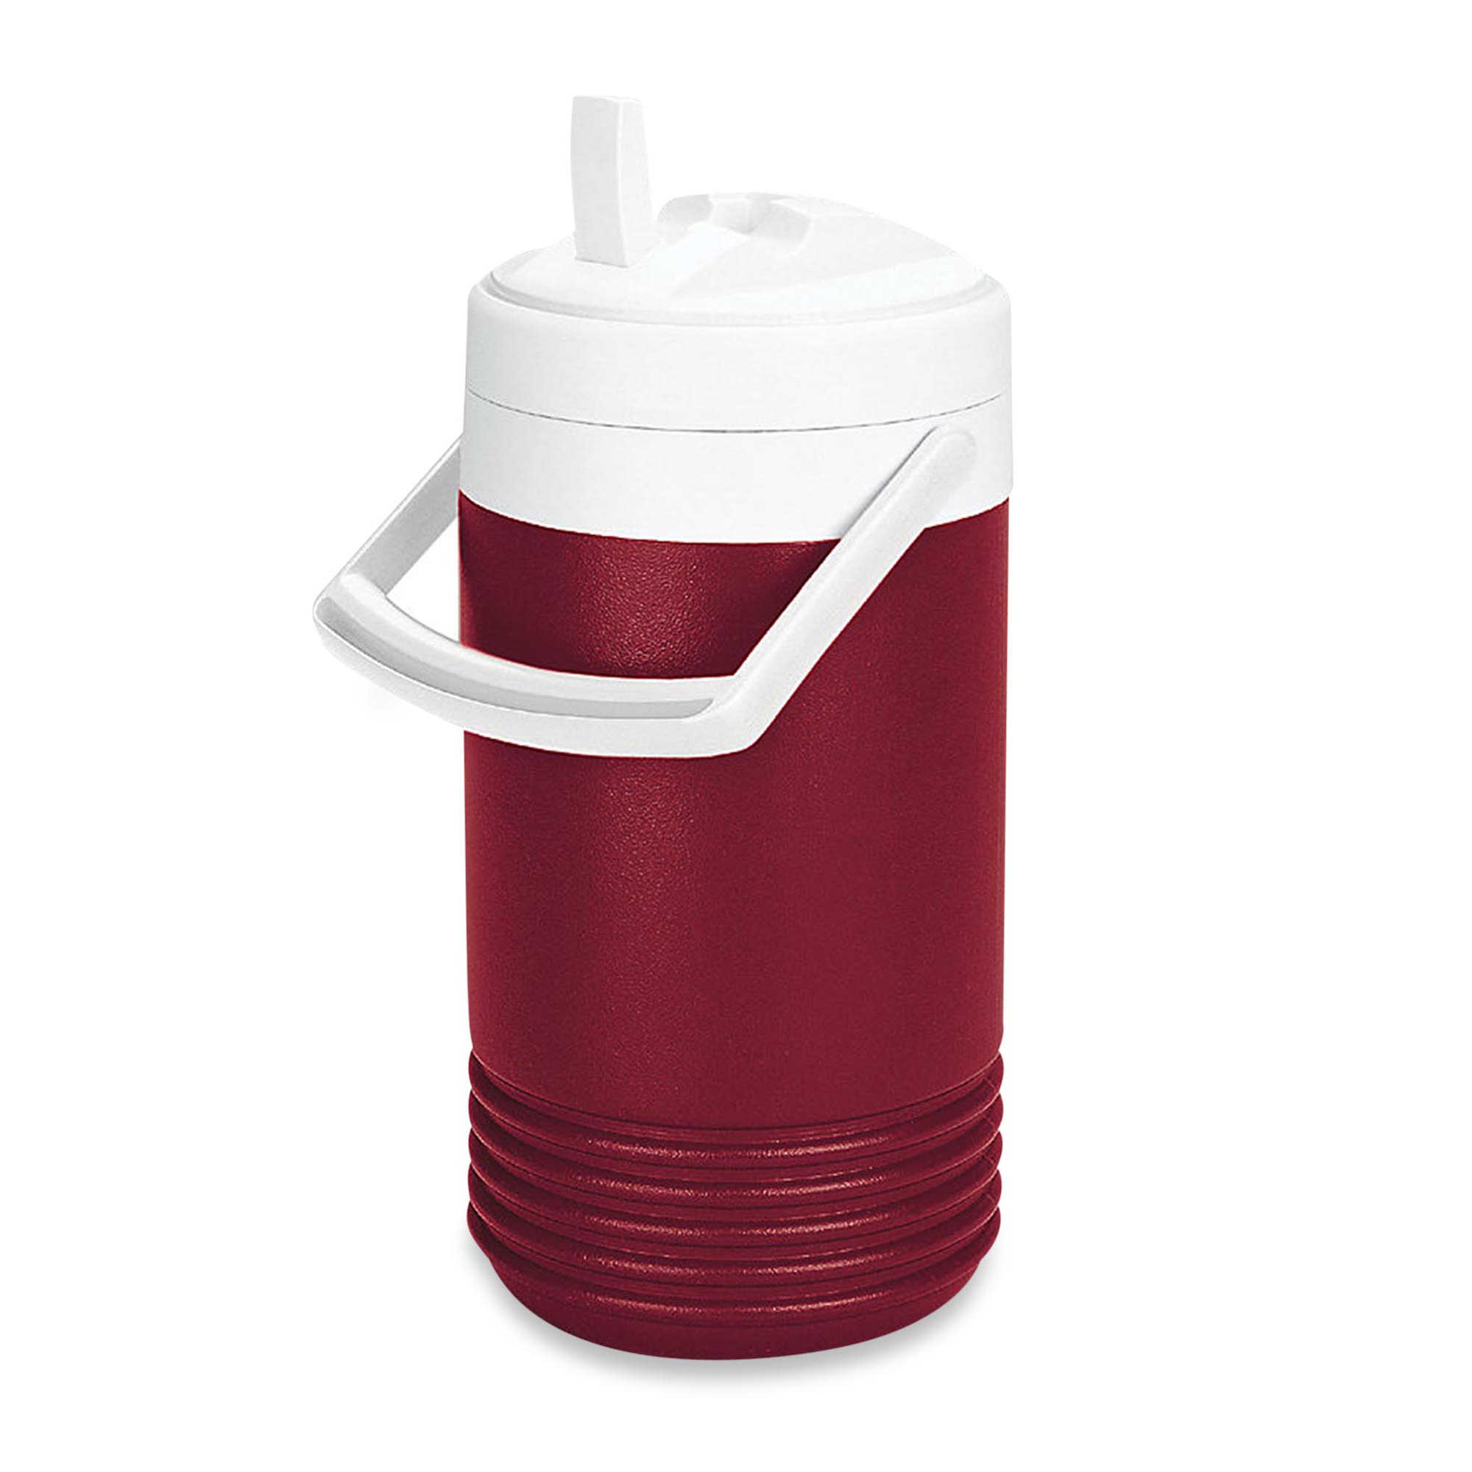
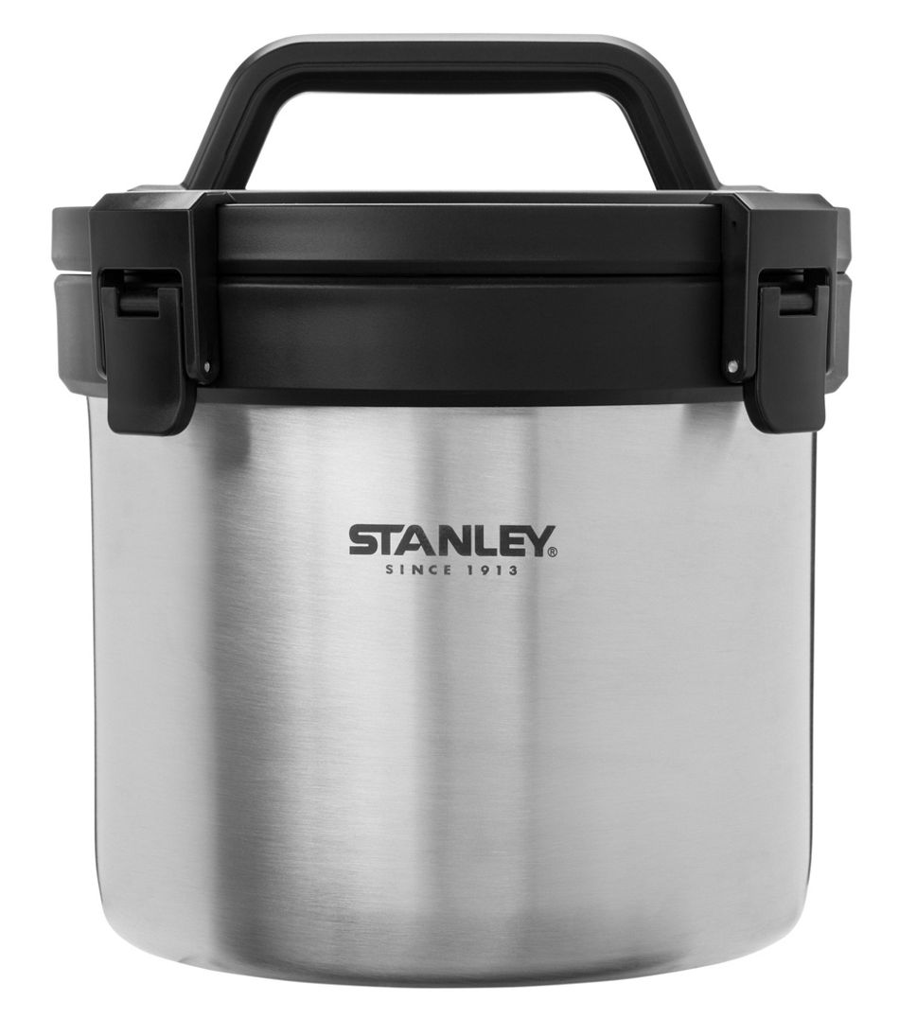
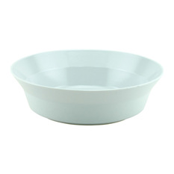
Freeze Dried bits and bobs
Small cooler for making group meals with freeze dried. Priorities: easy to open and easy to clean.
Measuring Cup (important)
Bowls and spill proof travel mugs with good insulation.
Good quick boil stove options
Notes:
Cooler for Freeze dried:
Keeps food warm
Need to be able to pour boiling water in it without mishaps
Strap in place.
Keeps the meal hot for several hours
Quantity of water is key – we use 10% more than specified and wait extra time
Jetboil stove – boils water in about 2 minutes. (up to 4 cups)
MSR ‘rapid boil’ for larger amounts.

Slide 30
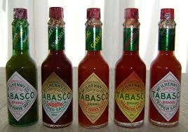
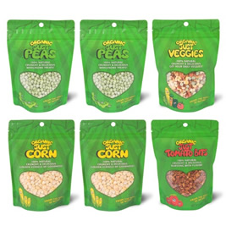
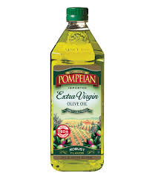
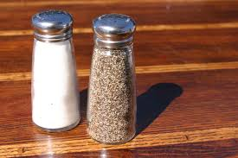
All Boats – Add-ons
Great!

Slide 31
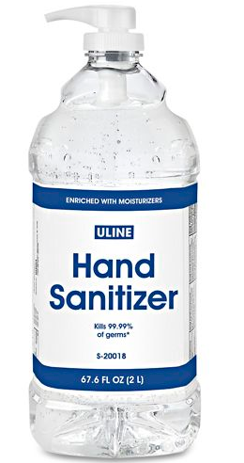
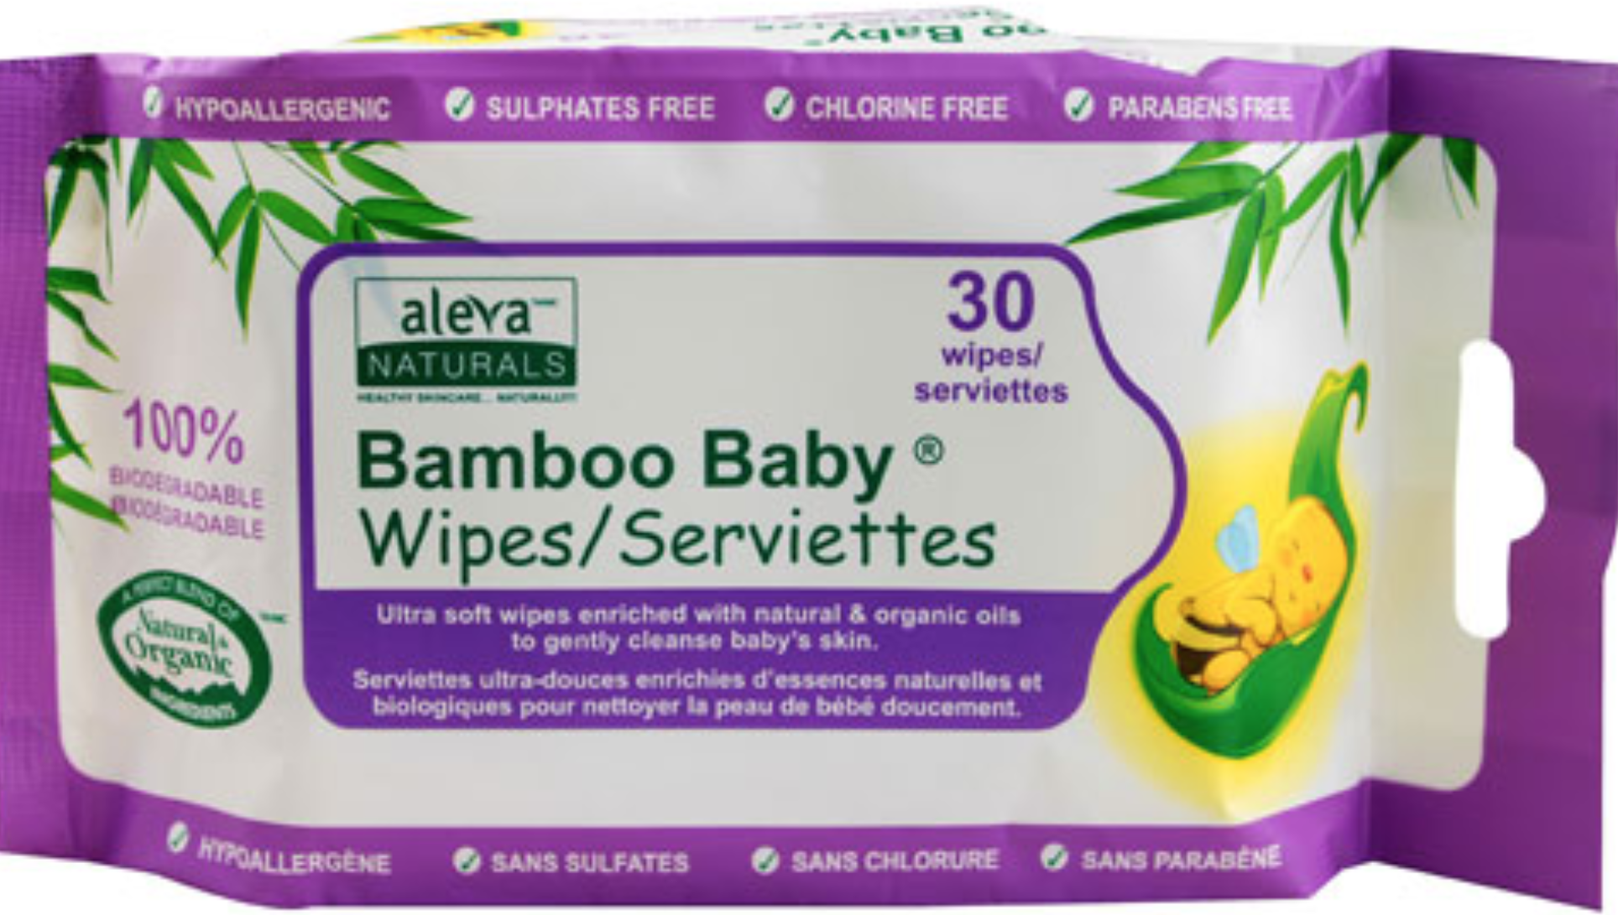
WET WIPES AND HAND SANITIZER
Wet Wipes - use biodegradable ones
Hand Sanitizer – tops and bottoms

Slide 32
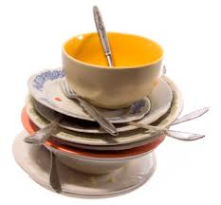
More Hygiene ideas
Paper towels are good for wiping dishes clean (cloth towels won’t dry out)
Paper lunch bags in the head to collect toilet paper then that can be thrown overboard.

Slide 33
Don’t Forget “non-food” items
Foil / Paper towels / Toilet Paper
Wooden clothespins
Lighter
Headlamp for each person
(Needs red lens and waterproof)
Dishwashing soap/ Hand Sanitizer
Garbage bags
Utensils / bowls / travel mugs

Slide 34
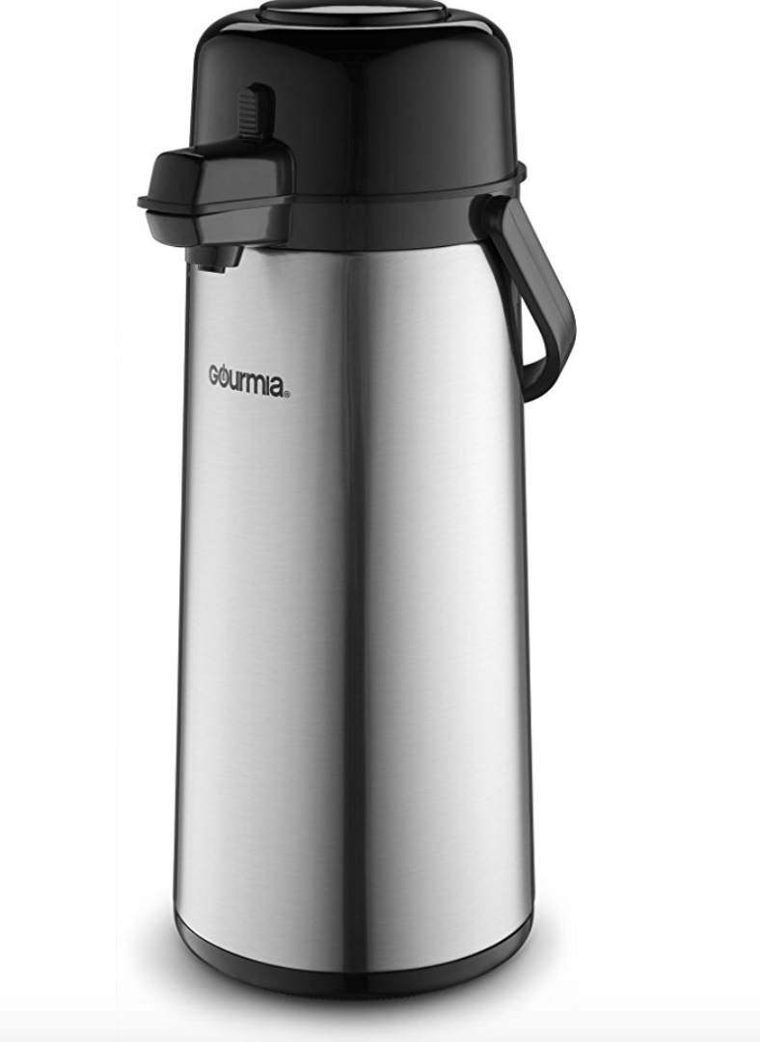
COFFEE AND PUMP POT!!
Coffee is a key ingredient for many in terms of staying awake. Don’t skimp.
A pump pot for keeping hot water is a great addition – keeps water hot for hours for coffee, tea, soup etc.
Fill it when you go off watch or whenever someone is boiling water.

Slide 35
Keep it simple you will be tired
Save your energy for sailing, not cooking

Slide 36
BEFORE YOU LEAVE THE DOCK
Remove packaging
Tape instructions to the food
Find a home for everything – organization is key
Break down meals and make sure you bring all the components! Can’t shoot off to the store if you forget the mustard

Slide 37
Don’t Bring
DO BRING
Plenty of water
Electrolyte powders
Bland food for first days
Snack food
Plenty of chocolate
Good water bottles
Squall proof coffee mugs
Pumppot if you have room
Cardboard – Cockroaches
Extra Packaging – unnecessary weight and takes up space
Non-biodegradable Wet Wipes

Slide 38
THE INFAMOUS CUP O NOODLES STORY
These are a great middle of the night snack or lunch.
Don’t eat too many.
Dr. McDougalls makes a good alternative. We bring a bit of both

Slide 39
Good Luck and see you there!
Wolfpack, start of 2014 Pac Cup

